Slide 1



eddi
Interactive Topic-Based Browsing of Social Status Streams
Michael Bernstein
mit csail
Bongwon Suh, Lichan Hong, Sanjay Kairam, Ed H. Chi
parc augmented social cognition
Jilin Chen
university of minnesota
mit human-computer interaction

Slide 2
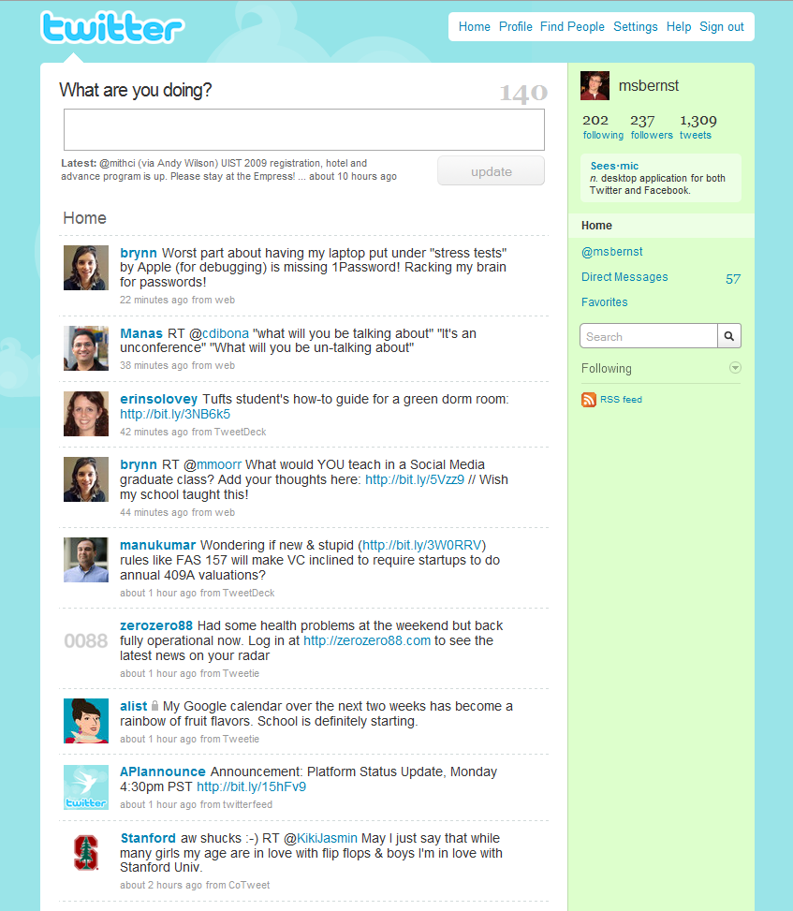
shopping
library science
google
pakistan
grammar
writing
facebook
Notes:
Twitter is exploding in popularity as a communication medium and as an information source. But it’s also exploding in diversity and scale. Here’s a small slice of my feed – it covers a wide variety of topics. Some of these I care about and some of these I don’t.

Slide 4
User Goal: Topic Exploration
on trending topics in the feed or topics of interest

Slide 5

Topic Detection is Difficult
Existing algorithms expect reasonably long documents
Wikipedia articles: average 400 words
Tweets: average 15 words
msbernst macbook died,
but the Genius guys
gave me a new one!
Existing algorithm might find:
  macbook
  died
  guys
Existing algorithm might miss:
  apple
  customer support

Slide 6
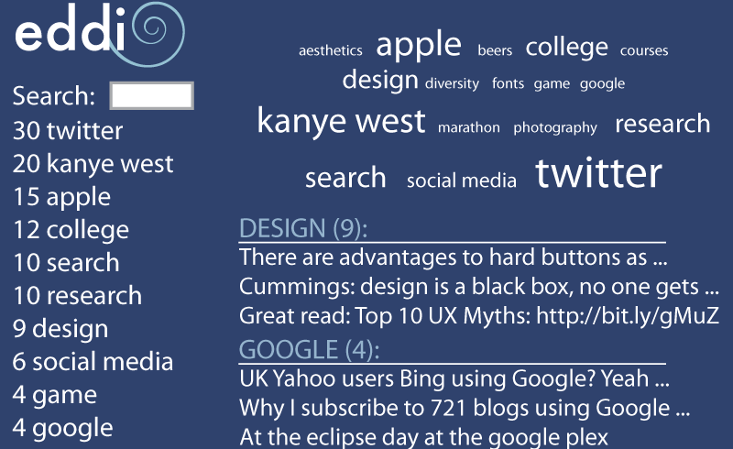
eddi
interactive topic browser
for twitter feeds
TweeTopic
Tweet
Noun Phrases
realtime topic detection algorithm for tweets
Web Search
Topic Keywords

Slide 7

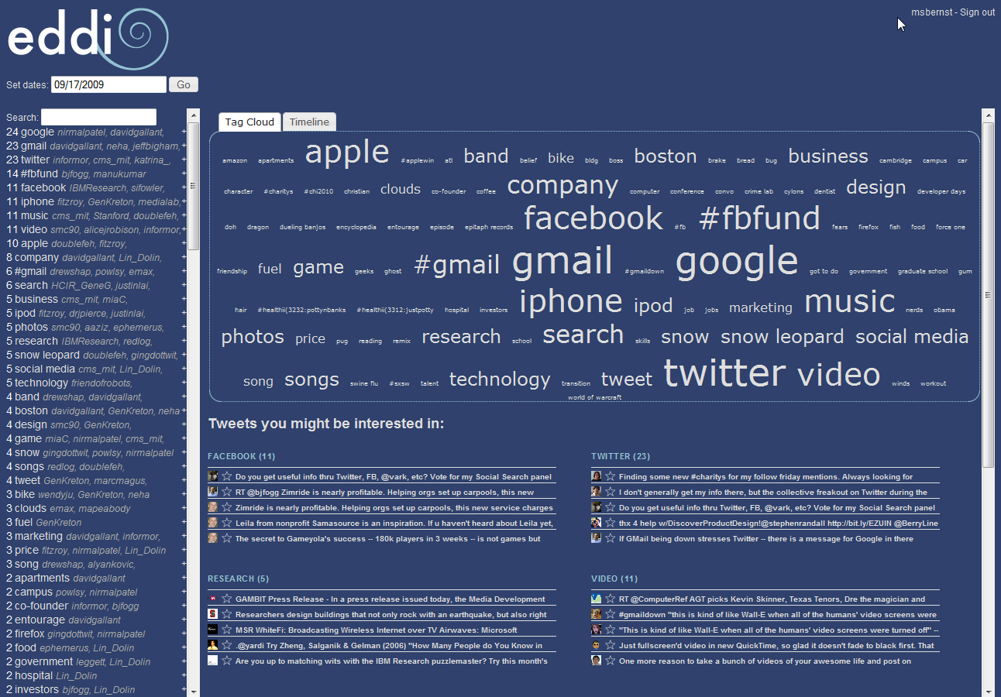

Slide 8
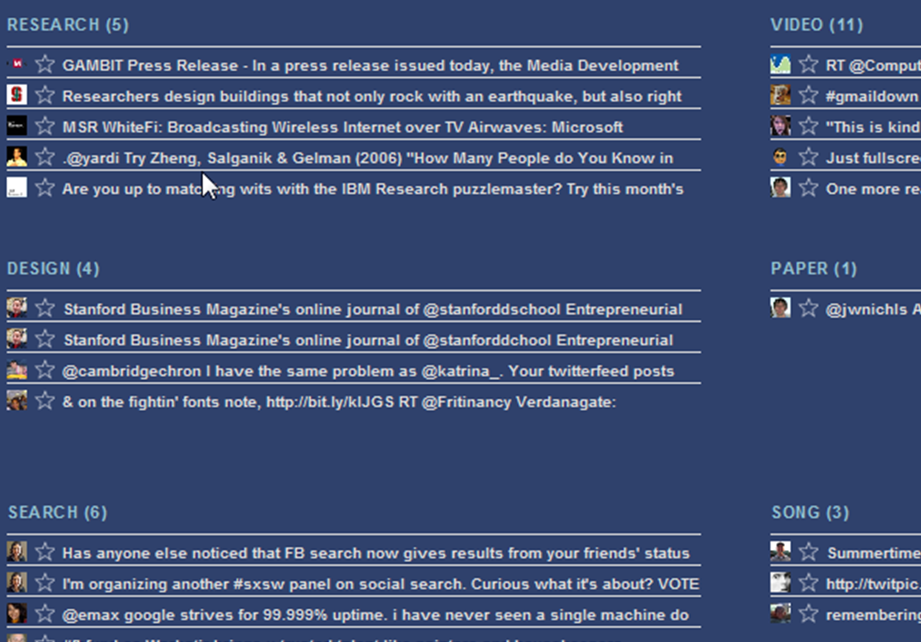

Slide 9
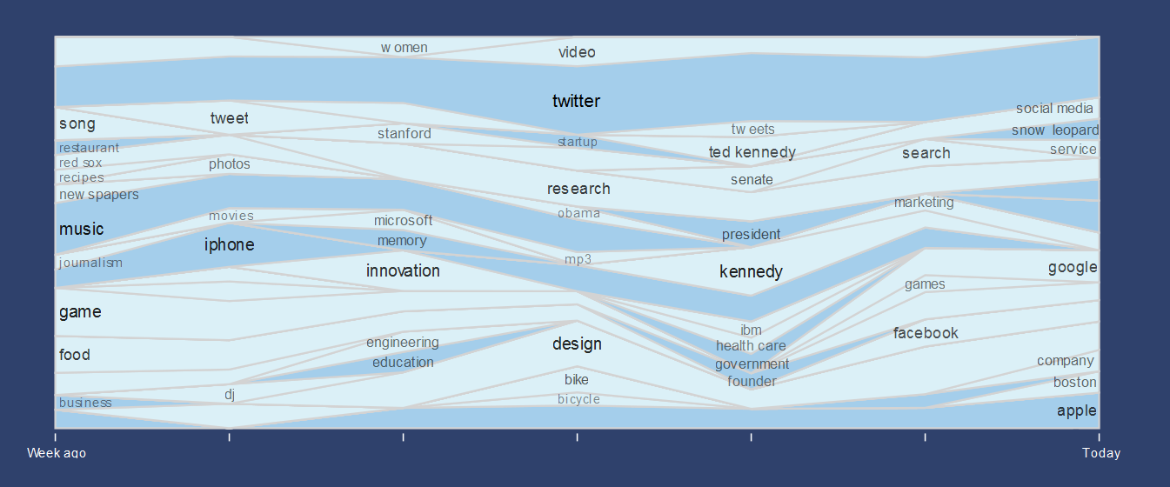
Notes:
TODO: photoshop the image to call out the items via color, rather than using these shapes

Slide 10
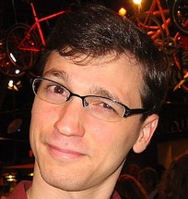
TweeTopic
from
tweet
msbernst Awesome article on some SIGGRAPH
user interface work:
http://bit.ly/30MJy
to
topics
animation
character
3d
computer graphics
user interface

Slide 11

Information Retrieval Techniques
Assume decent length to text
  Repetition as a measure of importance:
  e.g., Term Frequency – Inverse Document Frequency (tf-idf)
  Co-occurrence matrices:
  e.g., Latent Dirichlet Allocation (lda) [Blei et al., Ramage et al.]
But with 140 characters, it is difficult to distinguish signal from noise,
topic from commentary.
katrina_ Ron Rivest cracks me up. It keeps me
awake when algorithm design brings the lulz.

Slide 12
Information Retrieval Techniques
Assume decent length to text
  Repetition as a measure of importance:
  e.g., Term Frequency – Inverse Document Frequency (tf-idf)
  Co-occurrence matrices:
  e.g., Latent Dirichlet Allocation (lda) [Blei et al., Ramage et al.]
But with 140 characters, it is difficult to distinguish signal from noise,
topic from commentary.
katrina_ Ron Rivest cracks me up. It keeps me
awake when algorithm design brings the lulz.

Slide 13
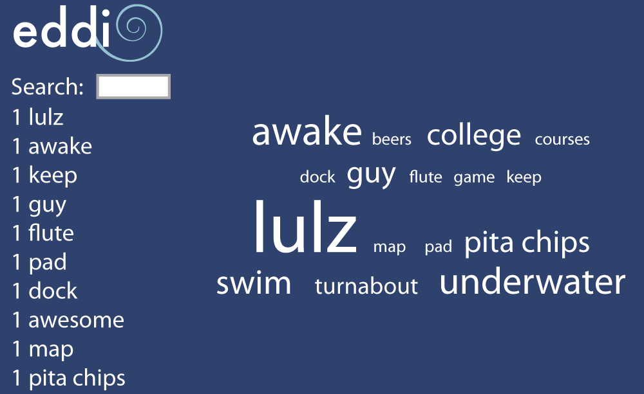
Information Retrieval Techniques
katrina_ Ron Rivest cracks me up. It keeps me
awake when algorithm design brings the lulz.
Notes:
You don't want those as topic headings. "Cracks, keep, and lulz."

Slide 14
TweeTopic: Intuition
Tweets look like search queries,
and search results can be mined for topics.

Slide 15
TweeTopic: Intuition
Tweets look like search queries,
and search results can be mined for topics.
Tweet
msbernst
Awesome article on some SIGGRAPH user interface work: http://bit.ly/30MJy
Tweet
Noun Phrases
Noun Phrases
article SIGGRAPH user interface work
Search
Web Search
Topic Keywords
SIGGRAPH 2004 Trip Report
This year’s themes at SIGGRAPH … good navigation interface …
www.stoneschool.com/Work/Siggraph/2004/index.html
Web Search
Topic Keywords
Number of Pages | Term
9 | SIGGRAPH
7 | user interface
6 | animation
6 | computer graphics
WIMP (computing) – Wikipedia
Possibility ... (like the noun GUI, for graphical user interface) ...
en.wikipedia.org/wiki/WIMP_(computing)
SIGGRAPH: Specialty 3D Applications
Standalone programs give alternatives to the toolset of a 3D ...
maxon.digitalmedianet.com/articles/viewarticle.jsp?id=55098

Slide 16
Noun phrase detection
1
Noun Phrases
Web Search
Topic Keywords
msbernst Awesome article on some SIGGRAPH user interface work:
http://bit.ly/30MJy

Slide 17
Noun phrase detection
1
Noun Phrases
Web Search
Topic Keywords
msbernst Awesome article on some SIGGRAPH user interface work:
http://bit.ly/30MJy

Slide 18
Noun phrase detection
1
Noun Phrases
Web Search
Topic Keywords
msbernst Awesome article on some SIGGRAPH user interface work: http://bit.ly/30MJy

Slide 19


Query a search engine
2
Noun Phrases
Web Search
Topic Keywords
article SIGGRAPH user interface work
Search

Slide 20
Query a search engine
2
Noun Phrases
Web Search
Topic Keywords
SIGGRAPH 2004 Trip Report
This year’s themes at SIGGRAPH … Automatic Distinctive Icons for Desktop Interfaces … such that they actually do provide a good navigation interface …
www.stoneschool.com/Work/Siggraph/2004/index.html
<html>
WIMP (computing) – Wikipedia
Another possibility is to have the P in WIMP stand for Program, allowing it to be used as a noun (like the noun GUI, for graphical user interface) rather ...
en.wikipedia.org/wiki/WIMP_(computing)
SIGGRAPH: Specialty 3D Applications
Aug 4, 2006 ... SIGGRAPH: Specialty 3D Applications Standalone programs give alternatives to the toolset of a 3D animation application By Frank Moldstad ...
maxon.digitalmedianet.com/articles/viewarticle.jsp?id=55098
Graphical specification of flexible user interface displays
Graphical specification of flexible user interface displays. Full text, Pdf (983 KB). Source, Symposium on User Interface Software and Technology archive ...
portal.acm.org/citation.cfm?id=73673
UIST 2010
UIST (ACM Symposium on User Interface Software and Technology) is the premier forum for innovations in the software and technology of human-computer …
www.acm.org/uist/

Slide 21
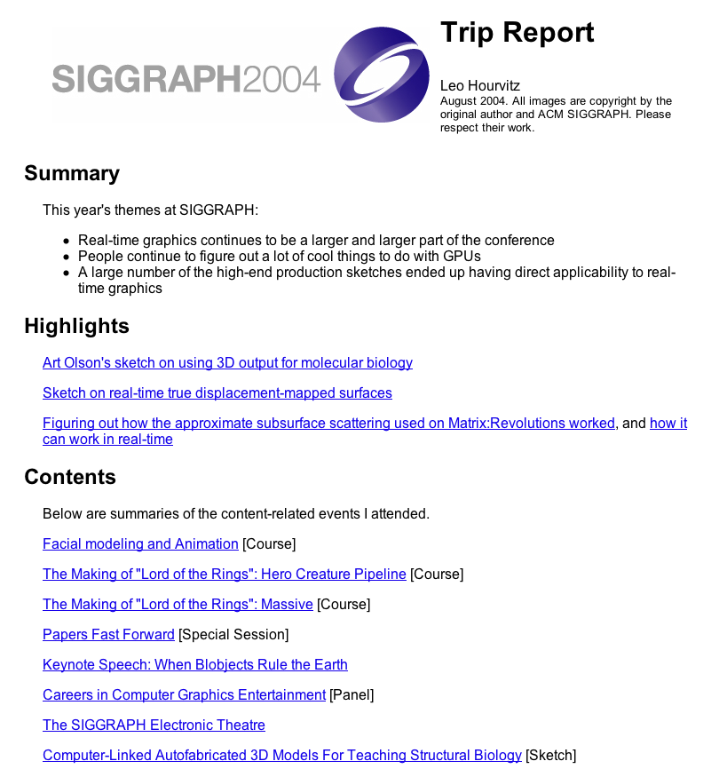
Mine topics from results
3
Noun Phrases
Web Search
Topic Keywords
SIGGRAPH 2004 Trip Report
This year’s themes at SIGGRAPH … Automatic Distinctive Icons for Desktop Interfaces … such that they actually do provide a good navigation interface …
www.stoneschool.com/Work/Siggraph/2004/index.html
TF-IDF on a web corpus:
sketch
model
paper
Gollum
cards
animation
map
texture
SIGGRAPH
fluids
skin
character
shader
collada
real-time
cloth
subsurface scattering
Balrog
special session

Slide 22
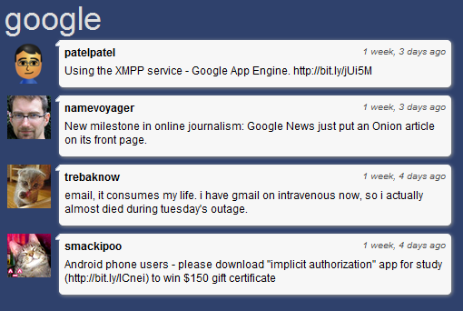
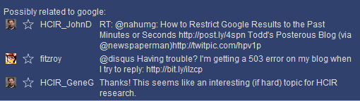
Mine topics from results
3
Noun Phrases
Web Search
Topic Keywords
Number of Pages (max. 10) | Term
9 | SIGGRAPH
7 | user interface
6 | animation
6 | computer graphics
5 | 3d
5 | character
4 | WIMP
4 | interaction
3 | pop-up menus
3 | mice
3 | subsurface scattering
2 | human computer interface
Keep terms in
at least 50%
of search results
Use less common terms
as suggestions

Slide 23
Apple
W00t! Snow Leopard gave me 10 gigs back!
RT @username: gmail is down, but the imap connection
on my iphone still works (fingers crossed!)
My iPhone 3GS cracked-on-a-rock, @username’s swam in a toilet,
both repaired/replaced in 20 min @ Boylston Apple Store. Total cost: $0.
Obama
I think the most striking thing about Obama’s speech +
GOP response for casual listeners would be how much agreement there was.
Watching Obama attempt to #reversethecursehealthcare
RT @username: The fastest way to prove you are an idiot
is to call the President a liar on live TV
Research
@username Congratulations on the CSCW best paper nomination!
Stanford scientists turn liposuction leftovers into embryonic-like
stem cells: http://bit.ly/3GHsw9
CORRECTION: the deadline for submissions to the Graduate Student Consortium
for TEI ’09 is October 2 http://bit.ly/15D8Mv

Slide 24
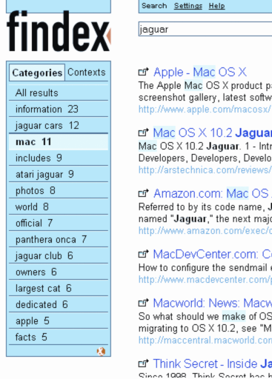
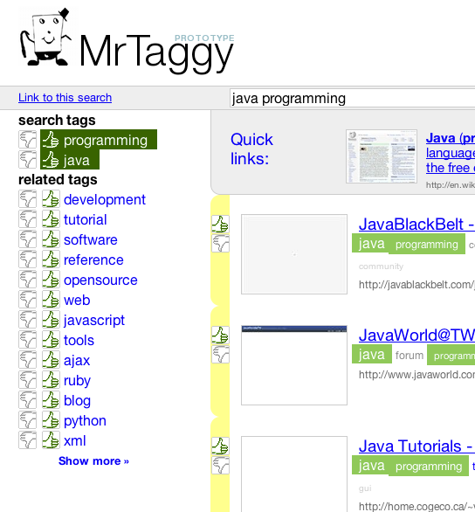
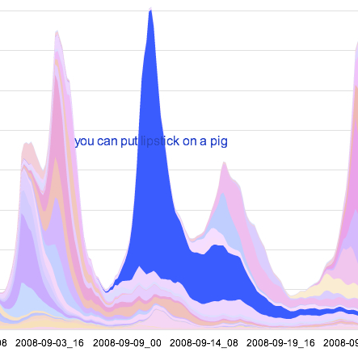
Related Work
Design
Topic browsing interfaces
[Käki et al., chi 2005]
[Kammerer et al., CHI 2009]
[Leskovec et al., KDD 2009]
Notes:
Todo: make full-slide related work

Slide 25
Related Work
Algorithms
Noun phrases as key concepts
in short segments of text
[Bendersky and Croft, SIGIR 2008]
Search engine callouts
to find query similarity
[Sahami and Heilman, WWW 2006]
LDA on Twitter
[Ramage et al., ICWSM 2010]

Slide 26
Evaluation
How does TweeTopic compare
to other topic detection
algorithms?
How does Eddi compare
to a typical chronological
Twitter interface?
Tweet
Noun Phrases
Web Search
Topic Keywords

Slide 27
TweeTopic Evaluation
Comparison topic detection algorithms
Random Unigram
msbernst Awesome article on some SIGGRAPH
user interface work:
http://bit.ly/30MJy

Slide 28
TweeTopic Evaluation
Comparison topic detection algorithms
Random Unigram
Inverse Document Frequency (idf)
msbernst Awesome article on some SIGGRAPH
user interface work:
http://bit.ly/30MJy

Slide 29
TweeTopic Evaluation
Comparison topic detection algorithms
Random Unigram
Inverse Document Frequency (idf)
Latent Dirichlet Allocation (lda)
msbernst Awesome article on some SIGGRAPH
user interface work:
http://bit.ly/30MJy
msbernst Awesome article on some SIGGRAPH
user interface work:
http://bit.ly/30MJy
msbernst Awesome article on some SIGGRAPH
user interface work:
http://bit.ly/30MJy
msbernst Awesome article on some SIGGRAPH
user interface work:
http://bit.ly/30MJy
graphics
Notes:
Shout out to ramage

Slide 30

TweeTopic Evaluation
100 random tweets from Twitter’s stream
Three human coders rated the top five recommendations from each algorithm (Fleiss’s κ=.70)
Logistic regression analysis for binary outcomes
Yup, Medal of Honor will have a demo http://bit.ly/bx6PSG
video games
medal of honor
reviews
honor
Notes:
Controlled for tweet, rater, and topic rank

Slide 31
Results: TweeTopic Doubles Baseline
Topic Labeling Accuracy
Odds Ratio (baseline = 1 at Random Unigram)
Notes:
Wald tests with bonferonni correction confirmed that it outperforms all the others

Slide 32
LDA vs. TweeTopic
I’m off to take a nap now.
See y’all in a few hours!
LDA
bed
half
hour
sleep
TweeTopic
naptime
power nap
sleep
take a nap

Slide 33
Eddi Evaluation
Recruited active Twitter users,
preferring those who followed
more than 100 people
Gave users 3 minutes to browse 24 hours
of their feed using Eddi or a chronological interface, over 6 total trials

Slide 34
Results: More Efficient and Enjoyable
Likert Response (Agreement)
1
4
9
Is Quick to Scan
Eddi
“Eddi helps me find things that
I’m interested in, faster.”
Chrono.
Is Enjoyable
“I get bored faster with the traditional feed. There’s way more stuff that I’m not interested in.”
Eddi
Chronological
I’m Confident I Saw Everything
Eddi
“[The chronological feed] is less enjoyable but more comprehensive.”
Chrono.

Slide 35
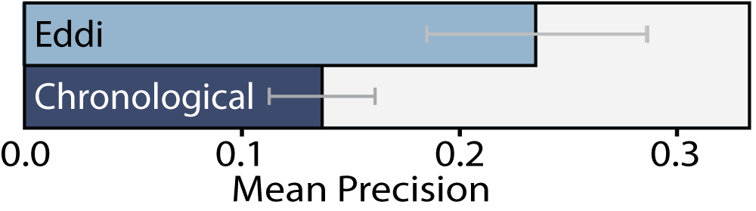
Results: Twice As Effective
Track tweets remaining onscreen for > 2 seconds
Get relevance judgments from users:
“I’m glad that I saw this tweet in my feed.”
Users consume a purer feed:

Slide 36
Discussion and Future Work
Eddi is most useful for overwhelming feeds
@msbernst follows 1000
@msbernst follows 100
@msbernst follows 10
people
people
people
Use case: filter accounts with selective interests
“Show me @GuyKawasaki when he tweets about social computing; ignore the rest.”
Notes:
He tweets ~once every four minutes

Slide 37
eddi
Interactive Topic-Based Browsing of Social Status Streams
Explore an overwhelming feed
by topics of interest
Uncover the central topic of a tweet,
given very little text

Slide 39
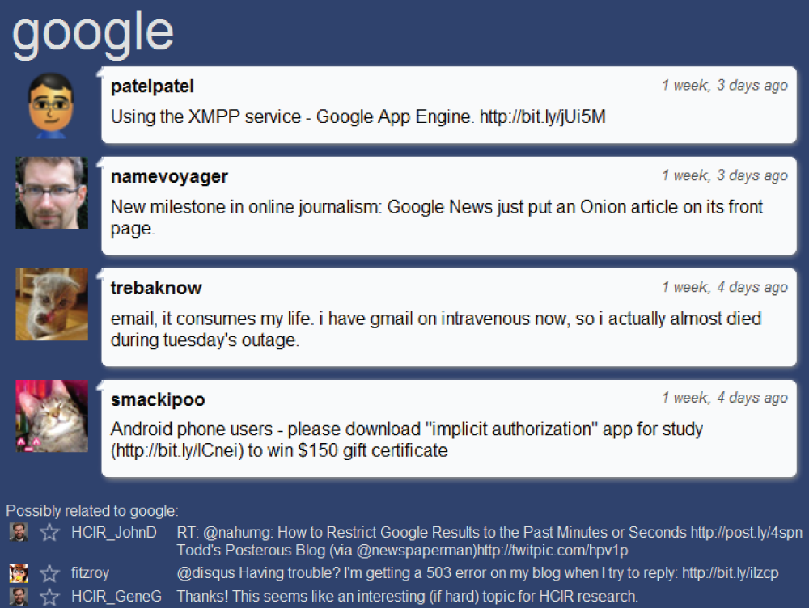

Slide 41

TweeTopic Evaluation
TweeTopic Variants
Transformed vs. Raw:
Do we massage the tweet to look like a query?
Iterated vs. None:
Do we keep removing words if the search engine fails?

Slide 42
Iterate to remove words if needed
4
article SIGGRAPH user interface work

Slide 43
Results: Noun Phrase Analysis Unnecessary
Topic Labeling Accuracy
Odds Ratio (baseline = 1 at Random Unigram)
Notes:
Wald tests with bonferonni correction confirmed that it outperforms all the others

Slide 44
Related Work
Twitter and Design
Common uses of Twitter:
information sharing, opinions, status
[Naaman et al., CSCW 2009]
50%
40%
30%
% of all tweets
20%
10%
0%
Information
Sharing
Opinions
Random
Thoughts
Personal
Status
Notes:
Todo: make full-slide related work

Slide 45
ed
c
h
l
i

