Slide 1
Soylent
A Word Processor with a Crowd Inside
Michael Bernstein
msbernst@csail.mit.edu
Greg Little, Rob Miller, David Karger, David Crowell, Katrina Panovich mit csail
Björn Hartmann Mark Ackerman uc berkeley university of michigan
mit human-computer interaction

Slide 2
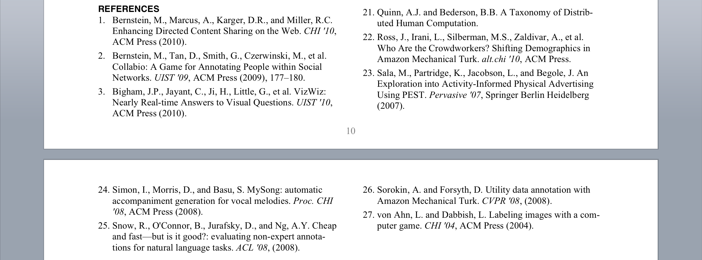
Shortening A Paper to Ten Pages
1) Do it yourself
2) Use an AI
3) Ask colleagues
Notes:
let's start with a scenario many of us are familiar with. we have a pretty strict page limit on a paper, and somewhere in this 7500 words we are just a few lines overlength. We've already spent time editing this paper. It's a pretty painful scenario.
move quickly through this or you’ll go overtime
ask colleagues, "but they're doing CHI papers too!"

Slide 3
Shortening A Paper to Ten Pages
4) Recruit a crowd
Notes:
We're introducing a fourth option with this work: a crowd. We want to recruit an entire crowd of helpers to support your writing process, to get 100 people to help you cut down your text. And what we're going to do is build it into the interface. (picture)

Slide 4
Shortening A Paper to Ten Pages
4) Recruit a crowd
Notes:
We're introducing a fourth option with this work: a crowd. We want to recruit an entire crowd of helpers to support your writing process, to get 100 people to help you cut down your text. And what we're going to do is build it into the interface. (picture)

Slide 5
Soylent is a word processing interface that uses crowd contributions to aid complex writing tasks.
Notes:
In this talk I'm introducing Soylent, a word processor with a crowd inside. Soylent is a new kind of word processing interface that is powered by crowd contributions. Three major features: ...

Slide 6
Soylent is a word processing interface that uses crowd contributions to aid complex writing tasks.
Soylent is people.
Amazon Mechanical Turk
Soylent’s core algorithms are human-powered.
Find Unnecessary Text
Requester: Matt C. Reward: $0.01 Tasks Available: 7
Shorten Rambling Text
Requester: Gordon L. Reward: $0.04 Tasks Available: 12
Notes:
Uses TurKit

Slide 7
Soylent is a word processing interface that uses crowd contributions to aid complex writing tasks.
Find-Fix-Verify:
Crowd control design pattern
Find a problem
Fix each problem
Verify quality of each fix
Soylent, a prototype...
Soylent, a prototype...
Soylent, a prototype...
Soylent, a prototype...
Notes:
This is hard because the crowd pulls in different directions and doesn’t always do the work you want it to do. We control it with a new design pattern we call Find-Fix-Verify.

Slide 8
Embed paid crowd workers in user interfaces to support cognition and manipulation tasks on demand
Notes:
You hit a button, and some dude goes off and does something

Slide 9
demo
Notes:
"we're just a few references overlength" --> "we're just a few lines overlength”
Shortn: authors are bad at hacking their own text. Nobody hacks it in tiny bits. Say out loud that the user is specifying how "tall" the text should be.
Rob's reason why the authors missed the error -- we're tired by page 7. Fresh eyeballs looking at a small bit of text.

Slide 10
Word processors don’t:
- parse semantics well
judge quality
Paid crowds don’t: - guarantee quality
- control costs
State of the Art
[Kittur ’08]

Slide 11
Paid crowds can:
- parse semantics well
judge quality
Soylent can: - guarantee quality
- control costs
Word with a Crowd Inside

Slide 12
Challenges in Programming Crowds
This project has interacted with ~9000 Turkers on ~2000 different tasks
Key Problem: crowd workers often produce poor output on open-ended tasks
30% Rule:
~30% of the results from open-ended tasks will be unsatisfactory
Introduction
Demo
Find-Fix-Verify
Evaluation
Discussion
Soylent

Slide 13
Two Personas: An Example
Proofread and correct the following paragraph:
The theme of loneliness features throughout many scenes in Of Mice and Men and is often the dominant theme of sections during this story. This theme occurs during many circumstances but is not present from start to finish. In my mind for a theme to be pervasive is must be present during every element of the story. There are many themes that are present most of the way through such as sacrifice, friendship and comradship. But in my opinion there is only one theme that is present from beginning to end, this theme is pursuit of dreams.
Notes:
Go FAST

Slide 14
Two Personas: An Example
Proofread and correct the following paragraph:
The theme of loneliness features throughout many scenes in Of Mice and Men and is often the dominant theme of sections during this story. This theme occurs during many circumstances but is not present from start to finish. In my mind for a theme to be pervasive is must be present during every element of the story. There are many themes that are present most of the way through such as sacrifice, friendship and comradship. But in my opinion there is only one theme that is present from beginning to end, this theme is pursuit of dreams.

Slide 15
The Lazy Turker
Does as little work as necessary to be paid
The theme of loneliness features throughout many scenes in Of Mice and Men and is often the dominant theme of sections during this story. This theme occurs during many circumstances but is not present from start to finish. In my mind for a theme to be pervasive is must be present during every element of the story. There are many themes that are present most of the way through such as sacrifice, friendship and comradship. But in my opinion there is only one theme that is present from beginning to end, this theme is pursuit of dreams.
Notes:
You can reject their work

Slide 16
The Lazy Turker
Does as little work as necessary to be paid
The theme of loneliness features throughout many scenes in Of Mice and Men and is often the dominant theme of sections during this story. This theme occurs during many circumstances but is not present from start to finish. In my mind for a theme to be pervasive is must be present during every element of the story. There are many themes that are present most of the way through such as sacrifice, friendship and comradeship. But in my opinion there is only one theme that is present from beginning to end, this theme is pursuit of dreams.

Slide 17
The Eager Beaver
Go beyond task requirements to be helpful, but introduce errors in the process
The theme of loneliness features throughout many scenes in Of Mice and Men and is often the dominant theme of sections during this story. This theme occurs during many circumstances but is not present from start to finish. In my mind for a theme to be pervasive is must be present during every element of the story. There are many themes that are present most of the way through such as sacrifice, friendship and comradship. But in my opinion there is only one theme that is present from beginning to end, this theme is pursuit of dreams.

Slide 18
The Eager Beaver
Go beyond task requirements to be helpful, but introduce errors in the process
The theme of loneliness features throughout many scenes in Of Mice and Men and is often the dominant theme of sections of this story. \n
This theme occurs during many circumstances but is not present from start to finish. \n
In my mind, for a theme to be pervasive it must be present during every element of the story. \n
There are many themes that are present most of the way through such as sacrifice, friendship and comradeship.\n
But in my opinion there is only one theme that is present from beginning to end: this theme is pursuit of dreams.

Slide 19
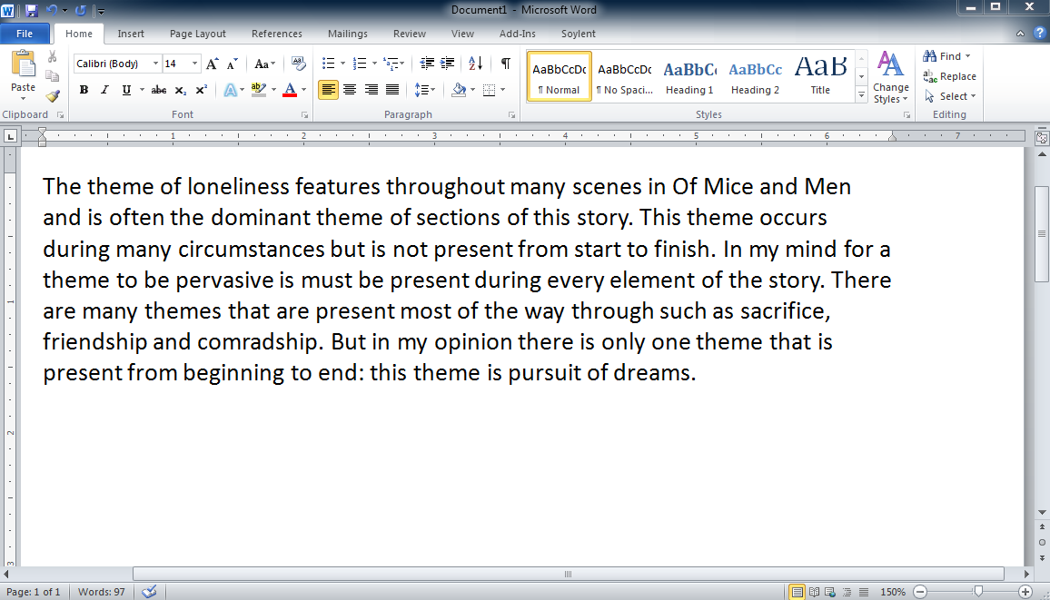
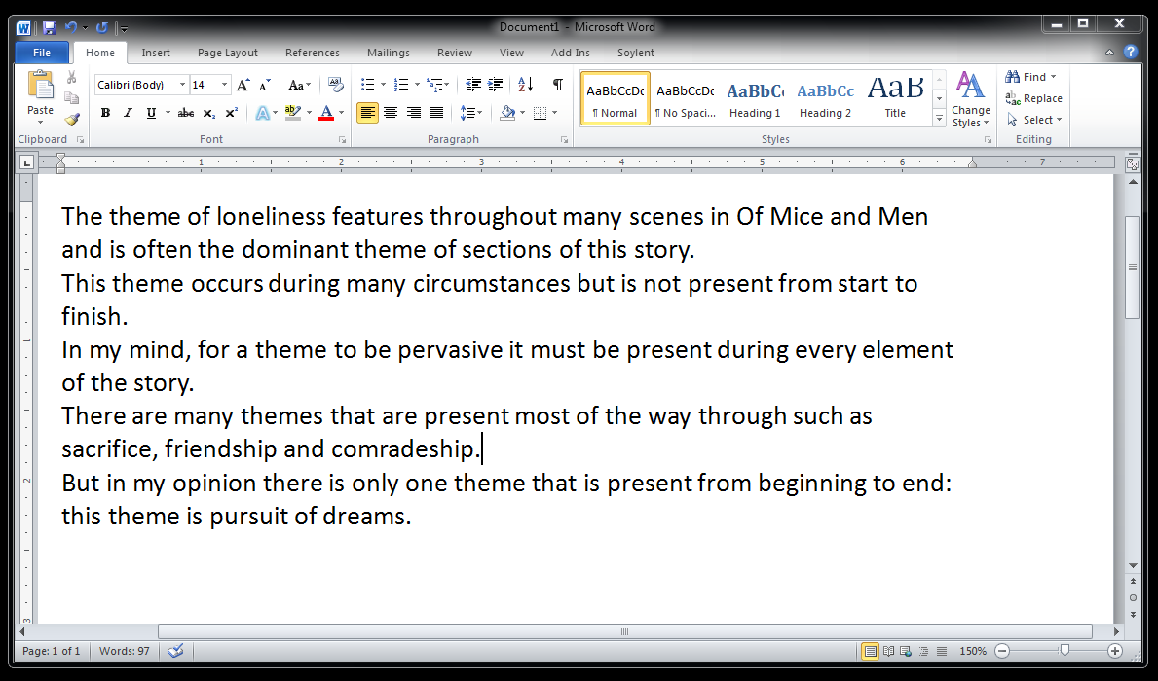
The Eager Beaver
Go beyond task requirements to be helpful, but introduce errors in the process

Slide 20
Find-Fix-Verify
Programming crowds today is haphazard, similar to UI technology before design patterns like Model-View-Controller
Find-Fix-Verify is a design pattern for programming crowds to complete open-ended tasks

Slide 21
Find
“Identify at least one area that can be shortened without changing the meaning of the paragraph.”
Independent agreement to identify patches
Fix
“Edit the highlighted section to shorten its length without changing the meaning of the paragraph.”
Soylent, a prototype...
Randomize order of suggestions
Verify
“Choose at least one rewrite that has style errors, and at least one rewrite that changes the meaning of the sentence.”

Slide 22
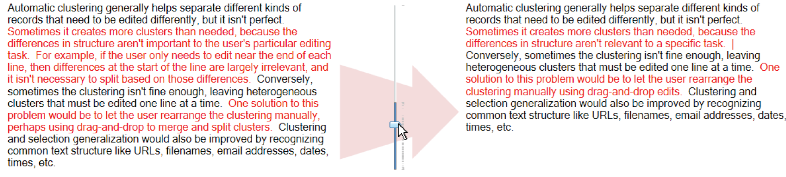
Keep suggestions that do not get voted out
Verify
“Choose at least one rewrite that has style errors, and at least one rewrite that changes the meaning of the sentence.”

Slide 23
Fix-Fix-Verify Discussion
Why split Find and Fix? Force Lazy Turkers to work on a problem of our choice Allows us to merge work completed in parallel
Why add Verify? Quality rises when we place Turkers in productive tension Allows us to trade off lag time with quality
Notes:
They’re working on the same sentence, trying to fix the same underlying problem

Slide 24
Evaluation Goals
Is Soylent’s crowdsourced user interface approach feasible? How high is the quality?
How long is the delay?
How much does it cost?
1
2
3
Introduction
Demo
Find-Fix-Verify
Evaluation
Discussion
Soylent
Notes:
go faster through this. “We evaluated soylent, and we wanted to ask three questions: quality, delay, and cost.”

Slide 25
Blog
Print publishers are in a tizzy over Apple’s new iPad because they hope to finally be able to charge for their digital editions. But in order to get people to pay for their magazine and newspaper apps, they are going to have to offer something different that readers cannot get at the newsstand or on the open Web.
Classic uist Paper
The metaDESK effort is part of the larger Tangible Bits project. The Tangible Bits vision paper introduced the metaDESK along with two companion platforms, the transBOARD and ambientROOM.
Shortn
Draft uist Paper
In this paper we argue that it is possible and desirable to combine the easy input affordances of text with the powerful retrieval and visualization capabilities of graphical applications. We present WenSo, a tool that uses lightweight text input to capture richly structured information for later retrieval and navigation.
Technical Writing
Figure 3 shows the pseudocode that implements this design for Lookup. FAWN-DS extracts two fields from the 160-bit key: the i low order bits of the key (the index bits) and the next 15 low order bits (the key fragment).
Rambling E-mail
A previous board member, Steve Burleigh, created our web site last year and gave me alot of ideas. For this year, I found a web site called eTeamZ that hosts web sites for sports groups. Check out our new page: […]

Slide 26
Blog – 83%
Print publishers are in a tizzy over Apple’s new iPad because they hope to finally be able to charge for their digital editions. But in order to get people to pay for their magazine and newspaper apps, they are going to have to offer something different that readers cannot get at the newsstand or on the open Web.
Classic uist Paper – 87%
The metaDESK effort is part of the larger Tangible Bits project. The Tangible Bits vision paper, which introduced the metaDESK along withand two companion platforms, the transBOARD and ambientROOM.
Cut 15% of original paragraph length on average.
Shortn
Draft uist Paper – 90%
In this paper we argue that it is possible and desirable to combine the easy input affordances of text with the powerful retrieval and visualization capabilities of graphical applications. We present WenSo, a tool thatwhich uses lightweight text input to capture richly structured information for later retrieval and navigation.
Technical Writing – 82%
Figure 3 shows the pseudocode that implements this design for Lookup. FAWN-DS extracts two fields from the 160-bit key: the i low order bits of the key (the index bits) and the next 15 low order bits (the key fragment).
Rambling E-mail – 78%
A previous board member, Steve Burleigh, created our web site last year and gave me alot of ideas. For this year, I found a web site called eTeamZ that hosts web sites for sports groups. Check out our new page: […]
Notes:
Cut more than a page from a CHI paper without touching figures or refs, and just removing fat from the writing.

Slide 27
Blog – 83% 3 para., 158 people, $4.57
Print publishers are in a tizzy over Apple’s new iPad because they hope to finally be able to charge for their digital editions. But in order to get people to pay for their magazine and newspaper apps, they are going to have to offer something different that readers cannot get at the newsstand or on the open Web.
Classic uist Paper – 87% 7 para., 264 people, $7.45
The metaDESK effort is part of the larger Tangible Bits project. The Tangible Bits vision paper, which introduced the metaDESK along withand two companion platforms, the transBOARD and ambientROOM.
Shortn
Draft uist Paper – 90% 5 para., 284 people, $7.47
In this paper we argue that it is possible and desirable to combine the easy input affordances of text with the powerful retrieval and visualization capabilities of graphical applications. We present WenSo, a tool thatwhich uses lightweight text input to capture richly structured information for later retrieval and navigation.
Technical Writing – 82% 3 para., 188 people, $4.84
Figure 3 shows the pseudocode that implements this design for Lookup. FAWN-DS extracts two fields from the 160-bit key: the i low order bits of the key (the index bits) and the next 15 low order bits (the key fragment).
Rambling E-mail – 78% 6 para., 362 people, $9.72
A previous board member, Steve Burleigh, created our web site last year and gave me alot of ideas. For this year, I found a web site called eTeamZ that hosts web sites for sports groups. Check out our new page: […]
Notes:
Cost works out to $1.40 per paragraph

Slide 28
Blog – 83% 3 para., 158 people, $4.57
Print publishers are in a tizzy over Apple’s new iPad because they hope to finally be able to charge for their digital editions. But in order to get people to pay for their magazine and newspaper apps, they are going to have to offer something different that readers cannot get at the newsstand or on the open Web.
Classic uist Paper – 87% 7 para., 264 people, $7.45
The metaDESK effort is part of the larger Tangible Bits project. The Tangible Bits vision paper, which introduced the metaDESK along withand two companion platforms, the transBOARD and ambientROOM.
Focus on unnecessarily wordy phrases
But in order to get people to pay for their magazine and newspaper apps, they are going to have to offer something different that readers cannot get at the newsstand or on the open Web.
Shortn
Draft uist Paper – 90% 5 para., 284 people, $7.47
In this paper we argue that it is possible and desirable to combine the easy input affordances of text with the powerful retrieval and visualization capabilities of graphical applications. We present WenSo, a tool thatwhich uses lightweight text input to capture richly structured information for later retrieval and navigation.
Technical Writing – 82% 3 para., 188 people, $4.84
Figure 3 shows the pseudocode that implements this design for Lookup. FAWN-DS extracts two fields from the 160-bit key: the i low order bits of the key (the index bits) and the next 15 low order bits (the key fragment).
Rambling E-mail – 78% 6 para., 362 people, $9.72
A previous board member, Steve Burleigh, created our web site last year and gave me alot of ideas. For this year, I found a web site called eTeamZ that hosts web sites for sports groups. Check out our new page: […]
Notes:
Cost works out to $1.40 per paragraph

Slide 29
Blog – 83% 3 para., 158 people, $4.57
Print publishers are in a tizzy over Apple’s new iPad because they hope to finally be able to charge for their digital editions. But in order to get people to pay for their magazine and newspaper apps, they are going to have to offer something different that readers cannot get at the newsstand or on the open Web.
Classic uist Paper – 87% 7 para., 264 people, $7.45
The metaDESK effort is part of the larger Tangible Bits project. The Tangible Bits vision paper, which introduced the metaDESK along withand two companion platforms, the transBOARD and ambientROOM.
Shortn
Draft uist Paper – 90% 5 para., 284 people, $7.47
In this paper we argue that it is possible and desirable to combine the easy input affordances of text with the powerful retrieval and visualization capabilities of graphical applications. We present WenSo, a tool thatwhich uses lightweight text input to capture richly structured information for later retrieval and navigation.
Merged sentences when patches crossed sentence boundaries
The metaDESK effort is part of the larger Tangible Bits project. The Tangible Bits vision paper, which introduced the metaDESK along withand two companion platforms, the transBOARD and ambientROOM.
Technical Writing – 82% 3 para., 188 people, $4.84
Figure 3 shows the pseudocode that implements this design for Lookup. FAWN-DS extracts two fields from the 160-bit key: the i low order bits of the key (the index bits) and the next 15 low order bits (the key fragment).
Rambling E-mail – 78% 6 para., 362 people, $9.72
A previous board member, Steve Burleigh, created our web site last year and gave me alot of ideas. For this year, I found a web site called eTeamZ that hosts web sites for sports groups. Check out our new page: […]
Notes:
Cost works out to $1.40 per paragraph

Slide 30
Blog – 83% 3 para., 158 people, $4.57
Print publishers are in a tizzy over Apple’s new iPad because they hope to finally be able to charge for their digital editions. But in order to get people to pay for their magazine and newspaper apps, they are going to have to offer something different that readers cannot get at the newsstand or on the open Web.
Classic uist Paper – 87% 7 para., 264 people, $7.45
The metaDESK effort is part of the larger Tangible Bits project. The Tangible Bits vision paper, which introduced the metaDESK along withand two companion platforms, the transBOARD and ambientROOM.
Shortn
Draft uist Paper – 90% 5 para., 284 people, $7.47
In this paper we argue that it is possible and desirable to combine the easy input affordances of text with the powerful retrieval and visualization capabilities of graphical applications. We present WenSo, a tool thatwhich uses lightweight text input to capture richly structured information for later retrieval and navigation.
Workers introduced style errors when not part of the community of practice
Technical Writing – 82% 3 para., 188 people, $4.84
Figure 3 shows the pseudocode that implements this design for Lookup. FAWN-DS extracts two fields from the 160-bit key: the i low order bits of the key (the index bits) and the next 15 low order bits (the key fragment).
In this paper we argue that it is possible and desirable to combine the easy input affordances of text with the powerful retrieval and visualization capabilities of graphical applications.
Rambling E-mail – 78% 6 para., 362 people, $9.72
A previous board member, Steve Burleigh, created our web site last year and gave me alot of ideas. For this year, I found a web site called eTeamZ that hosts web sites for sports groups. Check out our new page: […]
Notes:
Cost works out to $1.40 per paragraph

Slide 31
Blog – 83% 3 para., 158 people, $4.57
Print publishers are in a tizzy over Apple’s new iPad because they hope to finally be able to charge for their digital editions. But in order to get people to pay for their magazine and newspaper apps, they are going to have to offer something different that readers cannot get at the newsstand or on the open Web.
Parallelism can result in inconsistent changes
Classic uist Paper – 87% 7 para., 264 people, $7.45
The metaDESK effort is part of the larger Tangible Bits project. The Tangible Bits vision paper, which introduced the metaDESK along withand two companion platforms, the transBOARD and ambientROOM.
FAWN-DS extracts two fields from the 160-bit key: the i low order bits of the key (the index bits) and the next 15 low order bits (the key fragment).
Shortn
Draft uist Paper – 90% 5 para., 284 people, $7.47
In this paper we argue that it is possible and desirable to combine the easy input affordances of text with the powerful retrieval and visualization capabilities of graphical applications. We present WenSo, a tool thatwhich uses lightweight text input to capture richly structured information for later retrieval and navigation.
Technical Writing – 82% 3 para., 188 people, $4.84
Figure 3 shows the pseudocode that implements this design for Lookup. FAWN-DS extracts two fields from the 160-bit key: the i low order bits of the key (the index bits) and the next 15 low order bits (the key fragment).
Rambling E-mail – 78% 6 para., 362 people, $9.72
A previous board member, Steve Burleigh, created our web site last year and gave me alot of ideas. For this year, I found a web site called eTeamZ that hosts web sites for sports groups. Check out our new page: […]
Notes:
Cost works out to $1.40 per paragraph

Slide 32
Results: Lag
Soylent Posts Task
Most time is spent waiting: Median 18.5 minutes Summed medians across Find, Fix and Verify
q₁=8.3 minutes, q₃=41.6 minutes
Worker Accepts Task
Actual work time is very short: Median 2.0 minutes Summed medians across Find, Fix and Verify q₁=60 seconds, q₃=3.6 minutes
Worker Submits Task
Notes:
"our next step is to find ways to reduce wait time"

Slide 33
ESL: English as a Second Language
However, while GUI made using computers be more intuitive and easier to learn, it didn’t let people be able to control computers efficiently. Masses only can use the software developed by software companies.
Passes Word’s Grammar Checker
Marketing are bad for brand big and small. You Know What I am Saying. It is no wondering that advertisings are bad for company in America, Chicago and Germany.
Wikipedia
Dandu Monara (Flying Peacock, Wooden Peacock), The Flying machine able to fly. The King Ravana (Sri Lanka) built it. Accorinding to hindu believes in Ramayanaya King Ravana used "Dandu Monara" for abduct queen Seetha from Rama. According to believes "Dandu Monara" landed at Werangatota.
Crowdproof
Notes
Blah blah blah—argument about whether there should be a standard “nosql sto- rage” API to protect developers storing their stuff in proprietary services in the cloud. Probably unrealistic.
UIST Draft
Many of these problems vanish if we turn to a much older recording technology---text. When we enter text, each (pen or key) stroke is being used to record the actual information we care about---; none is wasted on application navigation or configuration.

Slide 34
ESL: English as a Second Language
However, while GUI made using computers be more intuitive and easier to learn, it didn’t allow people to let people be able to control computers efficiently. Masses only canThe masses can only use the software developed by software companies, unless they know how to write programs.
Crowdproof alone found 67% of errors.
Crowdproof
Crowdproof fixed 88% of the errors it found.
Crowdproof and Word together found 82% of errors.

Slide 35
Find BibTeX:
“Hi, please find the bibtex references for the 3 papers in brackets. You can located these by Google Scholar searches and clicking on bibtex.’’
Find Creative Commons Figures:
“Pick out keywords from the paragrah like Yosemite, rock, half dome, park. Go to a site which hsa CC licensed images […]’’
Human Macro
Blog Feedback:
“Please tell me how to make this paragraph communicate better. Say what's wrong, and what I can improve. Thanks!’’
Tense Change:
“Please change text in document from past tense to present tense”
Find and Format Addresses:
“Please complete the addresses below to include all informtion needed as in example below. [...]”
Notes:
note that they are misspelled and still worked

Slide 36
Find BibTeX:
“Hi, please find the bibtex references for the 3 papers in brackets. You can located these by Google Scholar searches and clicking on bibtex.’’
Duncan and Watts [Duncan and watts HCOMP 09 anchoring] found that Turkers will do more work, but quality is no higher.
Human Macro
@conference {
title={{Financial incentives […]}},
author={Mason, W. and Watts, D.J.},
booktitle={HCOMP ‘09},
[…]
}
The Human Macro executed requests perfectly 71% of the time.

Slide 37
Introduction
Demo
Find-Fix-Verify
Evaluation
Discussion
Soylent

Slide 38
Wizard of Turk: The New Wizard of Oz
Wizard of Oz prototyping is a tried-and-true technique in HCI and AI Put a human behind the curtain …until we understand how to engineer it
It’s now possible to wire a wizard permanently into an interactive system Fully deployable from day one AI vs. Turk is a cost / performance optimization Crowd contributions can provide training data
Interface
Wizard of Turk
Wizard of Oz
Notes:
We think that Soylent is an example of a new class of user interfaces. (not, “and here’s the discussion!”)
"There are AIs that do sentence compression like Shortn, but their biggest problem right now is lack of data. We can feed it that data, and eventually save the user money."

Slide 39
Soylent
A Word Processor with a Crowd Inside
A new class of crowd-powered interfaces
The Find-Fix-Verify design pattern
Crowd Personas: The Lazy Turker and the Eager Beaver

Slide 40
Soylent
soylent@csail.mit.edu

Slide 42
Effect of Price on Wait Time
Paying more had no effect on early arrivals, but sped up the latecomers
Notes:
Task: crowdproof, input was ESL first paragraph, separated Find from Fix+Verify so that Fix always had the same patches
All tasks had at least 3 workers in the first 10 minutes. After about 15 minutes, arrival time starts looking exponential.
So, you can get away with paying very little for interaction

Slide 43
Privacy, Legality, Ethics
Unknown third parties can see your document One solution: develop long-term relationships Or: enterprises hire wage workers under NDA
Who owns the edits to your document? Work-for-hire contract means the author retains rights Is this the correct model?
Taylorism and the Turker as API call Embed human-human contract ethics into your system Adjusting to minimum wage
Notes:
snooping on CHI papers right before the deadline
add 9000 Turkers to the author list

Slide 44
Related Work
Powering novel interactions with the wisdom of crowds [ChaCha; Sala et al., Pervasive 2007; Bigham et al., UIST 2010]
Improving quality on Mechanical Turk [Kittur et al., CHI 2008; Heer et al., CHI 2010]
Artificial intelligence techniques for word processing Automatic proofreading [Kukich, CSUR 1992] Sentence compression [Clarke and Lapata, ACL 2006] AI for EUP [Cypher 1993]

Slide 45
Results: Cost
$0.08 per Find, $0.05 per Fix, and $0.04 per Verify
Average paragraph cost $1.41 to Shortn: $0.55 to Find an average of two patches $0.48 to Fix each patch $0.38 to Verify each patch
Lower bound with $0.01 per task: $0.30 per paragraph

