Slide 1


4chan and /b/:
An Analysis of Anonymity and Ephemerality in a Large Online Community
Michael Bernstein, Andrés Monroy-Hernández, Drew Harry, Paul André,
Katrina Panovich and Greg Vargas
>>
Anonymous 07/20/11(Wed)15:30:05 No.339760588
mit computer science and ai lab
mit media lab
university of southampton
Notes:
collaboative grad student research, no profs

Slide 2

Mark Zuckerberg
Identity Representation
Pseudonyms and multiple accounts demonstrate
“a lack of integrity”
pseudonyms
Notes:
Let’s start this journey with some trends.
When you’re designing an online community or social media service, you need to make some choices.
On identity, pseudonyms were the norm on the Internet for a long time.
Then Facebook came along. We see more and more sites moving toward strong identity.

Slide 3

Google
“The web means
the end of forgetting.”
— New York Times
Mark Zuckerberg
Identity Representation
Pseudonyms and multiple accounts demonstrate
“a lack of integrity”
Archiving Strategy
Notes:
Likewise, the advent of search engines has shifted us toward stronger notions of archiving…the web means the end of forgetting.

Slide 4

Millen 2000
Archives are highly valued and expected to be read by newcomers.
Millen + Patterson 2003
Identity Representation
Real names and pseudonyms “promote trust, cooperation and accountability.”
Archiving Strategy
Notes:
Academic literature has followed suit. We argue that real names and pseudonyms are important to the health of online communities, and that centrally-maintained archives persist the group memory.

Slide 5
Ma + Agarwal 2007
Strong identity and permanent archives correlate with satisfaction and participation
Identity Representation
?
What happens in a large scale anonymous, ephemeral community?
Archiving Strategy
Notes:
Sometimes we argue both at once. But recently we are seeing a trend in the other direction.
Fully anonymous = not even a pseudonym, nobody knows who posted it

Slide 6
Ma + Agarwal 2007
Strong identity and permanent archives correlate with satisfaction and participation
Identity Representation
?
How does such a community produce so much of the Internet’s shared culture?
Archiving Strategy
Notes:
Sometimes we argue both at once.
But recently we are seeing a trend in the other direction.

Slide 7
Ma + Agarwal 2007
Strong identity and permanent archives correlate with satisfaction and participation
Identity Representation
4chan /b/
Archiving Strategy

Slide 8
Our Goal
Use 4chan /b/ as a lens
to understand the concepts
of anonymity and ephemerality.

Slide 9
Our Argument
Anonymity and ephemerality support community behaviors that generate internet culture.
Notes:
the memes, the catchphrases, the attitude

Slide 10
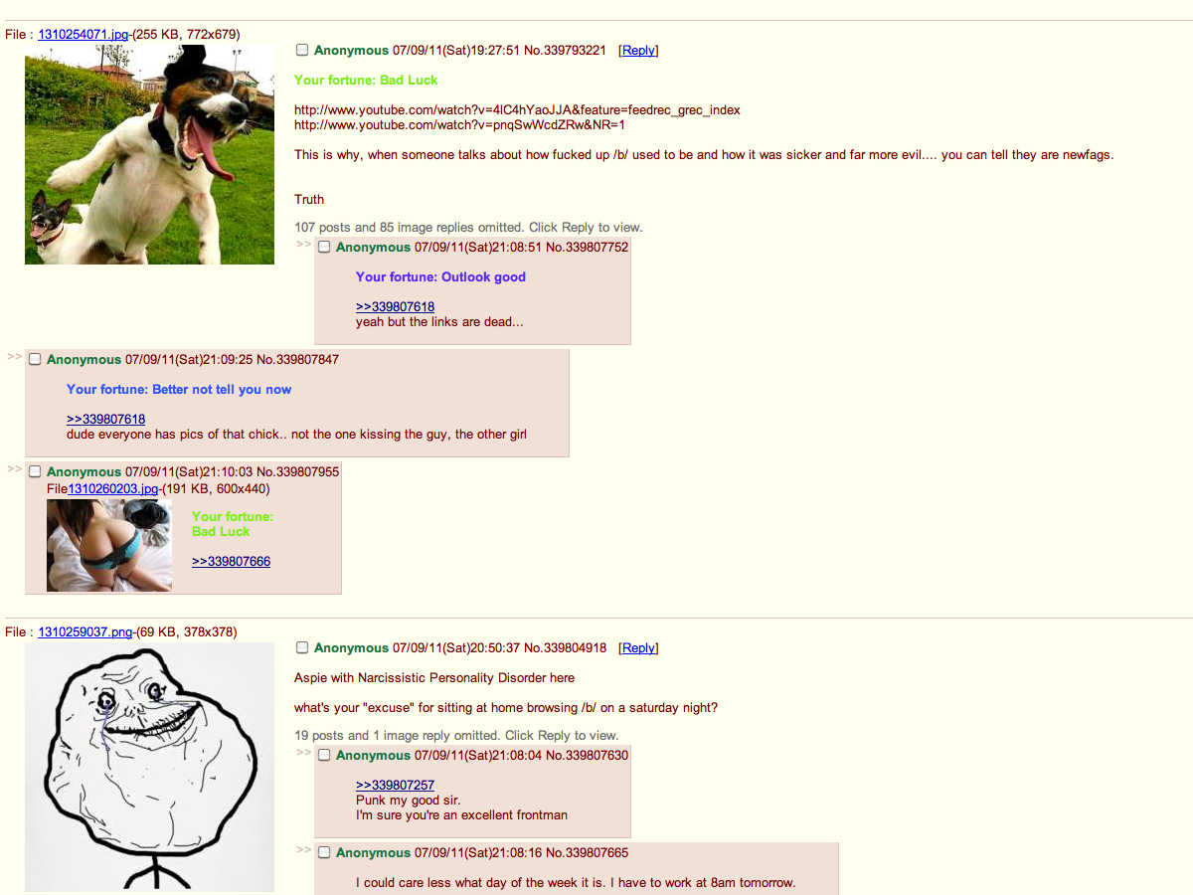
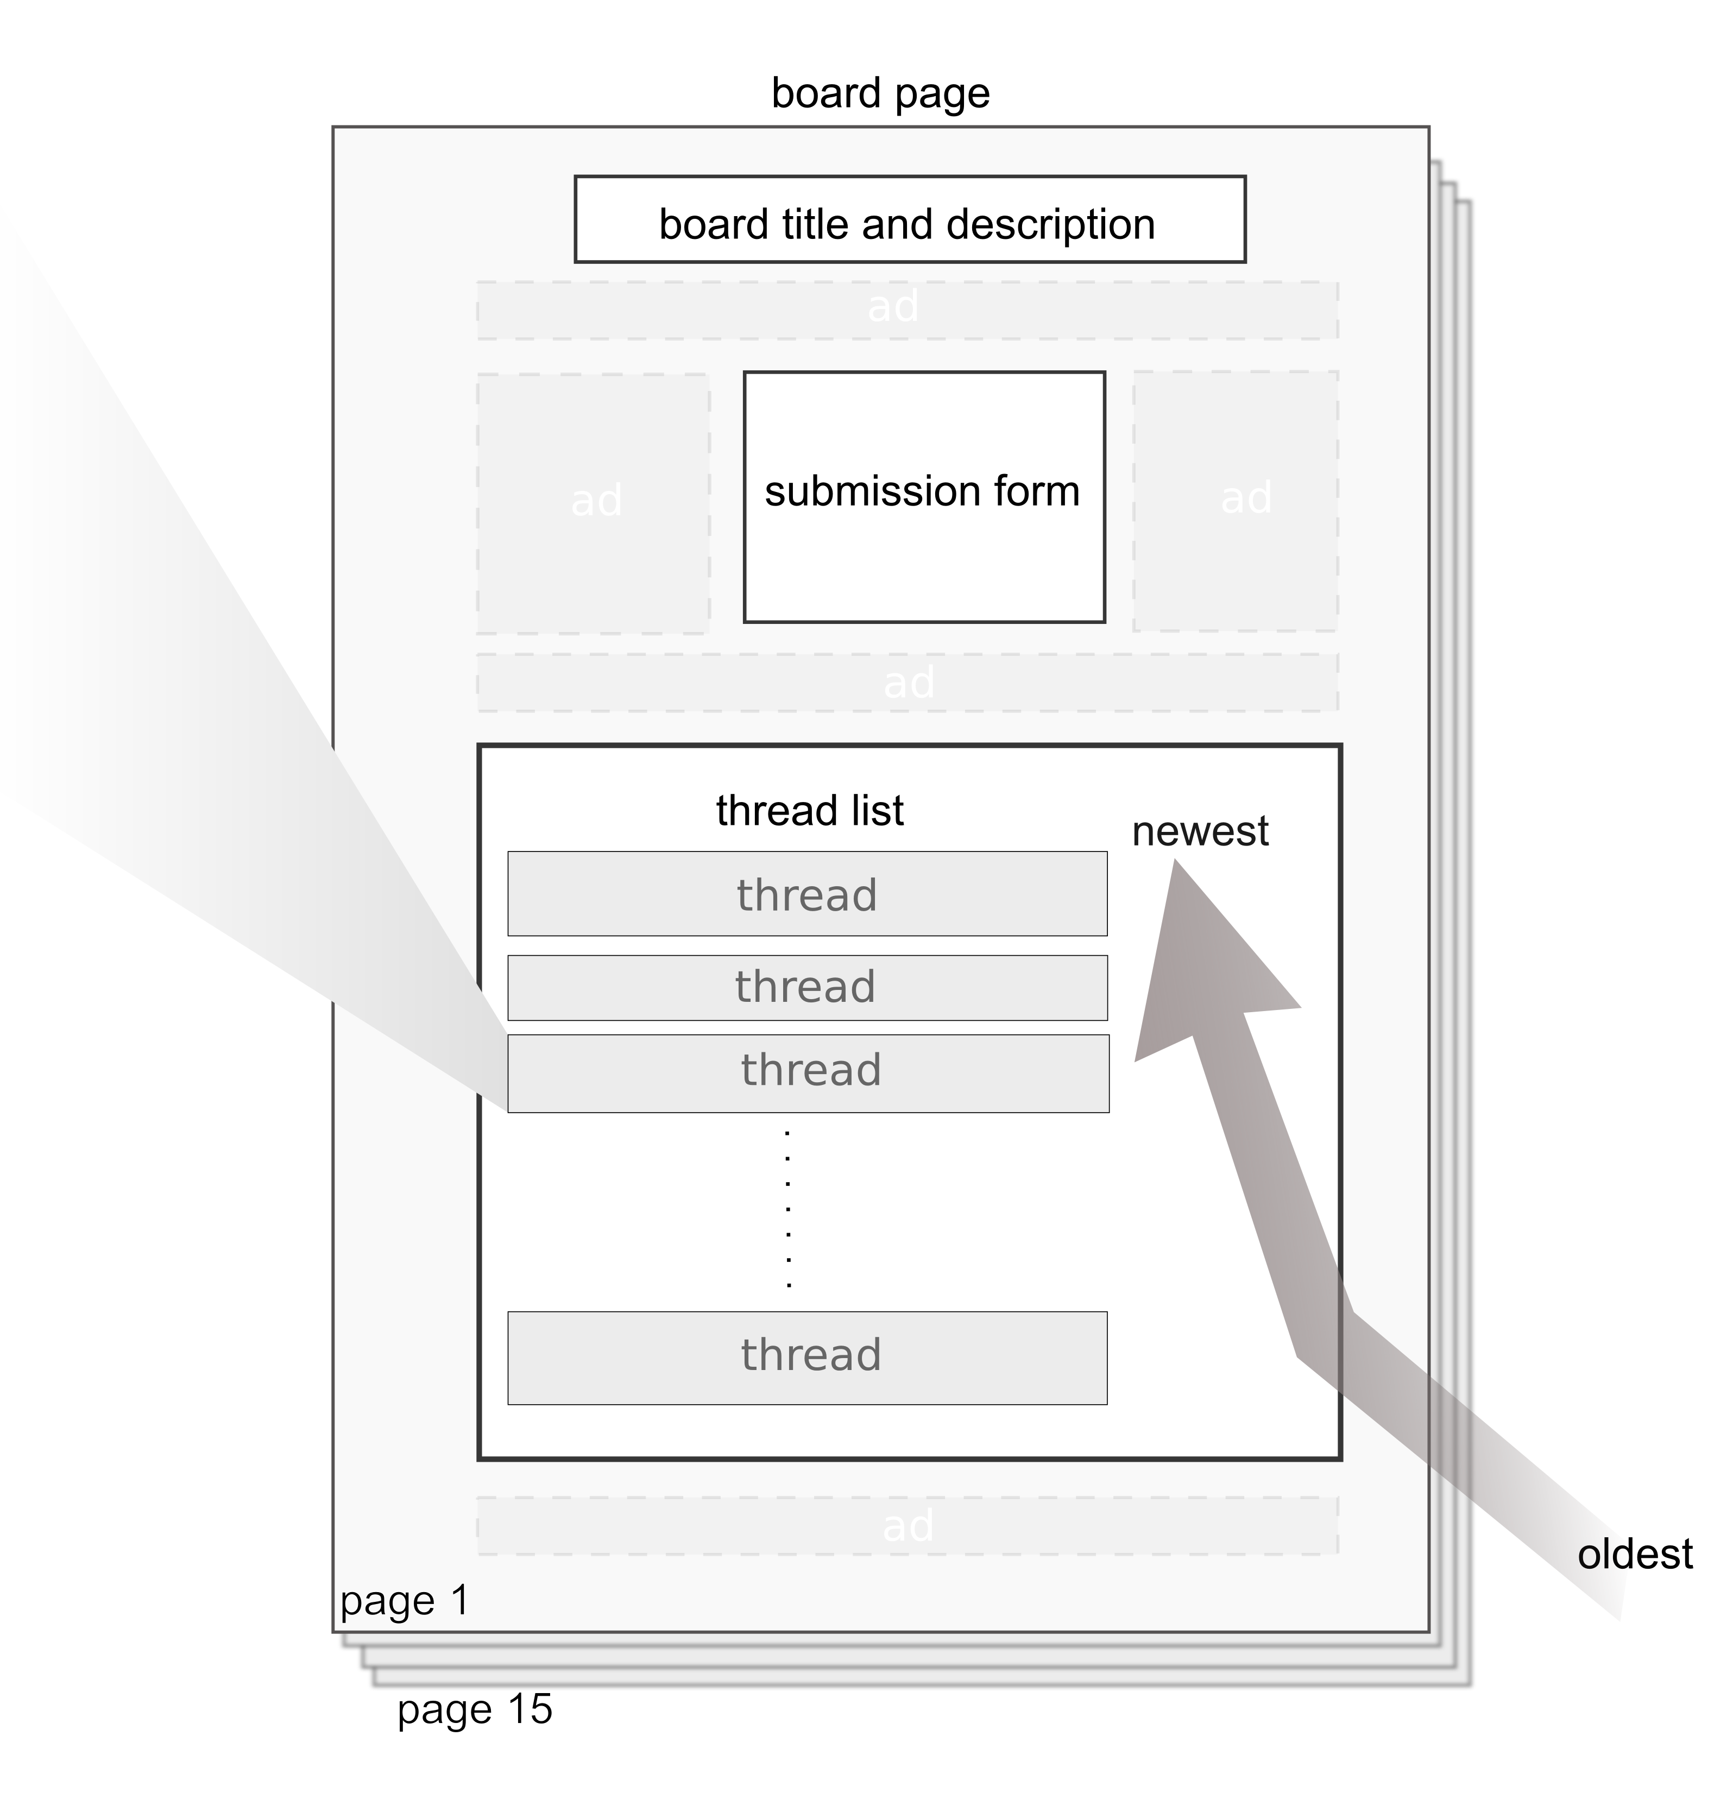


Notes:
This is what 4chan looks like. Visually, it’s a throwback to 90’s web design.
I’m going to try and mimic that aesthetic and attitude through the entire talk with these slides.
Content-wise: intentionally offensive. “newfag”, “oldfag”, … misogyny…
Porn→Cliff Lampe
Christopher Poole, or “moot”, created 4chan in 2003 as an anime discussion board
Copied the format of Japanese forum 2chan.
The format is: several threads per page, here you can see two compressed views of threads.
Posts start with an image, often replies have images.

Slide 11

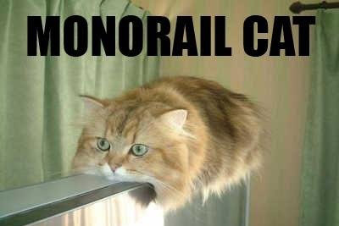
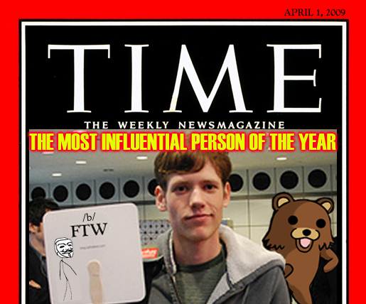
4chan’s Impact
>>
moot!Ep8pui8Vw2 07/20/11(Wed)15:30:05 No.339760588
over seven million users
>>
Anonymous 07/20/11(Wed)15:30:23 No.339760
prolific meme factory
> lolcats
> rickrolling
> chocolate rain
> pedobear
>>
Anonymous 07/20/11(Wed)15:30:43 No.339823
highly visible off-site activities
> electing moot Time Person of the Year
> hacktivist group Anonymous

Slide 12
/b/, the “Random” board
The most active board
>>
Anonymous 07/20/11(Wed)15:30:05 No.339760588
30% of all traffic
>>
moot!Ep8pui8Vw2 07/20/11(Wed)15:30:05 No.339760588
“the lifeforce of the website”
where the “rowdiness and lawlessness” happen
Notes:
About sixty boards today, spanning fashion, science, and “sexy beautiful women”

Slide 13


4chan /b/ and Ephemerality
>>
Anonymous 07/20/11(Wed)15:30:05 No.339760588
/b/ deletes content as soon as newer content arrives
>>
Anonymous 07/20/11(Wed)15:30:05 No.339760597
fast-paced and chaotic experience
Twitter’s design suggests ephemerality

Slide 14

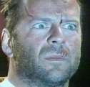
4chan /b/ and Anonymity
>>
Anonymous 07/20/11(Wed)15:30:05 No.339760588
posts are fully anonymous by default
rarely contain pseudonyms or other identity signals
>>
Anonymous 07/20/11(Wed)15:30:23 No.339760597
traditional reputation systems become unworkable
Formspring.me is based on anonymous feedback
Blizzard’s shift to real names sparked an uprising

Slide 15

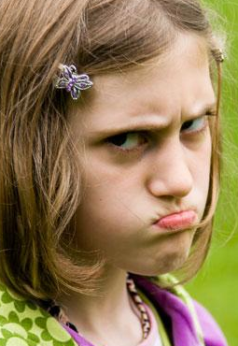


Related work
>>
Anonymity 07/20/11(Wed)15:30:05 No.339760588
>>
Sites with (discouraged) anonymous commenting:
Usenet [Donath 1999], Slashdot [Lampe+Resnick 2004]
Removing social cues makes communication impersonal [Short, Williams, Christie 1976]
and cold [Hiltz, Johnson, Turoff 1986], and anonymity directly undermines credibility [Rains 2007].
>>
Ephemerality 07/20/11(Wed)15:30:05 No.339760588
>>
Technology does not let us forget
[Grudin 2002; Mayer-Schonberger 2009]
Notes:
anonymous is 18% of slashdot comments, controlled via user moderation. slashdot norm is pseudonyms

Slide 16
ITT: In This Talk
Content
Analysis of threads on 4chan /b/
Ephemerality
Tempo and deletion dynamics
Anonymity
Practices around identity
Notes:
[[[4-5 minutes into talk?]]]

Slide 17
Content Analysis
Notes:
Why do this?
Important to give a sense of how the community succeeds
In a space where participation looks nothing like traditional participation, we need to give you a sense of what you’re getting.
Warn that this is offensive

Slide 18


Content Analysis Method
>>
Anonymous 07/20/11(Wed)15:31:04 No.3397256562
collected 598 thread-starting posts over ten days
>>
Anonymous 07/20/11(Wed)15:30:05 No.339760588
rounds of iterative coding
developed nine categories to describe thread themes

Slide 19
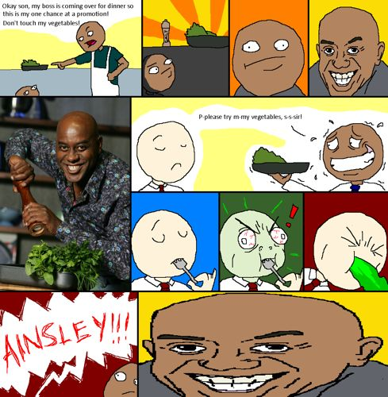
Themed
28%
>>
Anonymous 07/20/11(Wed)15:30:05
ITT [“In this thread”] we only
post stuff we have laughed at
so hard we had tears
Notes:
In keeping with /b/’s identity as an image board and the requirement that each thread-starter post an image, a common purpose of the board is to share images and web content. The two most prevalent thread types (Themed, 28%, and Shar- ing Content, 19%) both revolve around images and make up nearly half of all threads in our sample.

Slide 20

Sharing Content
19%
>>
Anonymous 07/20/11(Wed)15:30:05
This guy is a hero. :)
http://www.youtube.com/[xxxxx]
Notes:
In keeping with /b/’s identity as an image board and the requirement that each thread-starter post an image, a common purpose of the board is to share images and web content. The two most prevalent thread types (Themed, 28%, and Shar- ing Content, 19%) both revolve around images and make up nearly half of all threads in our sample.

Slide 21
Question or Advice
10%
>>
Anonymous 07/20/11(Wed)15:30:05
Soup /b/
Recently I’ve been hanging out with a girl a lot, we’re both in college. I spend the night at her place all the time and we kiss and whatnot. Problem is, she just broke up with her ex [...]
and I know she’s not over him.
I really like her but I dunno what
to do, so what do /b/?
Notes:
the kind of thing you’d rarely see teen- and college-age boys admitting online

Slide 22
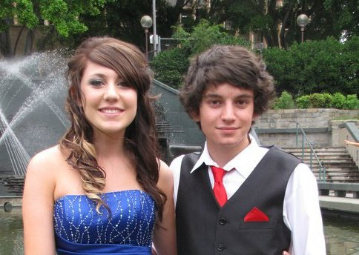


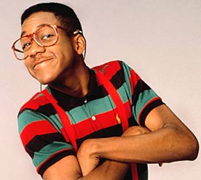
>>
Sharing Personal Information 9%
U JELLY? [“Jealous?”] This is me suiting up at my formal looking fucking brilliant, then there is you fags sitting back and watching.
>>
Discussion 8%
Hi Anonymous! So ive started this game called League of Legends a few days ago. [...] Is there anyone here who also
plays it? Lets talk about it!
>>
Request for Item 8%
anyone has a pic of that star wars battle tank with the german insignia shooped [“photoshopped”] on it? in return tits
>>
Request for Action 7%
Make a group saying [name] is awesome on face book.
DO IT FAGGOTS
>>
Discussing /b/ 5%
Heidi Ho there /b/ I’m a Newfag and now that i’ve been here
all Summer I was wondering if i need a letter of recommendation From a Registered OldFag?

Slide 23
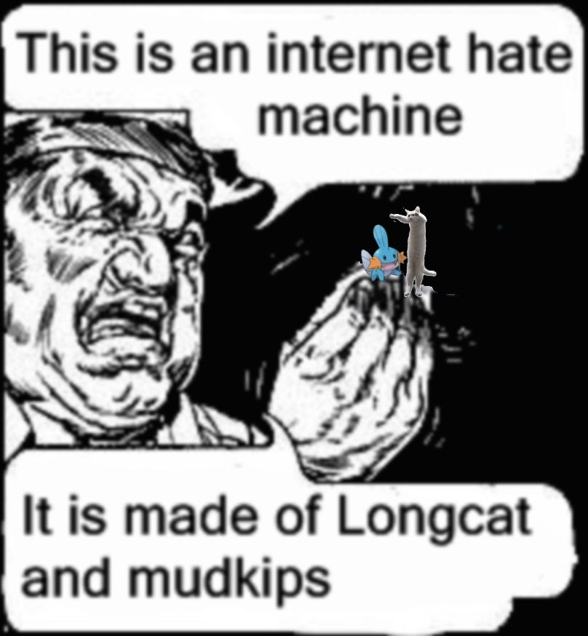

A Brief Word on Normalcy
>>
Media Representation 07/20/11(Wed)15:30:05
Fox News: 4chan is “The Internet Hate Machine”
-but-
it is a community like any other
>>
Nudity, Gore, Homophobia, Racism
intentionally offensive and off-color
create taste boundaries to keep out
those not in it for the lulz
Notes:
it's idiosyncratic, but it's not a hate machine.
see traditional kinds of things,
even in what seems to be tremendously hostile environment, we see lots of prosocial behaviors
hold nothing sacred. leads to many reactions like, that is simultaneously the funniest thing I’ve ever seen and I wish I could unsee it.

Slide 24
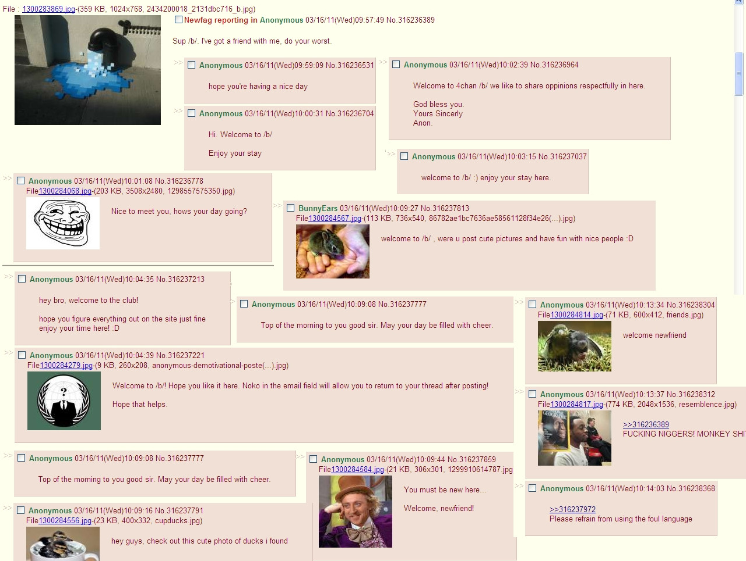
Notes:
/b/ trolls itself.

Slide 25
Study 1
Ephemerality
Notes:
What does an ephemeral community really look like?
How do people manage it?

Slide 26

Ephemerality on 4chan
Anonymous 07/20/11(Wed)15:30:05
cool paper bro

Slide 27
Ephemerality on 4chan

Slide 28
Ephemerality on 4chan

Slide 29
Ephemerality on 4chan

Slide 30
Ephemerality on 4chan

Slide 31
Ephemerality on 4chan

Slide 32
Ephemerality on 4chan

Slide 33
Ephemerality on 4chan
15 threads per page
15 pages
225 threads on /b/

Slide 34
Ephemerality on 4chan
404

Slide 35
Ephemerality on 4chan
Bumping
Anonymous 07/20/11(Wed)15:30:05
cool paper bro
>>
Anonymous
p values or GTFO

Slide 36

Data Collection
>>
Anonymous 07/20/11(Wed)15:30:05 No.339760588
complete dataset of /b/ activity over two weeks
5,576,096 posts in 482,559 threads
>>
Anonymous 07/20/11(Wed)15:30:34 No.339734523
recreate /b/’s thread position history using
post creation timestamps

Slide 37

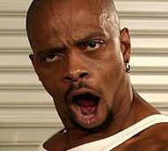
Entire Lifetime
>>
Thread Lifetime 07/20/11(Wed)15:30:34 No.3397345
median thread lifetime: 3.9 minutes
min: 28 seconds
max: 6.2 hours
>>
43% of threads get no replies
median thread has original post and one reply
>>
Longest-Lived Thread 07/20/11(Wed)15:30:34
ASK A
PAGAN
ANYTHING
go on do your worst (or alternatively actually get my re- spect and actually ask something useful)
>>
Short-Lived Thread 07/20/11(Wed)15:30:34 No.33973453984
I hope you’re glad the captcha is gone, woo yeah, let’s all be random lolz!

Slide 38

First Page
>>
Why first page? 07/20/11(Wed)15:30:34
threads get most of their visibility on the first page
reminder: bumped threads are returned to the first page
>>
Total time on first page 07/20/11(Wed)15:30:34
median time on first page: 5 seconds
min: less than 1 second
max: 37 minutes

Slide 39

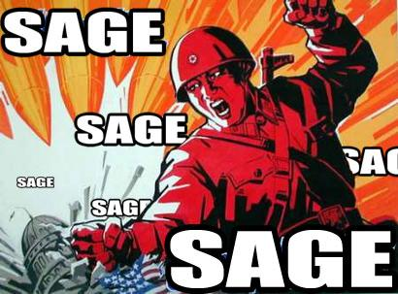
Bumping and Sage
>>
bump 07/20/11(Wed)15:30:34 No.33973454556
39
can reply with deliberate intent to bring the thread to the first page and keep it from 404ing
2.16% of posts contained “bump”, “bamp”, etc.
or similar inflections
>>
sage 07/20/11(Wed)15:30:34 No.33973454556
39
“sage” in email field leaves a reply
without bumping the thread: “burying” a thread
0.77% of posts were sages
>>
Interpretation 07/20/11(Wed)15:30:34
39
4chan members play within the bounds of ephemerality and manipulate it

Slide 40
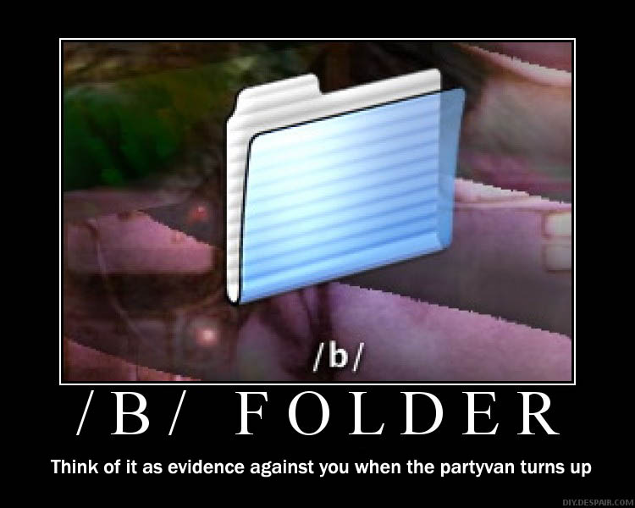
Ephemerality Discussion
>>
Volume comparisons 07/20/11(Wed)15:30:34
35,000 threads and 400,000 /b/ posts per day
vs. 7,100 digg threads per day
25,000 usenet posts per day
65,000 youtube videos per day
[Szabo+Huberman 2010, newsadmin.com]
>>
Alternate Archives 07/20/11(Wed)15:30:34
users save memorable content
to /b/ folders on their hard drives
4chanarchive.org for “epic” threads

Slide 41
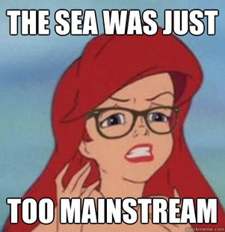
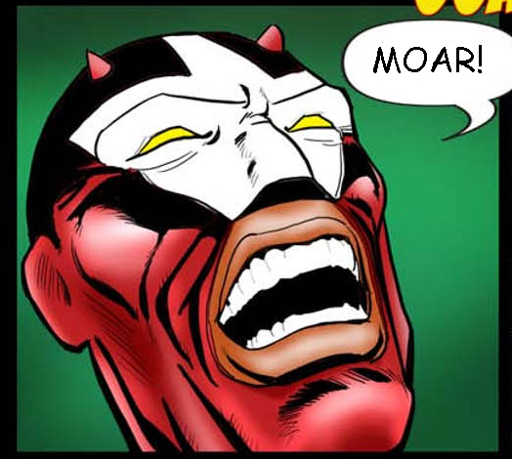
Ephemerality Discussion
>>
Role in meme creation 07/20/11(Wed)15:30:34
fast pace leads to continuously fresh content
no history may mitigate “rich get richer” phenomena
>>
Raising participation? 07/20/11(Wed)15:30:34
counterintuitively, ephemerality may actually
be increasing participation in /b/
participating in a thread is the best way
to keep it from 404ing
Notes:
Darwinian struggle for attention

Slide 42
Study 2
Anonymity
Notes:
4chan /b/ is known collectively as Anonymous: so how anonymous is it, really?
And how does that play out?

Slide 43
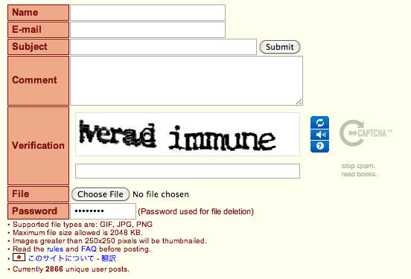
Anonymity on 4chan
>>
Anonymous 07/20/11(Wed)15:30:34 No.33973454556
[comment text]
>>
OP 07/20/11(Wed)15:30:34 No.33973454556
[post using an unverifiable name]
>>
username!Oo43raDvH61 07/20/11(Wed)15:30:34 No.33973454556
[post using a tripcode, /b/’s only identity mechanism]

Slide 44

Identity Markers
>>
Anonymous 07/20/11(Wed)15:30:34 No. 234028393
90.1% of posts were credited to “Anonymous”
>>
Gómez et al. 2008 07/20/11(Wed)15:30:34 No. 23402839
closest comparison in the literature:
18.6% of Slashdot comments are anonymous
>>
Runners-up 07/20/11(Wed)15:30:44 No. 23402839323
David | 1.06% (part of a 4chan meme)
– | 1.06%
OP | 0.24% (claiming to be the Original Poster of the thread)
>>
Tripcodes 07/20/11(Wed)15:30:34 No. 234028393
5% of posts used tripcodes

Slide 45

An Argument for Anonymity
>>
Anonymous 07/20/11(Wed)15:30:34 No. 2832974298
typical online community narrative is pro-identity
>>
Millen and Patterson 2003 07/20/11(Wed)15:30:34
revealing names and reputations
has a positive impact on communities
>>
Suler 2005 07/20/11(Wed)15:30:34
anonymity can fuel
the online disinhibition effect

Slide 46
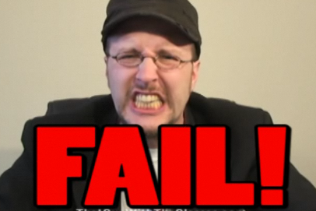
An Argument for Anonymity
>>
Anonymous 07/20/11(Wed)15:30:34 No. 2832974298
typical online community narrative is pro-identity
but, anonymity and disinhibition can have positive effects
>>
Anonymous 07/20/11(Wed)15:33:23
masking failure makes experimentation safer
creativity
memes
group ownership of creative content
>>
Anonymous 07/20/11(Wed)15:30:34 No. 29038240923
anonymity can provide a cover for intimate conversations
Soup /b/ Recently I’ve been hanging out with a girl a lot, we’re both in college. I spend the night at her place all the time and we kiss and whatnot. Problem is, she just broke up with her ex [...] and I know she’s not over him. I really like her but I dunno what to do, so what do /b/?

Slide 47
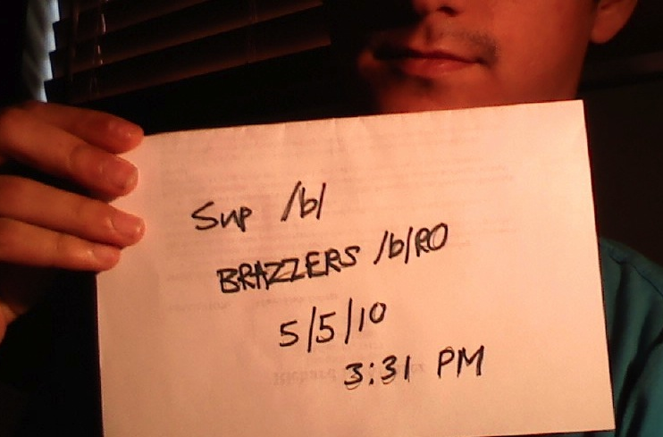

Identity without Accounts
>>
Anonymous 07/20/11(Wed)15:30:34 No. 2832974298
alternative identity signaling
>>
timestamping in photos
suggests authenticity
>>
slang helps delineate
group membership
4chan ‘dialect’ is nontrivial
required familiarity
with current trends and memes

Slide 48
Ingroup and Outgroup
>>
Anonymous 07/20/11(Wed)15:30:34 No. 2832974298
Triforcing as a classic identity barrier
>>
>>

Slide 49

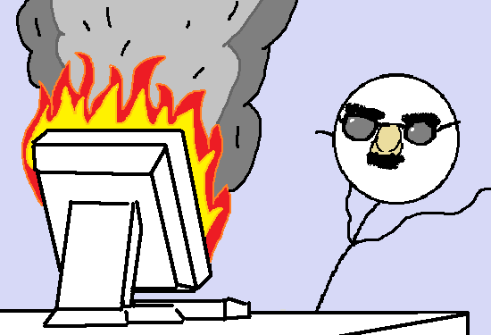
TL;DR: Conclusion
>>
Content 07/20/11(Wed)15:30:05 No.339760588
dominated by playful exchanges of images and links
>>
Ephemerality 07/20/11(Wed)15:30:05 No.339760588
median thread spends 5 seconds on the first page
expires completely in 5 minutes
content deletion drives many of /b/’s dynamics
>>
Anonymity 07/20/11(Wed)15:30:05 No.339760588
over 90% of posts are made completely anonymously
contrast to pseudonymous and fully identified sites
5% of posts use tripcode identity mechanisms

Slide 50
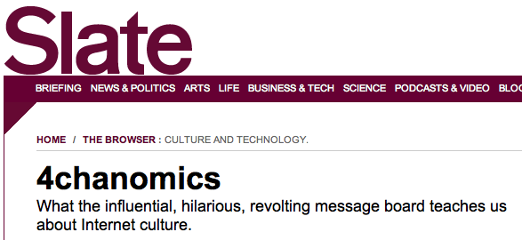
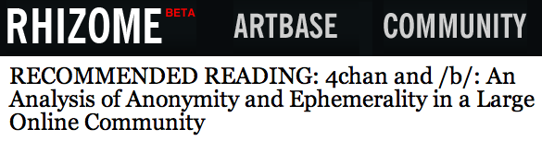
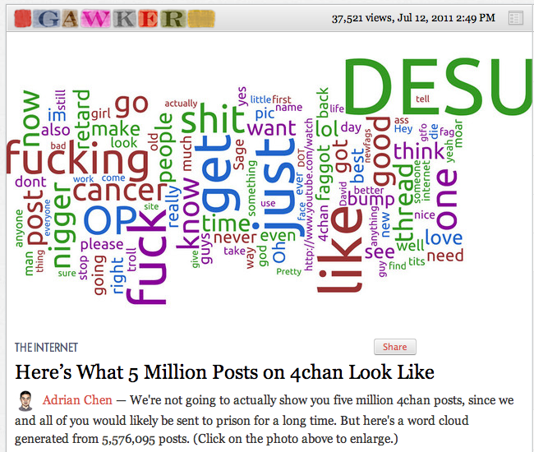
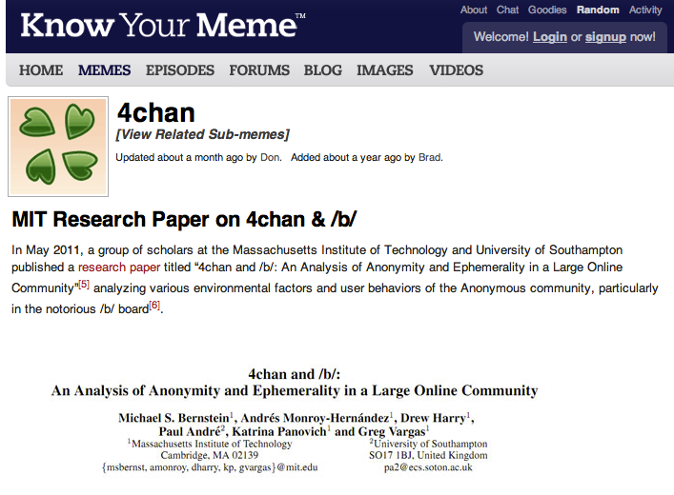
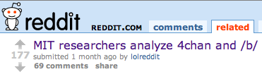
Come join the lulz
>>
Anonymous 07/20/11(Wed)15:30:34 No. 2832974298
research follows the data
but this turns a blind eye to important communities and movements
our chanthropologist toolkit can help you collect a dataset
>>
Anonymous 07/20/11(Wed)16:23:44 No. 2234534879
meme creation and spread
relationship to online activism and off-site activities
Notes:
but this turns a blind eye…FORTRAN
frankly, by the time they’re on twitter or reddit, their fate has already been decided
interest in this: slate, gawker, reddit, hacker news
Coleman
ischool

Slide 51
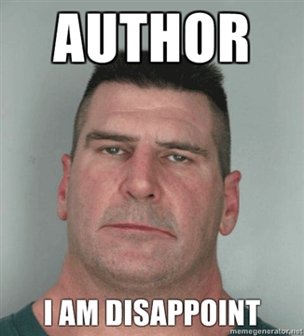
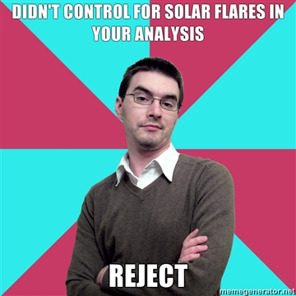
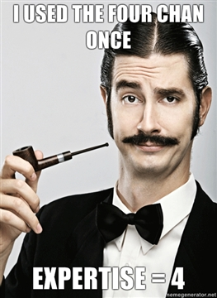

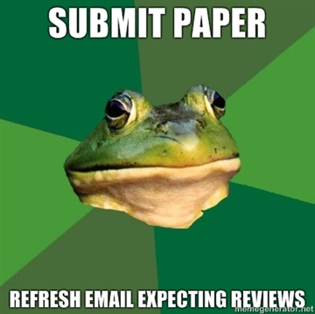
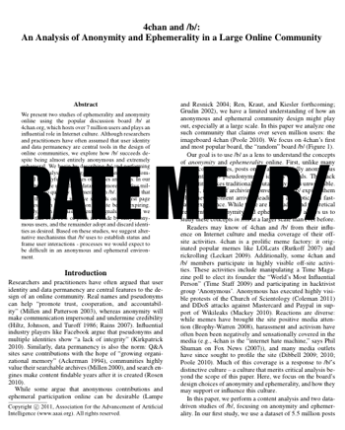

Slide 52
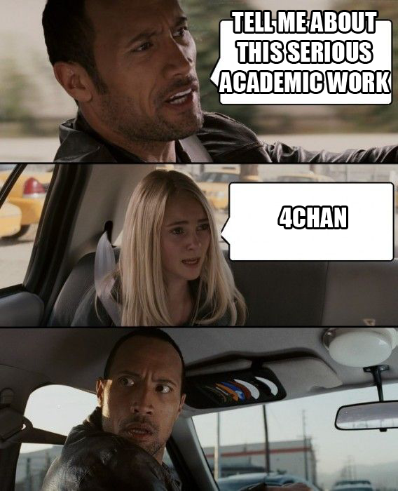
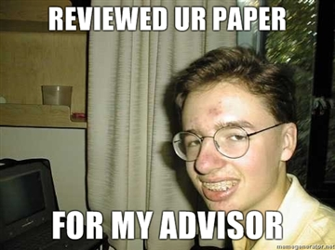
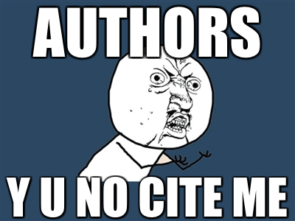
Acknowledgments: danah boyd, Amy Bruckman, Gabriella Coleman, Danyel Fisher, Benjamin Mako Hill, Alex Leavitt, Rob Miller, Lisa Nakamura,
Chris Schmandt, Christina Xu and Sarita Yardi

Slide 54
Reactions on /b/
>>
Find it funny or weird 07/20/11(Wed)15:30:34 No. 2832974298
ITT: /b/ gets trolled by the MIT
I bet the FBI paid MIT to study us
That's the britfags' tax money at work lol, paying scientists to fap over Emily Watson fakes
Lol at how formally they present what goes on here. Like newt gingrich is some isolated tribe in the rainforest with unique and primitive customs.
>>
Engaged with the content 07/20/11(Wed)15:30:34 No. 2832974298
skimmed the whole paper. interesting. i especially like seeing the breakdown of what types of threads are posted most. I would like to see the themed section broken down ie. 20% CP 8% furfag 17% raff u roose 2% fingerbox 5% sup my name is john and you're all a bunch of candy-ass s
This is... This is actually pretty damn interesting.
I think something is lost to the analysts here. The fact that one of the most popular /b/ activities is "pissing into the sea of piss”.
Notes:
but this turns a blind eye…FORTRAN
frankly, by the time they’re on twitter or reddit, their fate has already been decided
interest in this: slate, gawker, reddit, hacker news
Coleman
ischool

Slide 55
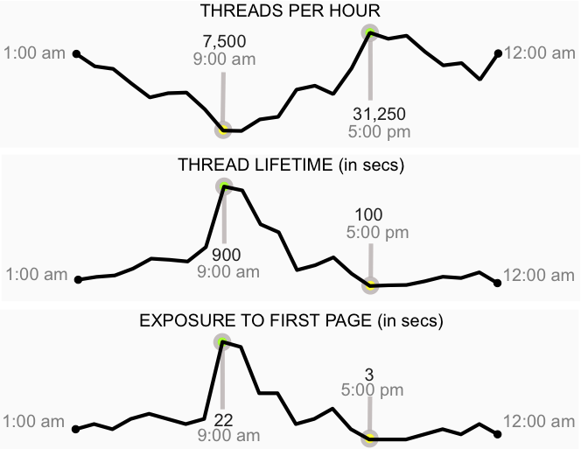
Time of Day
>>
primarily an after-work, after-school phenomenon

