Slide 1


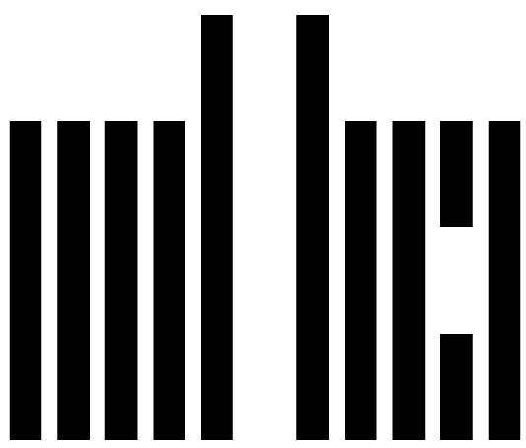
Crowds in Two Seconds
Enabling Realtime
Crowd-Powered Interfaces
Michael Bernstein, Joel Brandt, Rob Miller and David Karger
MIT CSAIL and Adobe Systems
mit human-computer interaction

Slide 2
Crowds in Two Seconds
Enabling Realtime
Crowd-Powered Interfaces
Soylent
[Bernstein et al. 2010]
Embed crowd
intelligence inside of
interactive applications.
VizWiz
[Bigham et al. 2010]
PlateMate
[Noronha et al. 2011]
Legion
[Lasecki et al. 2011]
Notes:
FAST
We are starting to see the potential of crowd-powered interfaces: [CLICK] applications that embed crowds inside of them to react with human intelligence.
But they’re limited by the problem of latency: how long the user has to wait for a response.

Slide 3
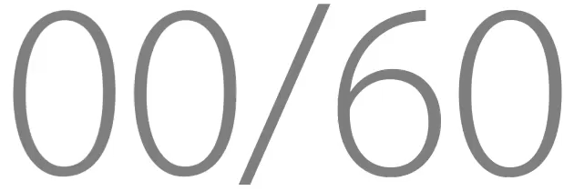


Go
Our goal is on-demand,
realtime crowds.
Crowds in 2 seconds
The user loses focus
after 10 seconds [Nielsen 1993]
Request
Votes in 5 seconds
Vote
Option A
Option B
Searches in 10 seconds
Notes:
13 minute, use sixty to make a point. There’s a timer on this slide.
Because 56 seconds
We’re talking interactive systems, so we are limited by *user interface latency*.
“Ten seconds has gone by now.” Ten second limit
Clever ways to deal with this in continuous or closed-loop like driving.
If we want to make these crowds integral part of user interfaces everywhere, we need to solve the problem of latency and create realtime crowdsourcing.
“And here I’ve introduced the entire talk to you in the same amount of time it would take to get a response right now.”

Slide 4
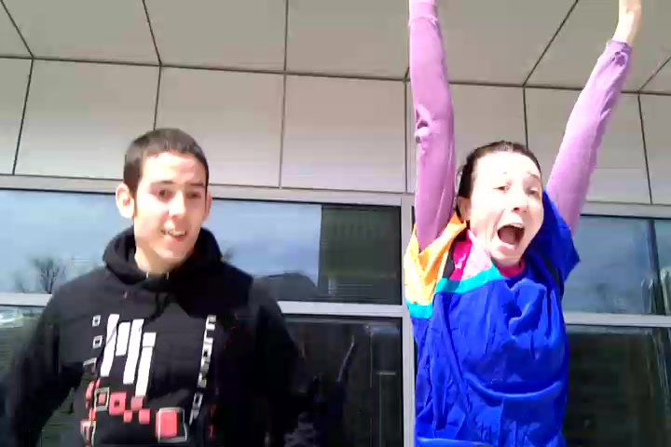
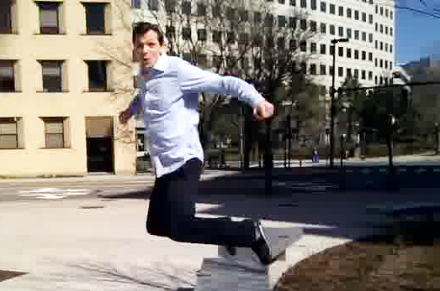
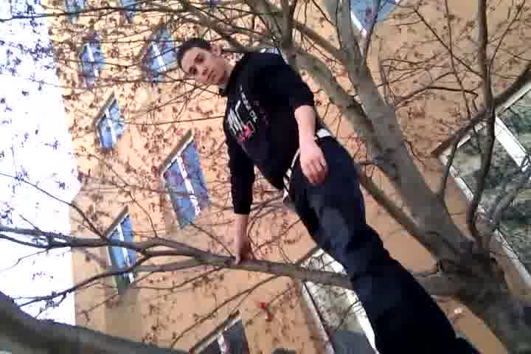
Adrenaline
Realtime Crowd-Powered Camera
Notes:
SLOW
There are two technical components to achieving this, and I’ll introduce them both through this application called Adrenaline.
Adrenaline is a camera that crowdsources the selection of the best photo in realtime.

Slide 5
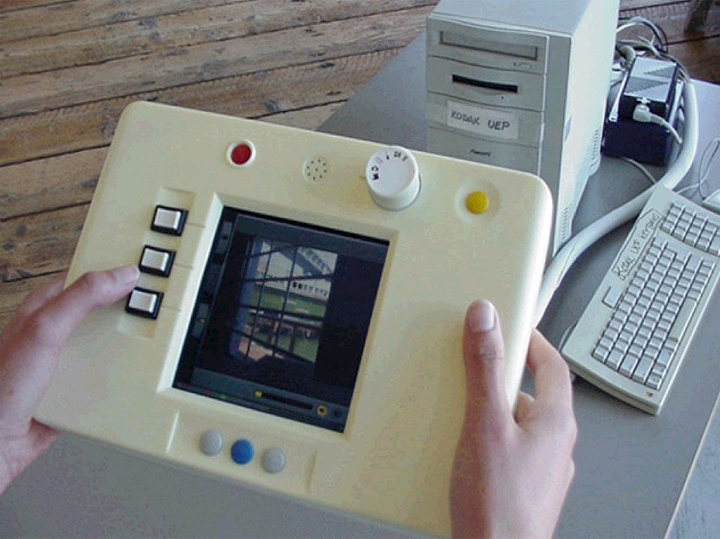
ideo prototype digital camera with instant review
Notes:
SLOW

Slide 6
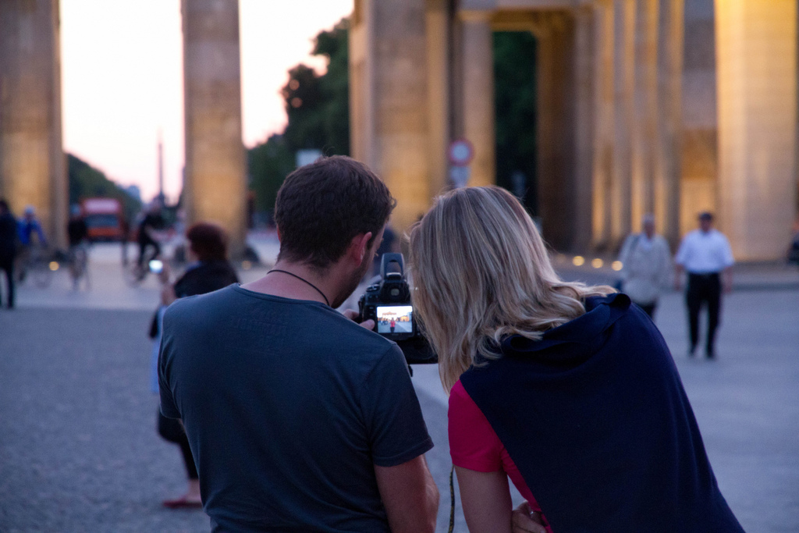
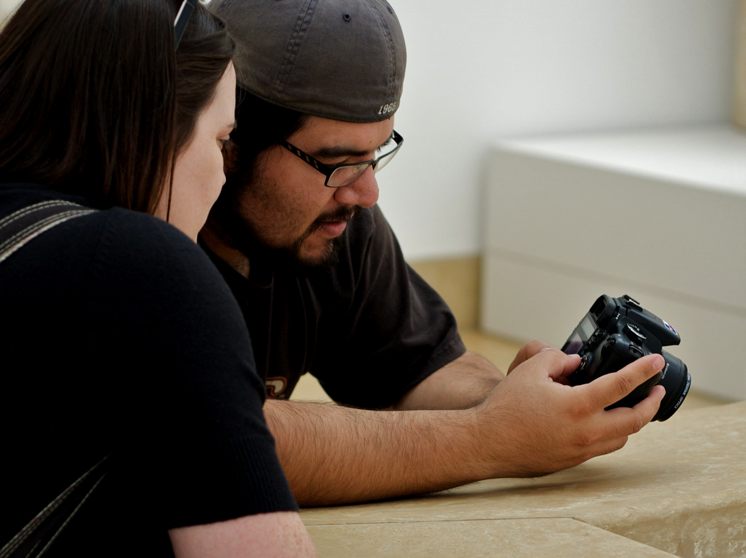
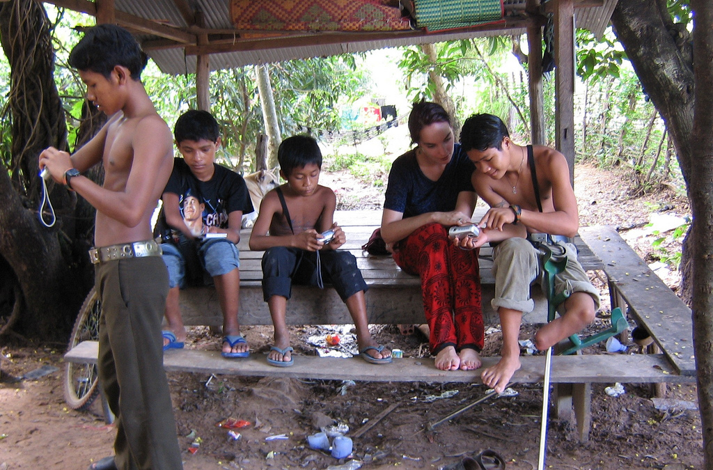
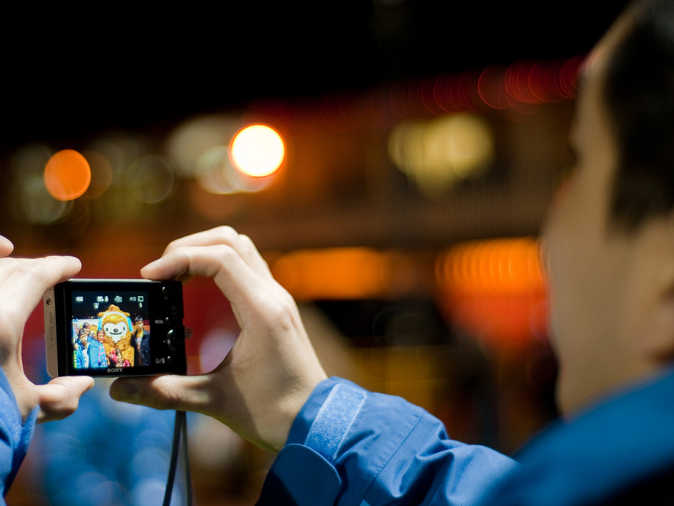
CC Flickr: jeffwilcox, jmpk, ebriel, jwl
Notes:
FAST
Ever since IDEO introduced the first digital camera prototype, there has been a design focus on immediate feedback: from two days to develop film, to looking at your photo moments later. If we want to build a crowd-powered camera, and we want to preserve the users’ expectations, we need to decide on these pictures in realtime.

Slide 7
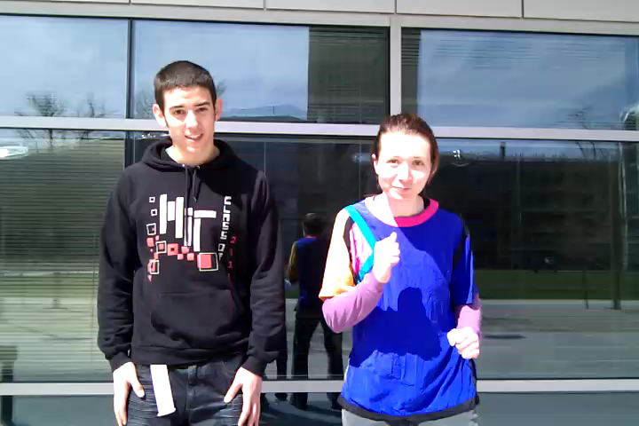
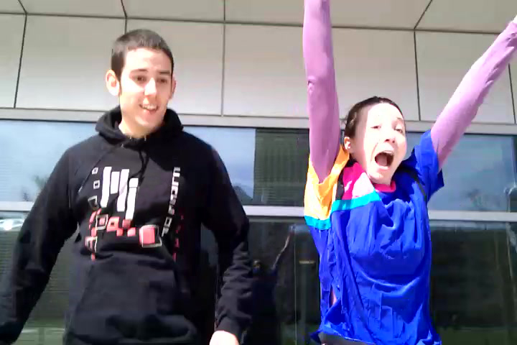
Adrenaline
Realtime Crowd-Powered Camera
Ten second video
Time to final picture:
Notes:
Here’s what it looks like.

Slide 8
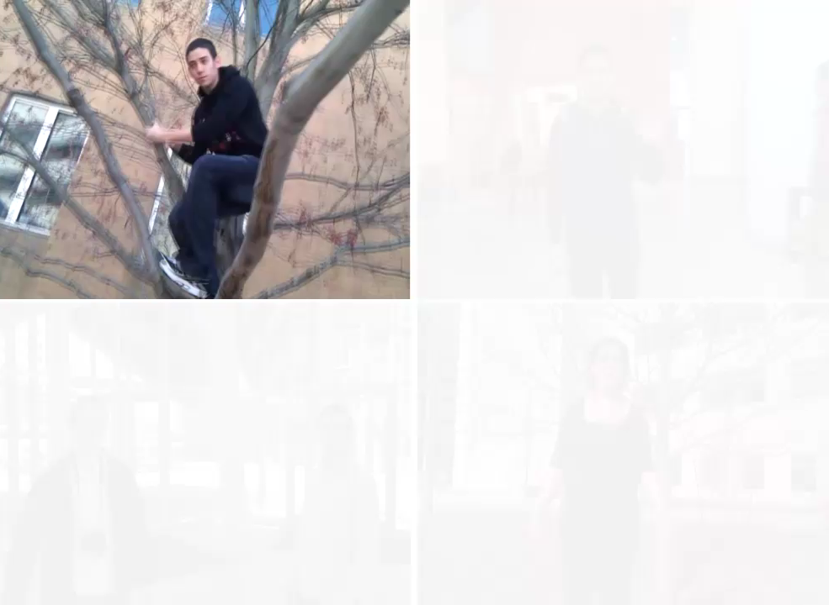
Adrenaline
A Crowd-Powered Camera
Notes:
Here are some examples of shots that people took with adrenaline.

Slide 9
How do we
recruit crowds quickly?
Approach:
Retainer model
Notes:
SLOW
The first technical component we’ll introduce addresses the question…
This is the challenge
This is our approach

Slide 10
Retainer Model
Recruit on-demand crowds
—not just individuals—
two seconds after request.
Introduction
Retainer Model
Rapid Refinement
Evaluation
Discussion
Realtime
Notes:
First technique to get entire groups quickly

Slide 11
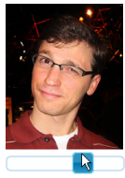
Retainer Model
Sign up in advance
Pay ½¢ per minute to be on call
Alert when task is available
Task:
Move the playback head
to find the best moment.
alert()
Start now!
OK
Wait at most:
5 minutes
Introduction
Retainer Model
Rapid Refinement
Evaluation
Discussion
Realtime
Notes:
FAST
Modal alert that forced the job to be focused in their web browser.

Slide 12
Retainer Experiment
1545 tasks from 280 workers
Manipulate retainer time:
{0.5, 1, 2, 5, 10, 30} minutes
Sample wait time from [0, retainer time]
He leapt the fence and
dashed toward the door.
Measure: time to dismiss the alert
alert()
Start now!
OK
Notes:
“benchmark tasks”

Slide 13
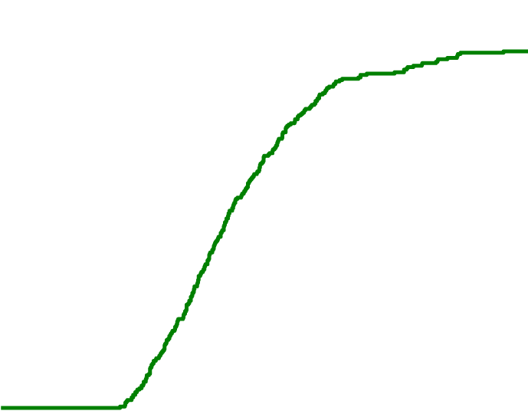
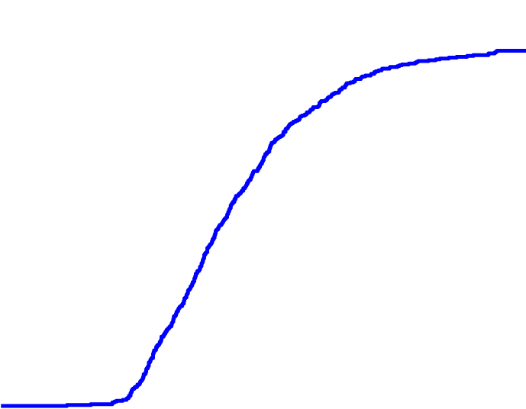
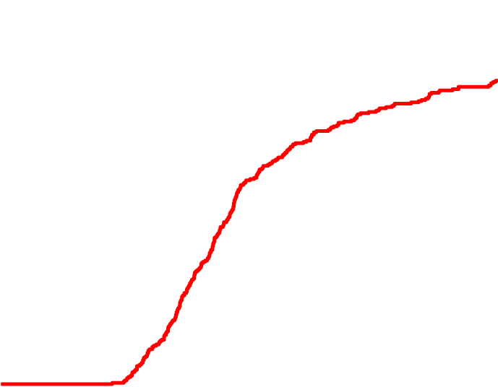
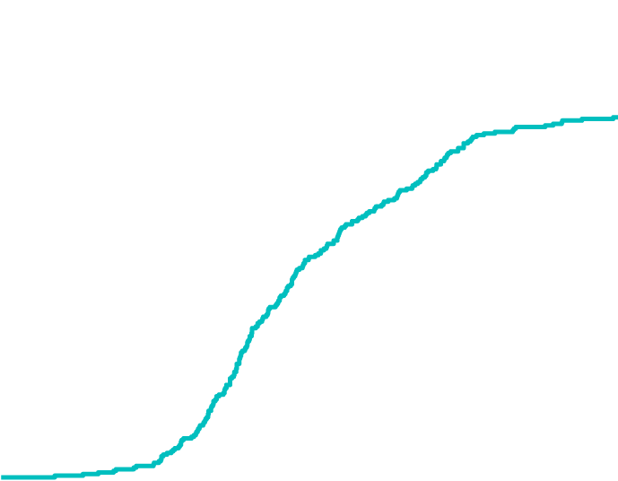
How quickly do retainer workers return?
1.0
0.9
0.8
0.7
0.6
0.5
0.4
0.3
0.2
0.1
0.0
30 sec
1 min
3 min
5 min
% returning in ≤ t
0.0 | 0.5 | 1.0 | 1.5 | 2.0 | 2.5 | 3.0 | 3.5 | 4.0
Time to dismiss alert t (seconds)
For retainer times under ten minutes,
46–61% within 2 seconds.
Notes:
FAST
These seems to be hitting limits on the cognitive recognize-act cycle and motor times, so let me give you a sense of how this works.
We ran an experiment, with 1500 tasks and 280 workers
The cumulative % of workers who have returned in time t or earlier
Now I’m going to show the lines for 30 seconds and 1 minutes
Now what if we have people wait around longer?
[say what’s coming before it appears]

Slide 14
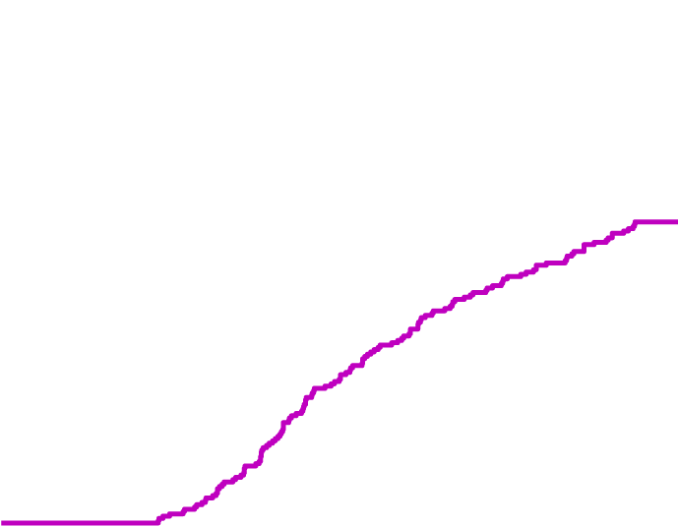
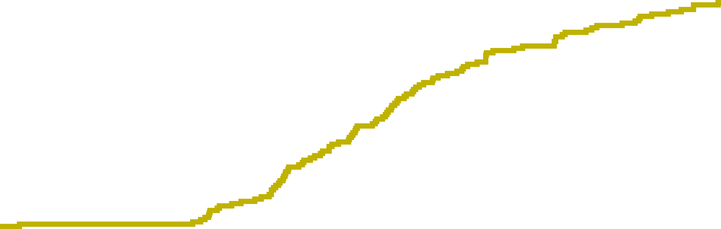
How quickly do retainer workers return?
1.0
0.9
0.8
0.7
0.6
0.5
0.4
0.3
0.2
0.1
0.0
30 sec
1 min
3 min
5 min
% returning in ≤ t
10 min
3¢ bonus
30 min
0.0 | 0.5 | 1.0 | 1.5 | 2.0 | 2.5 | 3.0 | 3.5 | 4.0
Time to dismiss alert t (seconds)
For retainer times under ten minutes,
69–84% within 3 seconds.
Notes:
FAST

Slide 15
How quickly do retainer workers return?
1.0
0.9
0.8
0.7
0.6
0.5
0.4
0.3
0.2
0.1
0.0
30 sec
1 min
3 min
5 min
% returning in ≤ t
10 min
30 min
0.0 | 0.5 | 1.0 | 1.5 | 2.0 | 2.5 | 3.0 | 3.5 | 4.0
Time to dismiss alert t (seconds)
One worker on retainer costs $0.30 / hour.
Notes:
SLOW

Slide 16


A|B: Instant Votes
Five votes in five seconds:
“Which font should I use?”
“Which tie matches better?”
“Which blog headline is catchier?”
Go
Notes:
Here’s an example of how long it actually takes.

Slide 17
The retainer model:
crowds in two seconds
and votes in five seconds.

Slide 18
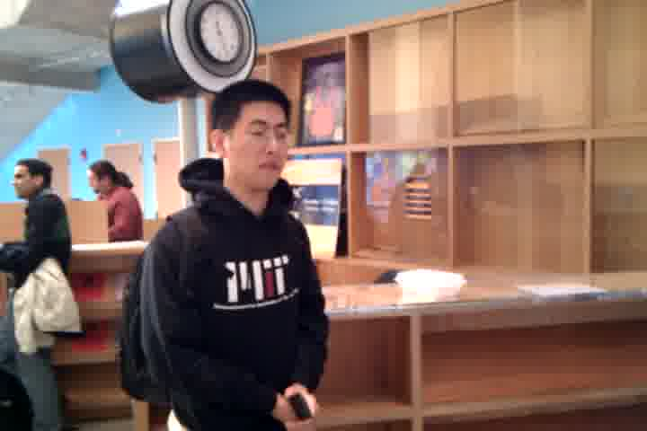
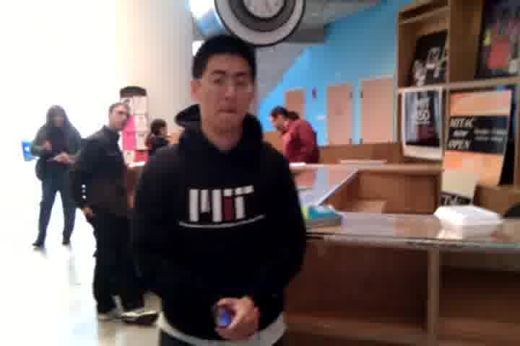
Notes:
FAST

Slide 19
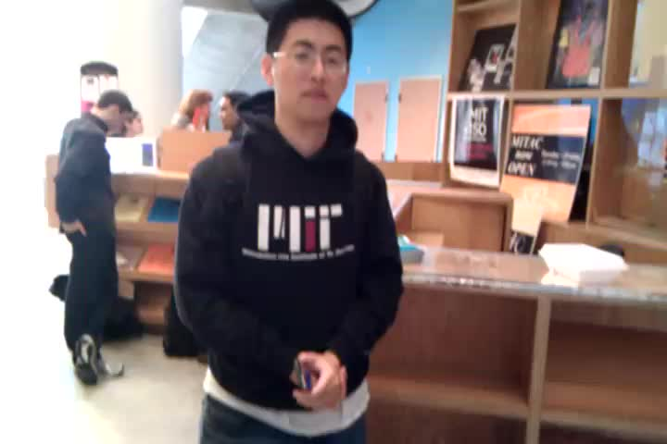
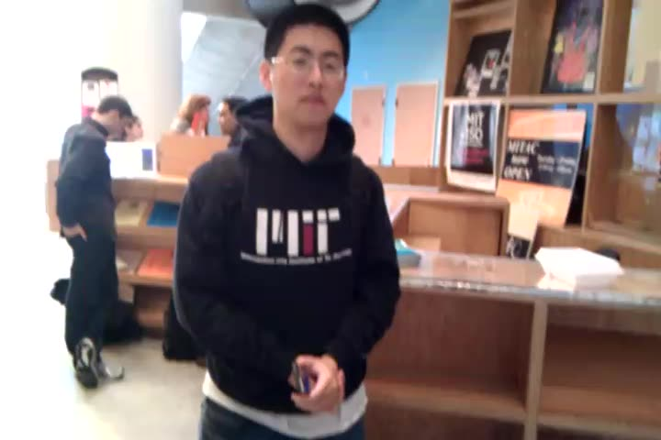

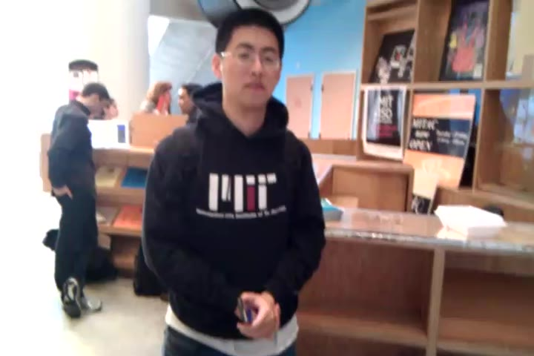
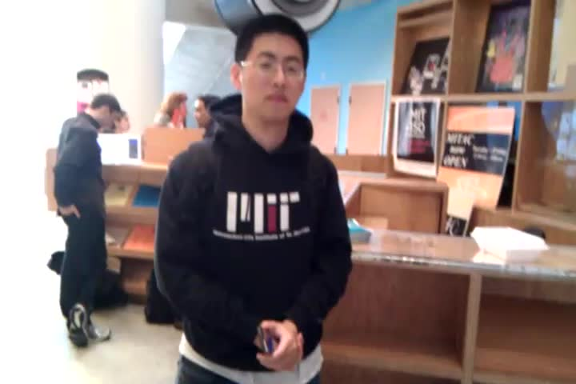


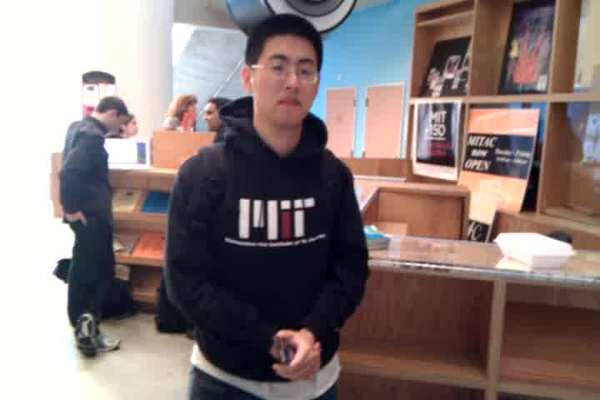
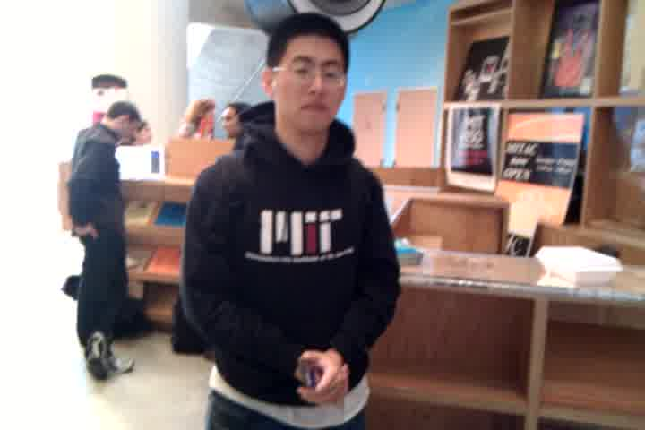
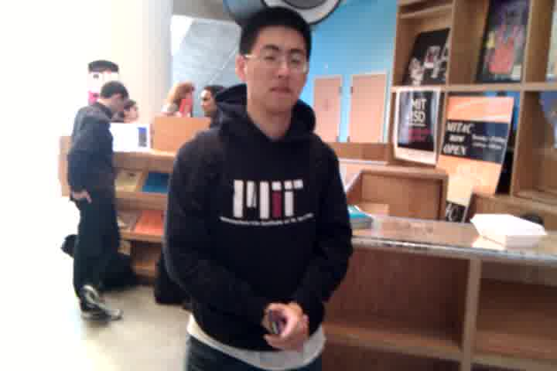
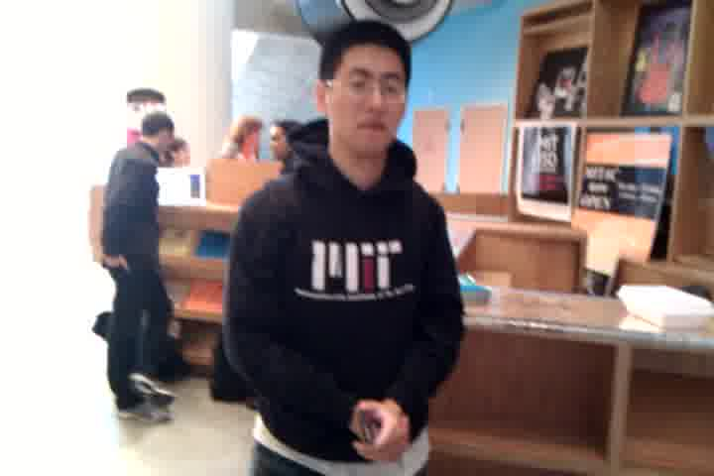

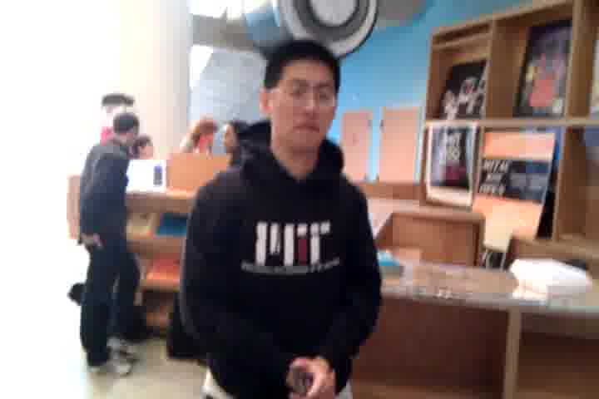
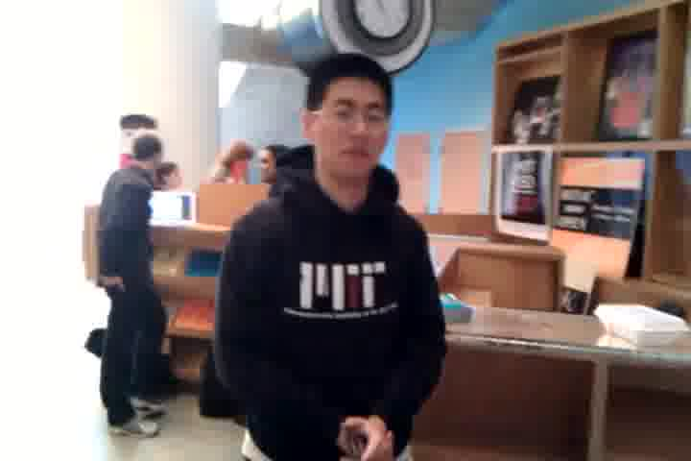
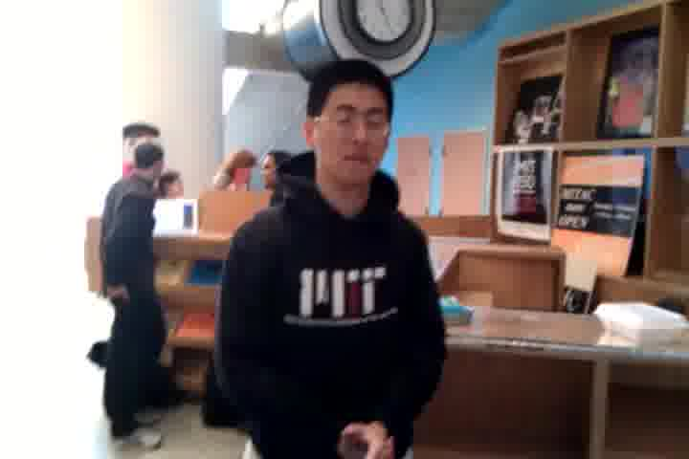
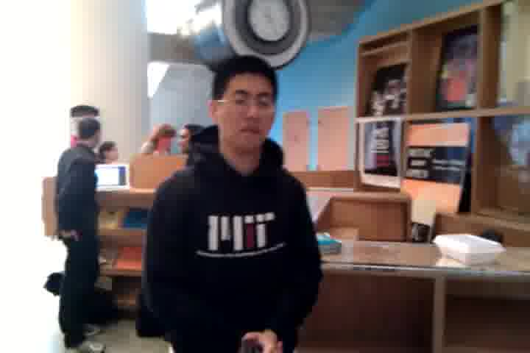
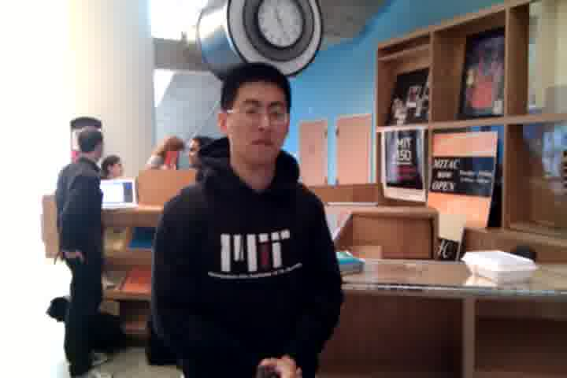
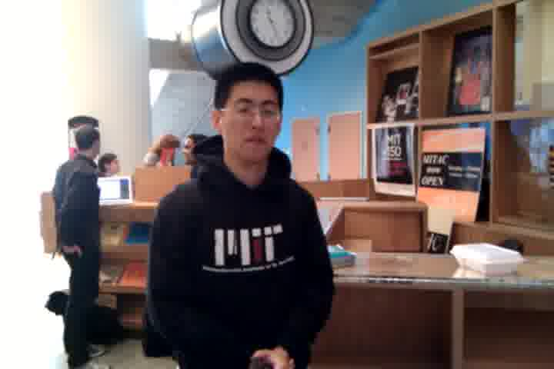
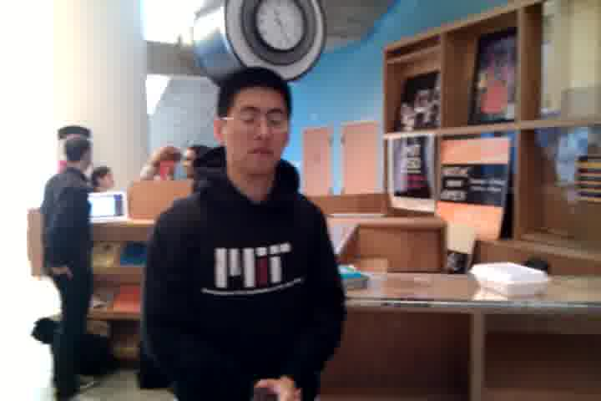
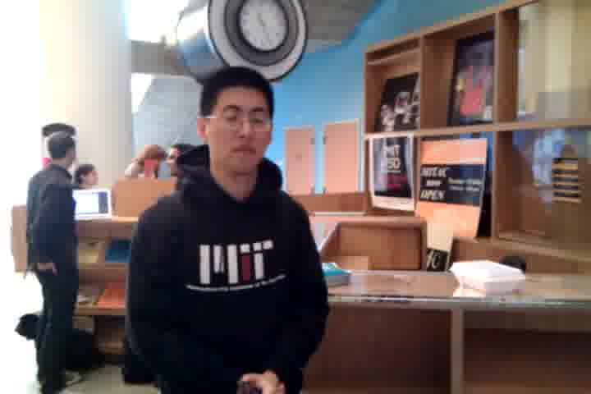
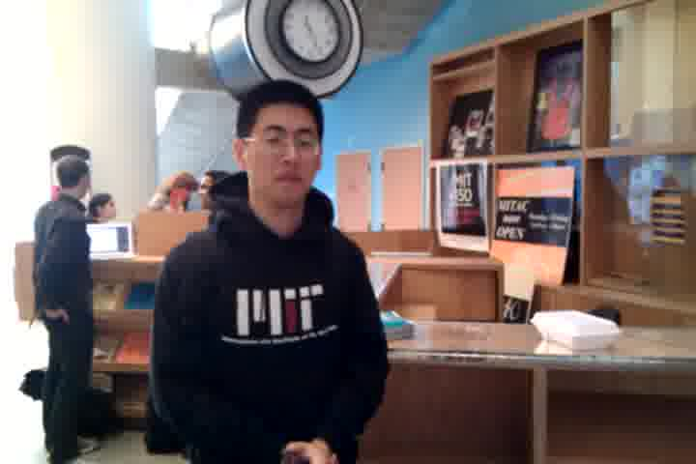
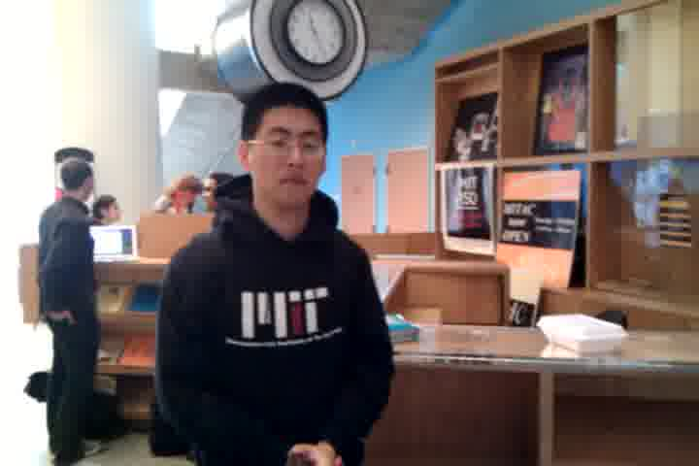
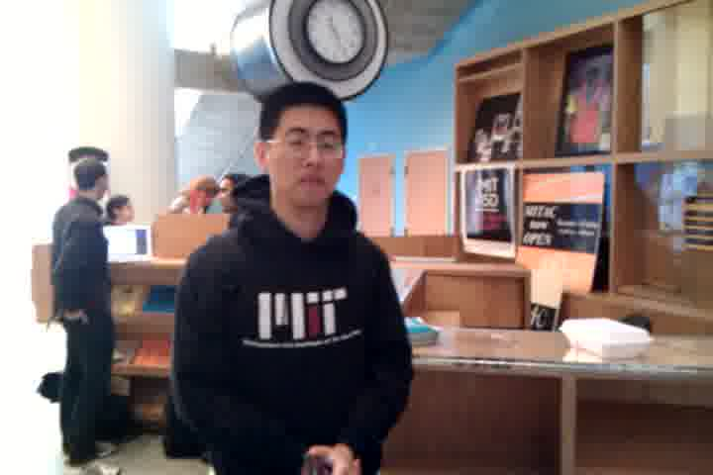
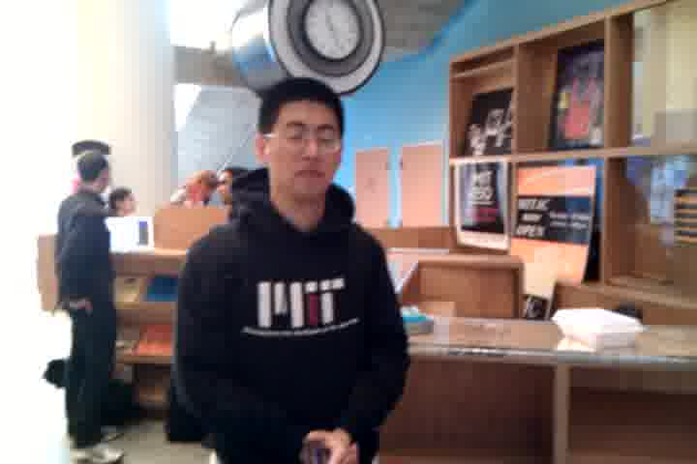
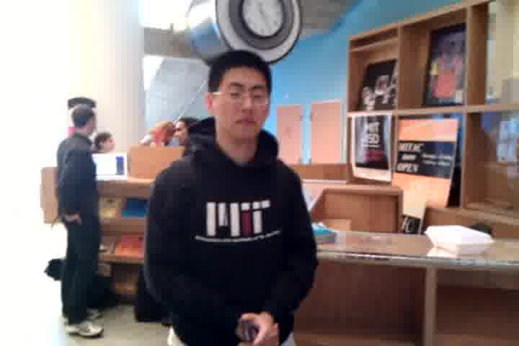
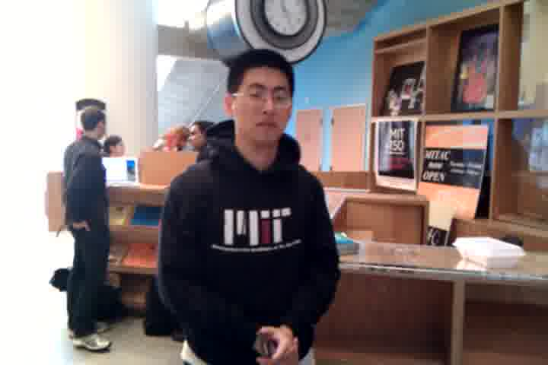
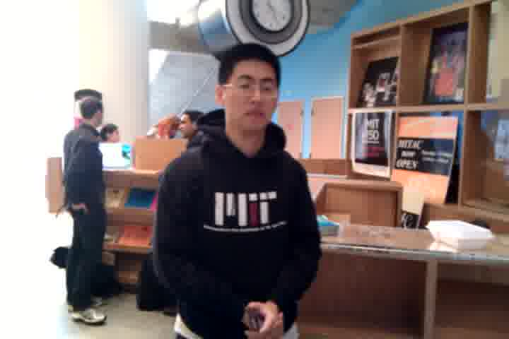
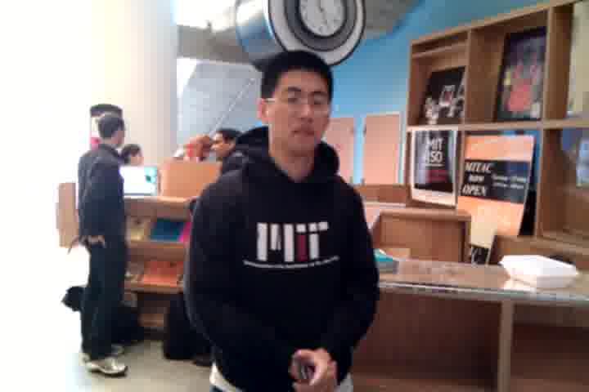
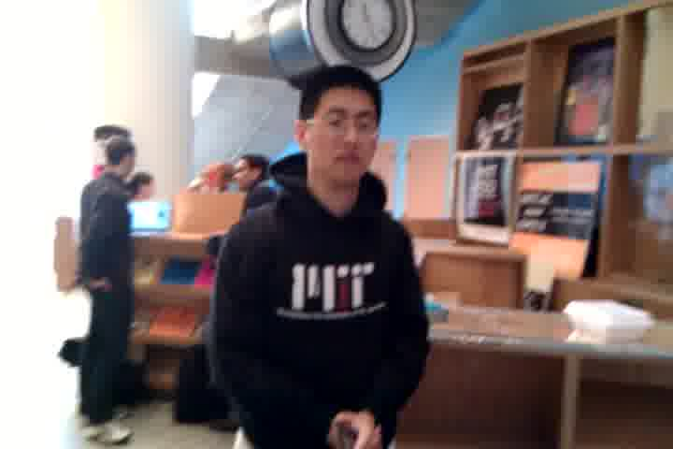
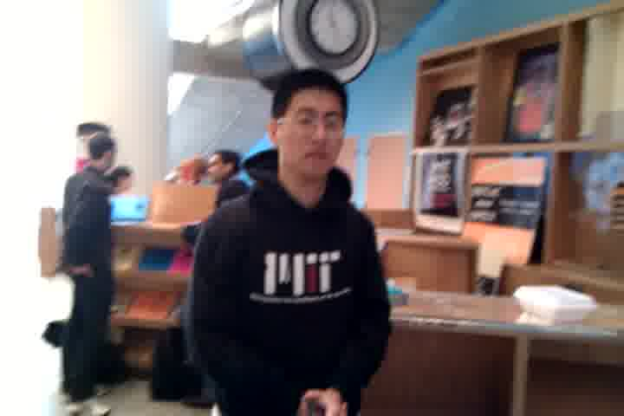
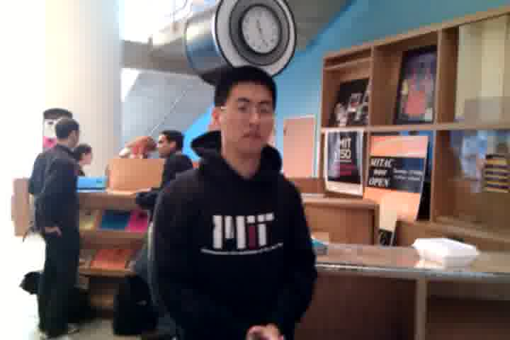
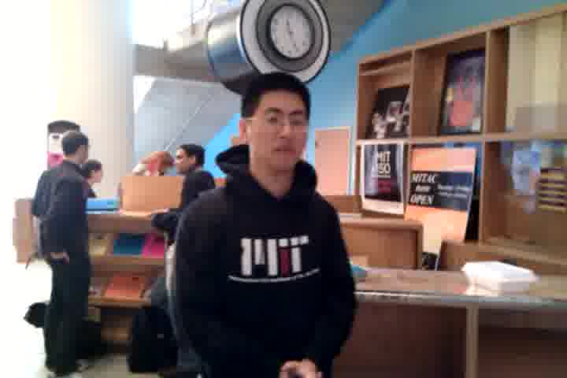
























































Slide 20
How do we overcome
slow work times?
Notes:
Our second technical challenge, now that we can recruit crowds quickly.
Work time is still too long to return responses in realtime.

Slide 21
How do we overcome
slow work times?
Wisdom of the crowd
Smarter than any individual member
[Surowiecki 2004]
Notes:
We didn’t know if it would be true, but we had an intuition that there might be…

Slide 22
How do we overcome
slow work times?
Momentum of the crowd
Faster than any individual member
through synchronous work
Notes:
We didn’t know if it would be true, but we had the insight that it might also be possible to get a “momentum of the crowd”. With the right algorithm behind it, we might be able to get the entire crowd to work faster than any individual member.

Slide 23

Rapid Refinement
Recognize potential agreement early,
then use it to reduce the search space in realtime.
Introduction
Retainer Model
Rapid Refinement
Evaluation
Discussion
Realtime

Slide 24

Rapid Refinement
Worker 1
Worker 2
Worker 3
Notes:
FAST FAST

Slide 25
Rapid Refinement
Worker 1
while (searchArea.size > 1):
a = calculateAgreement(workerPositions,
searchArea,
refinementRatio)
# a.percent = 0.00
if (a.percent > 0.30):
if (a.duration >= 2):
searchArea.left = a.left
searchArea.right = a.right
Worker 2
Worker 3

Slide 26
Rapid Refinement
Two
Seconds
Worker 1
while (searchArea.size > 1):
a = calculateAgreement(workerPositions,
searchArea,
refinementRatio)
# a.percent = 0.66
if (a.percent >= 0.66):
if (a.duration >= 2):
searchArea.left = a.left
searchArea.right = a.right
Worker 2
Worker 3

Slide 27





Rapid Refinement
Worker 1
Worker 2
Worker 3

Slide 28


Slide 29
Evaluation
Do the retainer model and rapid refinement produce realtime results?
What are their failure modes?
Introduction
Retainer Model
Rapid Refinement
Evaluation
Discussion
Realtime
Notes:
We will use Adrenaline as a benchmark task to understand how these approaches perform.
100 frames per video

Slide 30

Notes:
We gave 24 participants cell phones with Adrenaline and asked them to take video photos

Slide 31
Choosing and Rating Photos
Method
Measured speed and participant-rated quality
Five photograph selection algorithms:
1
Rapid Refinement
2
Professional Photographer
3
Computer Vision
4
Generate-and-Vote
crowd
5
Generate-One

Slide 32
Rapid Refinement
Computer Vision
Photographer
μ=5.8, σ=2.2
μ=4.9, σ=2.2
μ=6.4, σ=2.3
9 point Likert scale on self-rated quality
Notes:
Biggest challenge: too-fast agreement in late stages

Slide 33
Rapid Refinement
Computer Vision
Photographer
μ=5.8, σ=2.2
μ=4.9, σ=2.2
μ=6.4, σ=2.3
Good Photos
Typical Photos
Notes:
Biggest challenge: too-fast agreement in late stages

Slide 34
Rapid Refinement
Computer Vision
Photographer
μ=5.8, σ=2.2
μ=4.9, σ=2.2
μ=6.4, σ=2.3
Good Photos
Typical Photos
Agreement misfire
Bad Photos
Notes:
Biggest challenge: too-fast agreement in late stages

Slide 35
Rapid refinement fastest, with least timing variance
Results
Algorithm | Histogram of Execution Times N=72 photos
Rapid Refinement
Generate One
Generate and Vote
μ=12.6 sec, σ=2.2 sec
22¢
μ=16.3 sec, σ=9.8 sec
22¢
μ=45.3 sec, σ=14.0 sec
53¢
ANOVA with pairwise posthoc tests p < .05

Slide 36
Tradeoffs in Rapid Refinement
Strengths:
- Quick preliminary results (10 sec)
- Combines work and verification
Weaknesses:
- Sacrifices quality for speed
- Stifles individual creativity
Generalizability:
- Any continuous search space
(e.g., parameter tuning)

Slide 37
The retainer model
and rapid refinement
execute large searches
in roughly ten seconds.

Slide 38

Introduction
Retainer Model
Rapid Refinement
Evaluation
Discussion
Realtime
Notes:
These techniques are useful for other applications as well. Suppose we wanted to embed crowds in a graphic design program to help generate realistically varying art assets.

Slide 39

With eight workers on retainer:
First movement: 2.1 seconds
First figure complete: 25.0 seconds
New figure completed: every 3.3 seconds
Notes:
With 8 workers on retainer: out to 300 total

Slide 40
The Future of Realtime Crowds
Synchronous crowds change the focus
from divide-and-conquer to collaboration:
Simultaneous authoring [Kittur 2010]
Distributed teams
How might we design a crowdsourcing market
to support realtime requests?
Notes:
Queueing theory, “following” model, …

Slide 41
Crowds in Two Seconds
Enabling Realtime
Crowd-Powered Interfaces
Realtime crowd-powered interfaces
Techniques for fast, synchronous crowds:
Retainer Model
Rapid Refinement
1.
2.
Notes:
Where the fastest crowd-powered interfaces used to be limited by a median response time of nearly a minute
Retainer Model to gather synchronous crowds quickly
Rapid Refinement coordinates work for faster results

Slide 43
Retainer Model
We need to gather flash crowds:
not just individuals, but entire groups, and quickly
Mechanical Turk
Post task
Worker accepts task
Worker begins task
Worker completes task
Introduction
Retainer Model
Continuous Ref.
Evaluation
Discussion
Adrenaline

Slide 44
Retainer Model
We need to gather flash crowds:
not just individuals, but entire groups, and quickly
QuikTurKit [Bigham et al. 2010]
Retainer Model
Post task
Worker accepts task
Worker begins task
Worker completes task
Post task
Worker accepts task
Pay 0.5–1¢ per minute to wait on retainer
Notify worker
to begin task
Worker completes task

Slide 45
Retainer Model Discussion
With long waits, offer a bonus when
workers respond quickly
Ten-minute wait:
Without 3¢ bonus: 25% in two seconds
With 3¢ bonus: 61% in two seconds
One worker on retainer costs $0.30 / hour.
Notes:
If time to create, show same graph

Slide 46

Retainer Design Experiment
Four designs:
1
Baseline
(no alert)

Slide 47

Retainer Design Experiment
Four designs:
1
Baseline
(no alert)
playAudio(“alert_chime.mp3”);
alert(“Start now!”);
2
Alert

Slide 48

Retainer Design Experiment
Four designs:
1
Baseline
(no alert)
2
Alert
3
Game

Slide 49
Retainer Design Experiment
Four designs:
1
3¢ bonus
for dismissing
the alert
within 2 seconds
Baseline
(no alert)
2
Alert
3
Game
4
Reward
Between subjects, N=1913 tasks

Slide 50

Retainer Time Results
A small reward brought 61% of workers back within 2 seconds, and 75% within 3 seconds.
(Performance similar to 2-minute retainer w/o bonus)

Slide 51
Results: Quality
Rapid Refinement had lower variance
than Generate-One.
(σ=2.2 vs. σ=2.6 on a 9-point Likert scale)
Generate-and-Vote matches the professional photographer.
(μ=6.6 vs. μ=6.4)
Cost:
Rapid Refinement and Generate-One: 22¢
Generate-and-Vote: 53¢
Notes:
Live system: closer to ten cents (use fewer workers)

Slide 52
Results: Delay

