Slide 1



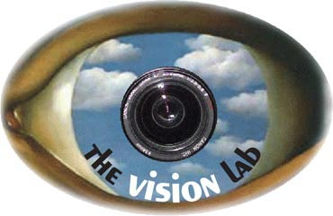

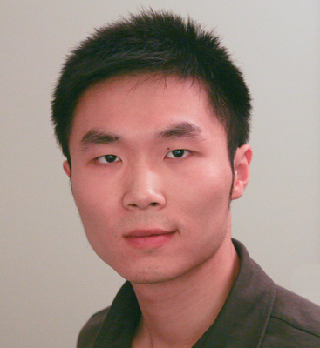
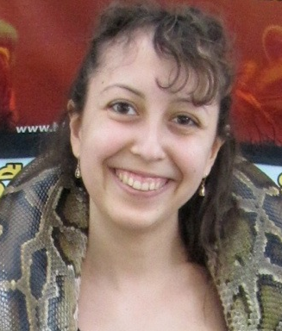

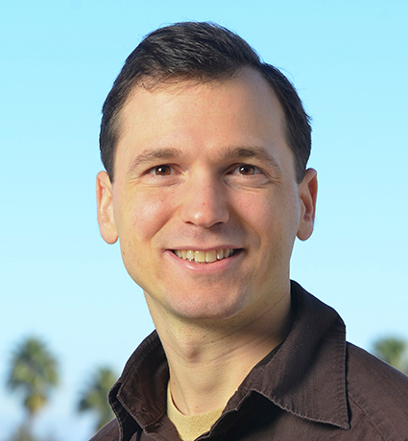
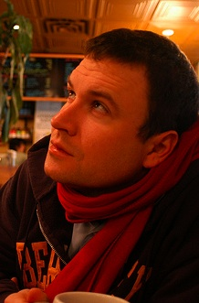
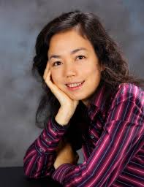
Scalable Multi-Label Annotation
Jia Deng Olga Russakovsky Jonathan Krause, Michael Bernstein Alexander Berg Li Fei-Fei
Notes:
This is work with a great group of Stanford students and professors at Michigan, Stanford, and UNC Chapel Hill.
I am the one down here.

Slide 2
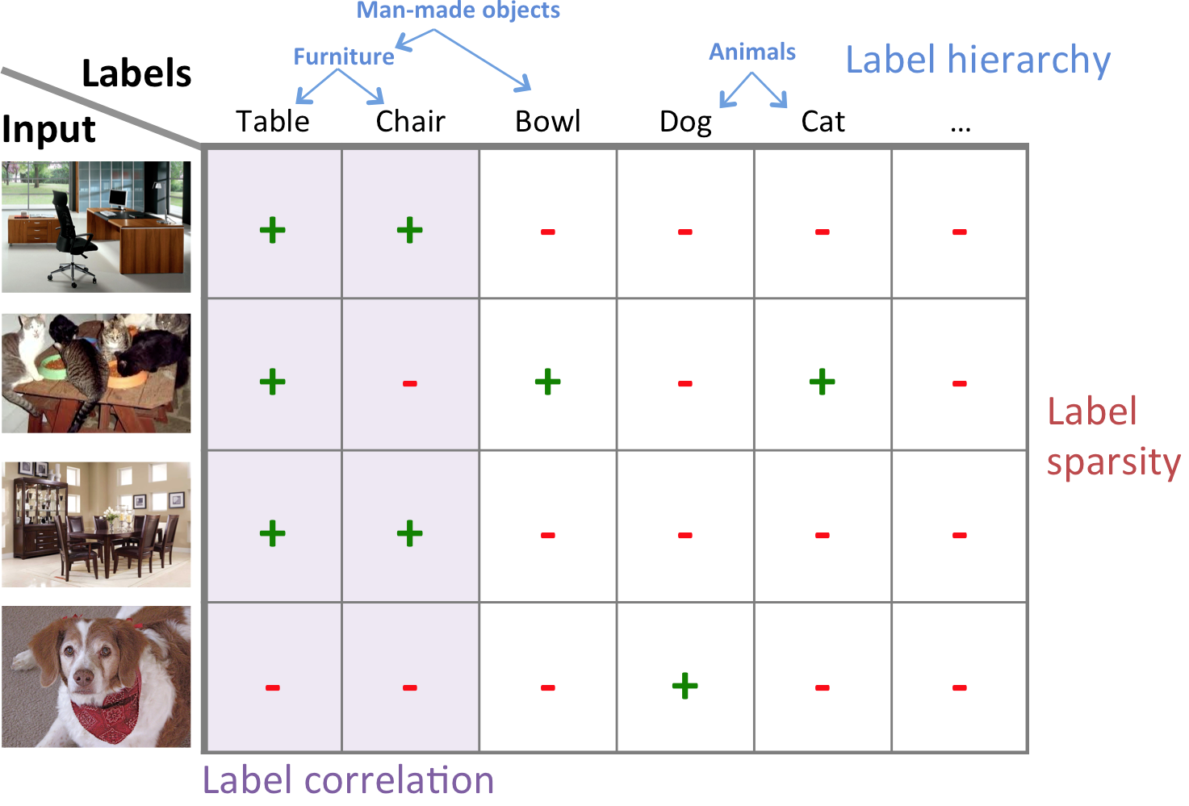
Multi-label annotation
Data Item
Labels
Table | Chair | Horse | Dog | Cat | Bird
+ | + | - | - | - | -
Task: Crowdsource object labels for images.
Application: Benchmarking, training, modeling
Generalization:
musical attributes of songs
actions in movies
sentiments in documents
Notes:
In Multi-Label Annotation, we want to specify multiple labels (here shown with binary values) for a data item, in this case the image. We are coming to this problem as computer vision researchers, so performed experiments with image annotation, but the general idea of large-scale acquisition of multiple labels is quite general, for instance labeling properties of music, actions in videos or movies, or sentiment about entities in documents.

Slide 3
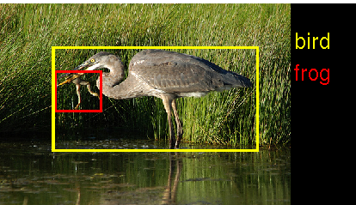
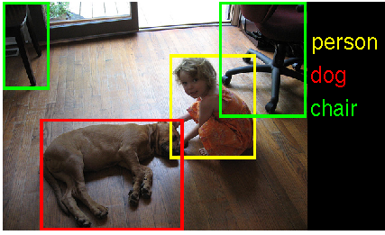
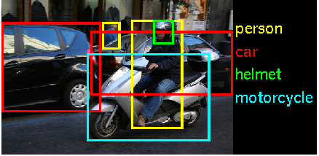
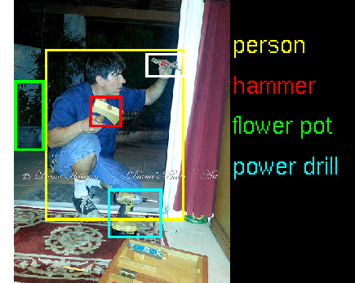


















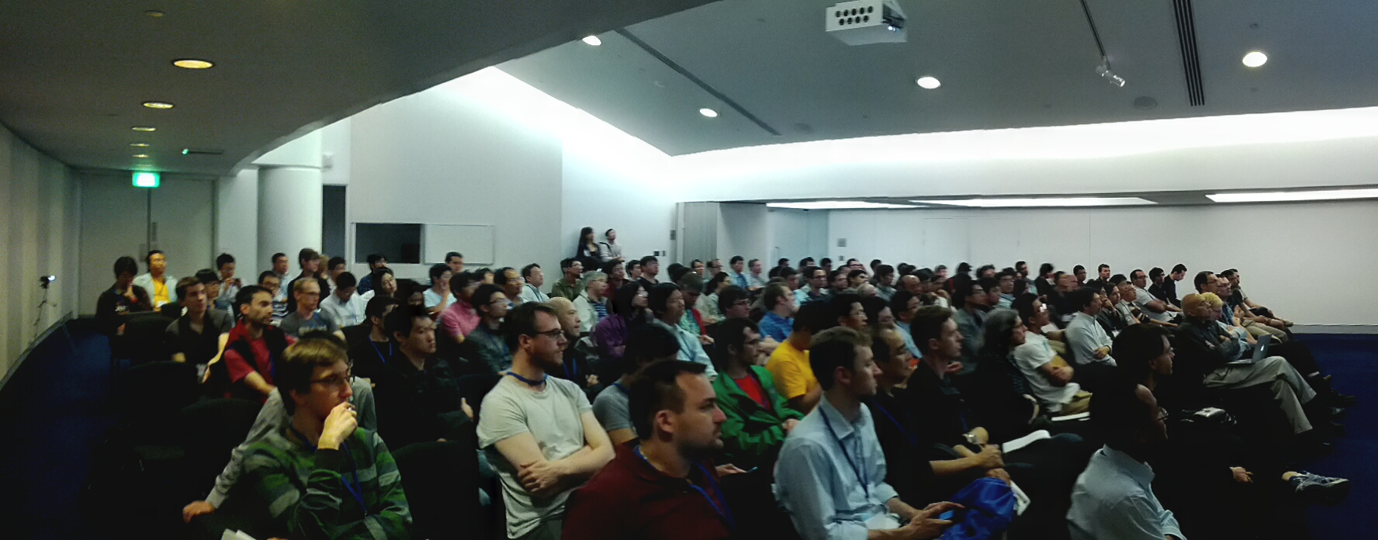
Large-Scale Visual Recognition Challenge
ILSVRC 2010-2014
Current focus:
200 Category Detection
(~100,000 fully labeled images)
Notes:
Our immediate motivation was annotation for the Large Scale Visual Recognition Challenge which we have been organizing since 2010.
Over the years this challenge has become a focal point for folks in computer vision working on image classification, retrieval, and object detection, with groups from around the world using and reporting results on the dataset – including some very high profile work at the university of toronto!
In the last year and half we significantly increased the complexity of labeling for this challenge to label bounding boxes for 200 categories in ~100,000 images – more than 20 million labels.
Even if each label costs a small fraction of cent, the cost for this scale of annotation adds up!
In computer vision we have seen (and hope to continue seeing) an enormous benefit this large scale annotation effort!

Slide 4


Naïve approach: ask for each object
Table | Chair | Horse | Dog | Cat | Bird
? | ? | ? | ? | ? | ?
Question
Is there a table?
Machine
Crowd
Answer
Yes
cost:
estimation:
use the crowd-machine diagram
show UI.

Slide 5
Naïve approach: ask for each object
Table | Chair | Horse | Dog | Cat | Bird
+ | ? | ? | ? | ? | ?
Question
Is there a table?
Machine
Crowd
Answer
Yes
cost:
estimation:
use the crowd-machine diagram
show UI.

Slide 6
Naïve approach: ask for each object
Table | Chair | Horse | Dog | Cat | Bird
+ | + | ? | ? | ? | ?
Question
Is there a chair?
Machine
Crowd
Answer
Yes
cost:
estimation:
use the crowd-machine diagram
show UI.

Slide 7
Naïve approach: ask for each object
Table | Chair | Horse | Dog | Cat | Bird
+ | + | - | ? | ? | ?
Question
Is there a horse?
Machine
Crowd
Answer
No
cost:
estimation:
use the crowd-machine diagram
show UI.

Slide 8
Naïve approach: ask for each object
Table | Chair | Horse | Dog | Cat | Bird
+ | + | - | - | ? | ?
Question
Is there a dog?
Machine
Crowd
Answer
No
cost:
estimation:
use the crowd-machine diagram
show UI.

Slide 9
Naïve approach: ask for each object
Table | Chair | Horse | Dog | Cat | Bird
+ | + | - | - | - | ?
Question
Is there a cat?
Machine
Crowd
Answer
No
cost:
estimation:
use the crowd-machine diagram
show UI.

Slide 10
Naïve approach: ask for each object
Table | Chair | Horse | Dog | Cat | Bird
+ | + | - | - | - | -
Question
Is there a bird?
Machine
Crowd
Answer
No
cost:
estimation:
use the crowd-machine diagram
show UI.

Slide 11
Naïve approach: ask for each object
Cost: O(NK) for N images and K objects
Table | Chair | Horse | Dog | Cat | Bird
+ | + | - | - | - | -
+ | - | - | - | + | -
+ | + | - | - | - | -
Notes:
Again the naïve approach for N data items and K labels would require N times K questions – even if each one costs a fraction of a penny, these things add up when we are talking about millions of questions!

Slide 12
Hierarchy
Animal
Furniture
Mammal
Table | Chair | Horse | Dog | Cat | Bird
+ | + | - | - | - | -
Notes:
BY 2:30
Our main idea in this paper is to take advantage of structure between the labels, and patterns in which labels appear in a particular data item.

Slide 13
Hierarchy
Animal
Mammal
Furniture
Table | Chair | Horse | Dog | Cat | Bird
+ | + | - | - | - | -
+ | - | - | - | + | -
+ | + | - | - | - | -
Correlation
Sparsity
Notes:
Give an example. why it is useful. generalize to multiple domains.

Slide 14
Better approach: exploit label structure
Animal
Furniture
Mammal
Table | Chair | Horse | Dog | Cat | Bird
? | ? | ? | ? | ? | ?
Question
Machine
Crowd
Answer
Notes:
Give an example. why it is useful. generalize to multiple domains.

Slide 15
Better approach: exploit label structure
Animal
Furniture
Mammal
Table | Chair | Horse | Dog | Cat | Bird
? | ? | ? | ? | ? | ?
Question
Is there an animal?
Machine
Crowd
Answer
No
Notes:
Give an example. why it is useful. generalize to multiple domains.

Slide 16
Better approach: exploit label structure
Animal
Furniture
Mammal
Table | Chair | Horse | Dog | Cat | Bird
? | ? | - | - | - | -
Question
Is there an animal?
Machine
Crowd
Answer
No
Notes:
Give an example. why it is useful. generalize to multiple domains.

Slide 17
Better approach: exploit label structure
Animal
Furniture
Mammal
Table | Chair | Horse | Dog | Cat | Bird
? | ? | - | - | - | -
Question
Is there furniture?
Machine
Crowd
Answer
Yes
Notes:
Give an example. why it is useful. generalize to multiple domains.

Slide 18
Better approach: exploit label structure
Animal
Furniture
Mammal
Table | Chair | Horse | Dog | Cat | Bird
? | ? | - | - | - | -
Question
Is there a table?
Machine
Crowd
Answer
Yes
Notes:
Give an example. why it is useful. generalize to multiple domains.

Slide 19
Better approach: exploit label structure
Animal
Furniture
Mammal
Table | Chair | Horse | Dog | Cat | Bird
+ | ? | - | - | - | -
Question
Is there a chair?
Machine
Crowd
Answer
Yes
Notes:
Give an example. why it is useful. generalize to multiple domains.

Slide 20
Better approach: exploit label structure
Animal
Furniture
Mammal
Table | Chair | Horse | Dog | Cat | Bird
+ | + | - | - | - | -
Question
Is there a chair?
Machine
Crowd
Answer
Yes
Notes:
Give an example. why it is useful. generalize to multiple domains.

Slide 21
Selecting the Right Question
Goal:
Get as much utility (new labels) as possible,
for as little cost (worker time) as possible,
given a desired level of accuracy
Notes:
The underlying question is, what QUESTIONS should we be asking.
We consider some criteria – we want as much utility as possiible, each questions provides as many new labels as possible, we want the questions to require a small amount of worker time to answer, and we want the resulting answers and labels to be accurate. We will talk about these in reverse order

Slide 22
Accuracy constraint
User-specified accuracy threshold, e.g., 95%
Majority voting assuming uniform worker quality
  [GAL: Sheng, Provost, Ipeirotis KDD ‘08]
Might require only one worker, might require several based on the task
Notes:
First, to ensure ACCURACY we follow an approach like GAL, calibrated on a some held out data to determine how many times we need to get another label in order to achieve the desired accuracy for a particular question.

Slide 23
Cost: worker time (time = money)
expected human time to get an answer with 95% accuracy
Question (is there …) | Cost (second)
a thing used to open cans/bottles | 14.4
an item that runs on electricity (plugged in or using batteries) | 12.6
a stringed instrument | 3.4
a canine | 2.0
Notes:
Next we consider the time-cost of each question -- Here are some examples of questions and the worker time required in seconds. We can have complicated question like “is there a thing used to open cans or bottles?” or a simpler question like is there a canine? These time-costs reflect that we sometimes need to ask multiple users to achieve the desired expected accuracy.

Slide 24
Utility: expected # of new labels
Table | Chair | Horse | Dog | Cat | Bird
+ | ? | ? | ? | ? | ?
Yes
Table | Chair | Horse | Dog | Cat | Bird
? | ? | ? | ? | ? | ?
No
Table | Chair | Horse | Dog | Cat | Bird
- | ? | ? | ? | ? | ?
Is there a table?
utility = 1
Notes:
Now we can look at the utility of a question – how many new labels is it expected to provide.
If we ask about a particular label the utility is 1.
We can also ask a higher level question…

Slide 25
Utility: expected # of new labels
Table | Chair | Horse | Dog | Cat | Bird
+ | ? | ? | ? | ? | ?
Yes
Table | Chair | Horse | Dog | Cat | Bird
? | ? | ? | ? | ? | ?
No
Table | Chair | Horse | Dog | Cat | Bird
- | ? | ? | ? | ? | ?
Is there a table?
utility = 1
Pr(Y) = 0.5
Table | Chair | Horse | Dog | Cat | Bird
? | ? | ? | ? | ? | ?
Table | Chair | Horse | Dog | Cat | Bird
? | ? | ? | ? | ? | ?
Table | Chair | Horse | Dog | Cat | Bird
? | ? | - | - | - | -
Is there an animal?
Pr(N) = 0.5
utility = 0.5 * 0 + 0.5 * 4 = 2
Notes:
Here we combine a prior on the outcome of the question (in this example it is uniform, but in practice we estimate this on data) to find the expected utility.
----- Meeting Notes (4/30/14 17:00) -----
5.5

Slide 26
Selecting the Right Question
Pick the question with the most labels per second
Query: Is there a... | Utility (num labels) | Cost (worker time in secs) | Utility-Cost Ratio (labels per sec)
mammal with claws or fingers | 12.0 | 3.0 | 4.0
living organism | 24.8 | 7.9 | 3.1
mammal | 17.6 | 7.4 | 2.4
creature without legs | 5.9 | 2.6 | 2.3
land or avian creature | 20.8 | 9.5 | 2.2
Notes:
So we have a constraint on accuracy, and then consider the utility to cost ratio in order to select the next question to ask. Again this will depend on what labels we already know – utility measures how many new labels we expect…

Slide 27
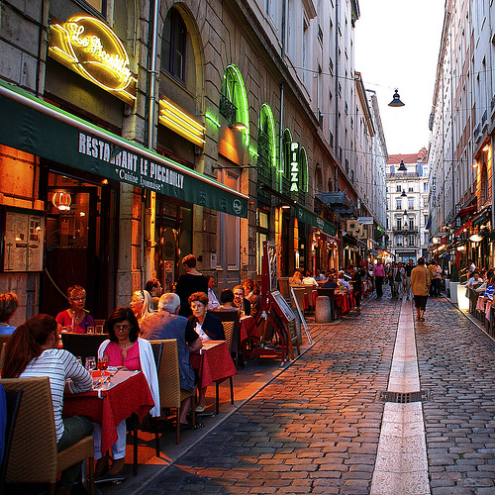
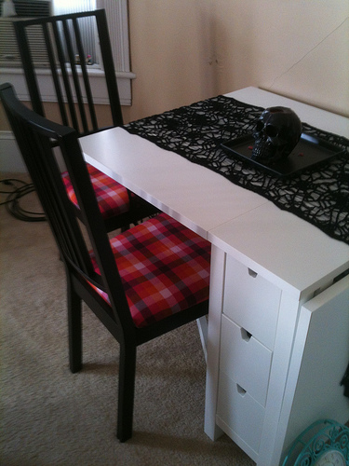
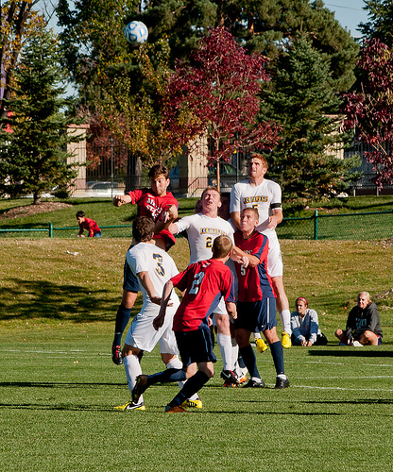
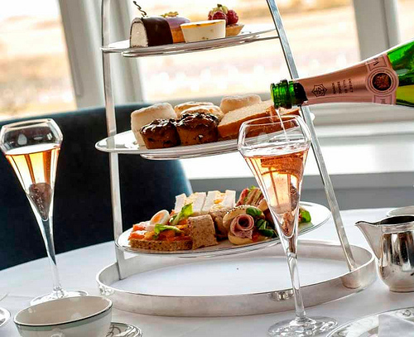
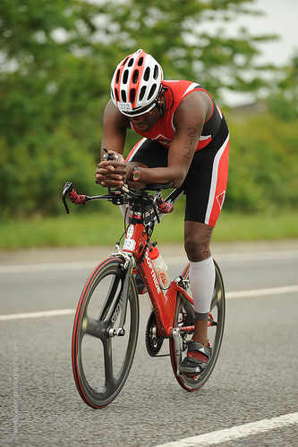
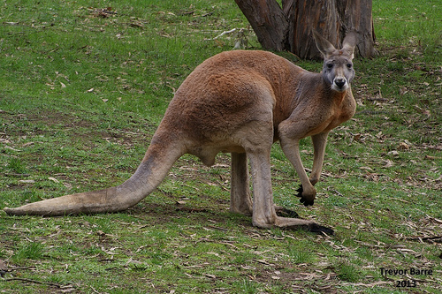
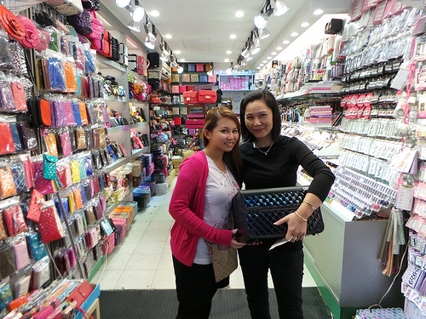
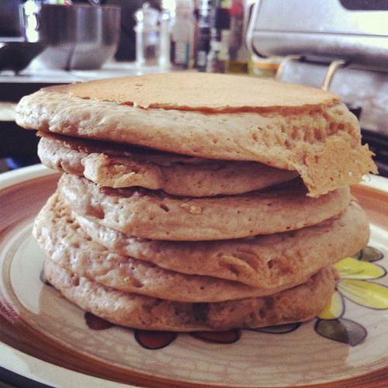
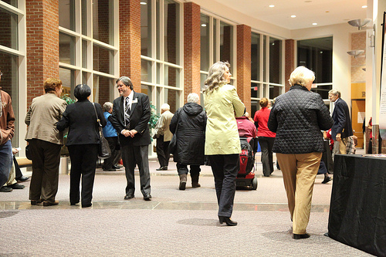
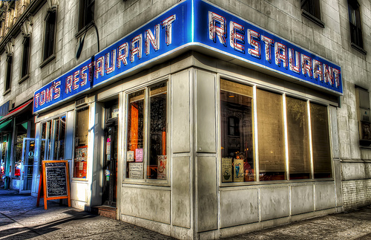
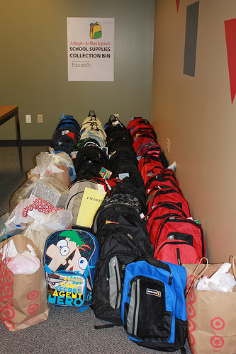
Results
Dataset: 20K images from ImageNet Challenge 2013.
Labels: 200 basic categories (dog, cat, table…), 64 internal nodes in hierarchy
Notes:
Need at least 1 minute
For the experiments in this paper we consider labeling a subset of the imagenet challenge data from 2013.

Slide 28
Results
Dataset: 20K images from ImageNet Challenge 2013.
Labels: 200 basic categories (dog, cat, table…), 64 internal nodes in hierarchy
Setup:
  50-50 training test split
  Estimate parameters on training, simulate on test
  Future work: online estimation
Notes:
With 200 labels (basic categories like dog, cat, table, bike, etc.) in a hierarchy with 64 internal nodes, 5050 train test leaves 2million labels for naïve, a large scale test.

Slide 29
Results: accuracy
Annotating 10K images with 200 objects
Accuracy Threshold per question (parameter) | Accuracy (F1 score) Naïve approach | Accuracy (F1 score) Our approach
0.95 | 99.64 (75.67) | 99.75 (76.97)
0.90 | 99.29 (60.17) | 99.62 (60.69)
Notes:
First we verify that we are achieving our desired high accuracy in labels – we are well above 99% and at least as good as the naïve (and more expensive) approach.

Slide 30
Results: cost
Annotating 10K images with 200 objects
Accuracy Threshold per question (parameter) | Cost saving (our approach compared to naïve approach)
0.95 | 3.93x
0.90 | 6.18x

Slide 31
Results: cost
Annotating 10K images with 200 objects
6 times more labels per second
Accuracy Threshold per question (parameter) | Cost saving (our approach compared to naïve approach)
0.95 | 3.93x
0.90 | 6.18x

Slide 32
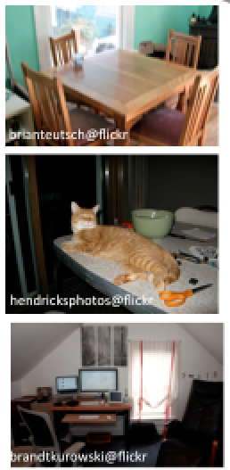
Conclusions
Speeds up crowdsourced multi-label annotation by exploiting the structure and distribution of labels.
Could be a bargain for you!
Animal
Hierarchy
Mammal
Furniture
Table | Chair | Horse | Dog | Cat | Bird
+ | + | - | - | - | -
+ | - | - | - | + | -
+ | + | - | - | - | -
Sparsity
Correlation

Slide 34
Better approach: exploiting hierarchy, sparsity and correlation
Animal
Mammal
Furniture
Table | Chair | Horse | Dog | Cat | Bird
? | ? | ? | ? | ? | ?
Question
Is there an animal?
Machine
Crowd
Answer
No
Notes:
Give an example. why it is useful. generalize to multiple domains.

Slide 35
Better Approach
Animal
Mammal
Furniture
Table | Chair | Horse | Dog | Cat | Bird
? | ? | - | - | - | -
Question
Is there an animal?
Machine
Crowd
Answer
No
Notes:
Give an example. why it is useful. generalize to multiple domains.

Slide 36
Better Approach
Animal
Mammal
Furniture
Table | Chair | Horse | Dog | Cat | Bird
? | ? | - | - | - | -
Question
Is there furniture?
Machine
Crowd
Answer
Yes
Notes:
Give an example. why it is useful. generalize to multiple domains.

Slide 37
Better Approach
Animal
Mammal
Furniture
Table | Chair | Horse | Dog | Cat | Bird
+ | ? | - | - | - | -
Question
Is there a table?
Machine
Crowd
Answer
Yes
Notes:
Give an example. why it is useful. generalize to multiple domains.

Slide 38
Better Approach
Animal
Mammal
Furniture
Table | Chair | Horse | Dog | Cat | Bird
+ | + | - | - | - | -
Question
Is there a chair?
Machine
Crowd
Answer
Yes
Notes:
Give an example. why it is useful. generalize to multiple domains.

Slide 39
Algorithm
Initialize all labels to ‘missing’
While there are missing labels do
  Select a question Q from all possible questions
  Obtain an answer A to question Q from the crowd
  Set values of some labels to +1 or -1

Slide 40
Algorithm
Initialize all labels to ‘missing’
While there are missing labels do
  Select a question Q from all possible questions
  Obtain an answer A to question Q from the crowd
  Set values of some labels to +1 or -1

