Slide 1
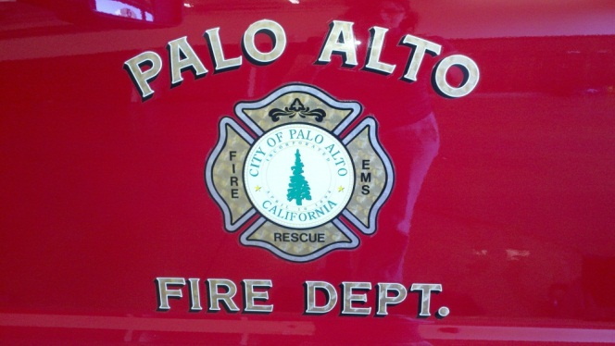
CPR & AED
Training
City of Palo Alto Fire Department

Slide 2
Objectives
Overview of Cardiac Arrests
Overview of chance of survival
Use of AEDs
Importance of CPR
City of Palo Alto AED program overview
Practice the skills

Slide 3
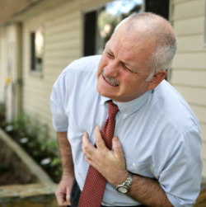
Sudden cardiac arrest claims more then 350,000 American lives each year. Many people show no warning signs. Occurs in people with no previous symptoms of heart disease. 50% of the sudden deaths in men 63% in women 12% in children 17% workplace deaths
The Facts

Slide 4
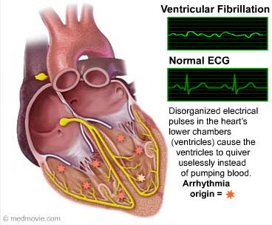
The Usual Suspect...
Ventricular fibrillation (VF)
VF is the most frequent initial rhythm in sudden cardiac arrest.
Heart’s electrical impulses suddenly become chaotic.
Pumping action abruptly stops.
Victim rapidly loses consciousness, has no pulse, and stops breathing.
Death follows within minutes!

Slide 5
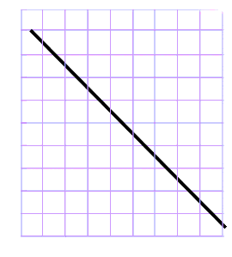
Chances of survival reduce 10% with each minute.
1,000 Cardiac Arrest
occur each day in the U.S.
National Survival average is 5% = 50 Lives Saved
CPR alone until Paramedics arrive, < 10% Survive = 100 Lives Saved
Communities optimizing defibrillation immediately at the scene (such as Seattle) 25%-30% = 300 Lives Saved
100
90
80
70
60
50
Success %
40
30
20
10
0
1
2
3
4
5
6
7
8
9
Time (minutes)
Adapted from text: Cummins RO,
Annals Emerg Med. 1989, 18:1269-1275

Slide 6
What to do?
Only 1 known therapy for VF !
Defibrillation - technique of giving an electric shock to restore the heart’s normal rhythm.
Must be done within minutes of collapse.
In just 10 minutes, survival rates drop to almost zero.
- American Heart Association

Slide 7
Chain of Survival
Early
Advanced
Care
Early
Access
Early
CPR
Early
Defibrillation

Slide 8
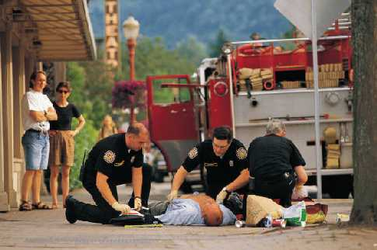
Suspected Cardiac Arrest
No signs of life
Not moving
Not Breathing
No pulse*
Call 911
Get AED
Begin CPR

Slide 9
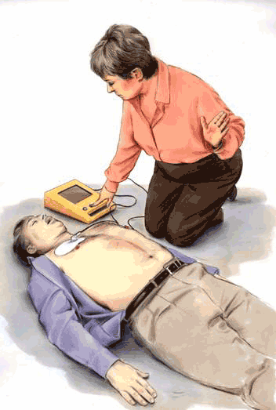
Links (cont.)
Early Defibrillation
Use an AED (Automatic External Defibrillator) to treat ventricular fibrillation

Slide 10
Automated External Defibrillator AED
Lightweight and portable
Automatically analyzes heart rhythms
Guides the user through defibrillation
Easy to use, safe and effective
Long life batteries and comprehensive “self checking” protocols

Slide 11
AEDs
ONLY
Advises to shock the patient
If there is a shockable
rhythm

Slide 12
Good Samaritan Act (HSC)
1714.21. (a) For purposes of this section, the following definitions shall apply: (1) "AED" or "defibrillator" means an automated or automatic external defibrillator. (2) "CPR" means cardiopulmonary resuscitation.
(b) Any person who, in good faith and not for compensation, renders emergency care or treatment by the use of an AED at the scene of an emergency is not liable for any civil damages resulting from any acts or omissions in rendering the emergency care.

Slide 13
Suspected cardiac arrest
No signs of life
Not moving
Not Breathing
No pulse*
Call 911!!!
Get AED
Begin CPR, (Compressions only)
If two rescuers, start compressions while another gets the AED

Slide 14
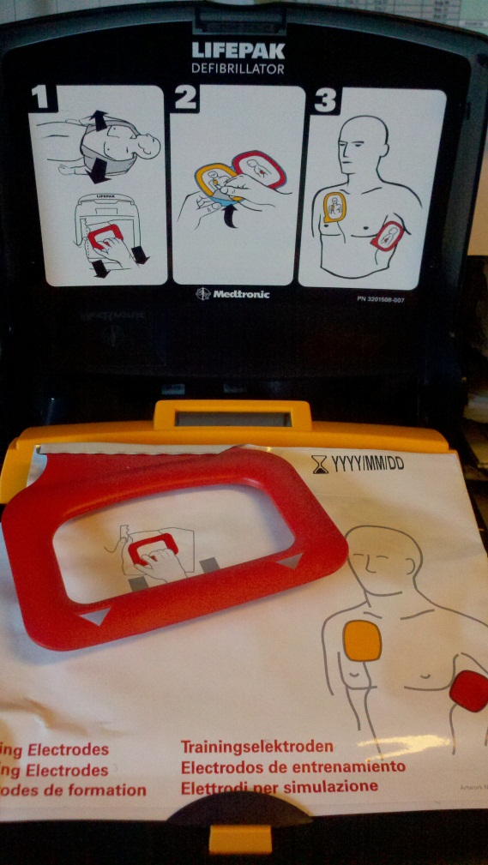
Attach electrodes
Turn AED on
AED will self test
The AED will walk you through the process: “Listen to all prompts”
The Cable is already attached to the electrodes
Appling electrodes to chest
- Cut or remove shirt/blouse
- Prep chest if necessary
- Pictures on package and on electrodes show proper placement

Slide 15
Initial Voice Prompts
prompt “Call for help now, remove clothing from patient’s chest.” :
Follow all other prompts.
Make sure no one is touching the patient when AED is determining patient’s cardiac rhythm.
Make sure no one is touching the patient during a shock.

Slide 16
Voice prompts continued…
If the patient is in Ventricular Fibrillation the AED will charge (audible) and a ”Shock Advised” prompt will be given.
Check again to make sure no one is touching the patient.
Press the SHOCK button when prompted.

Slide 17
If patient regains pulse
Keep airway open.
Assist with breathing, as needed.
Do not remove electrodes.
Turn over care when Paramedics arrive.
The defibrillation pads on the City’s AEDs will work with our FD Monitors

Slide 18
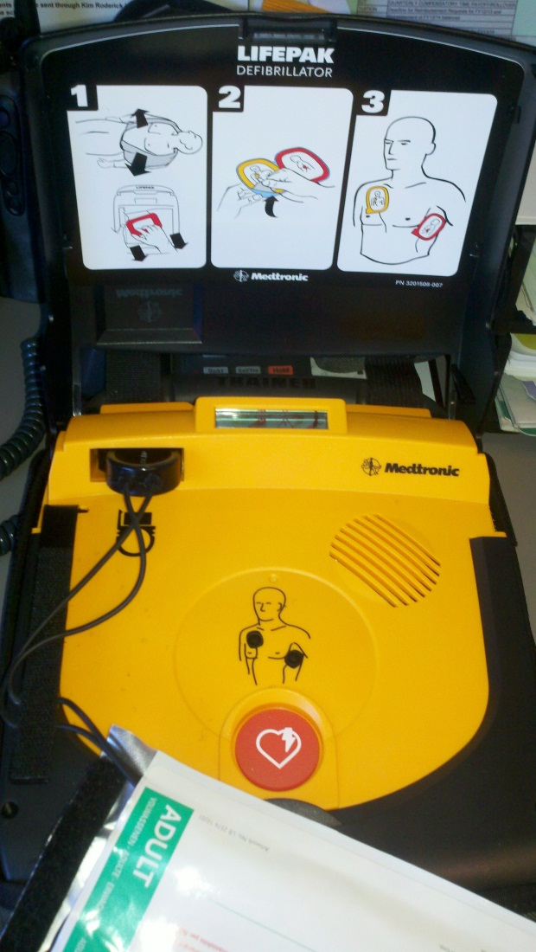
Pediatric Considerations
Some AEDs have a pediatric option, for 8 years or less
There are specific pads or a key to change the mode
The CR Plus needs specific Pediatric Pads
Per AHA, if no pediatric mode is available then use the adult pads and place them front and back
Spare Pads are stored in the lid of the AED

Slide 19
Public Access Defibrillation (PAD) Programs Save Lives…
Airlines: 1997-1999 (NEJM study)
74% survival when first defibrillation < 3min
Casinos: Las Vegas
Of 105 patients in VF, 53% survived to discharge
Local community PAD: Rochester, Minnesota
45% VF victims (21 of 44 victims survived)
First Responder Police Department; No ALS
ALS without PAD in N.Y. (26 of 2,329 survived)

Slide 20
AED Locations for Palo Alto
Greer Park
Children’s Library
Community Theatre
Art Center
Gamble Gardens Carriage House
Junior Museum and Zoo
Pearson-Arastradero Preserve Ranger Station
Golf Course Peers Park
Baylands Baseball Fields
Mitchell Park Library
Main Library
City Hall all floors
Cubberley Community Center I and II
Lucie Stern
College Terrace Library
Downtown Library
Mayfield Soccer Field
Baylands Nature Reserve
Hoover Park
Seale Park
Animal Services Center
Foothills Park Interpretive Center
Bowling Green Park
Mitchell Park Community Center 1st and 2nd floor
MSC Center Building A and Utility Control Center

Slide 21
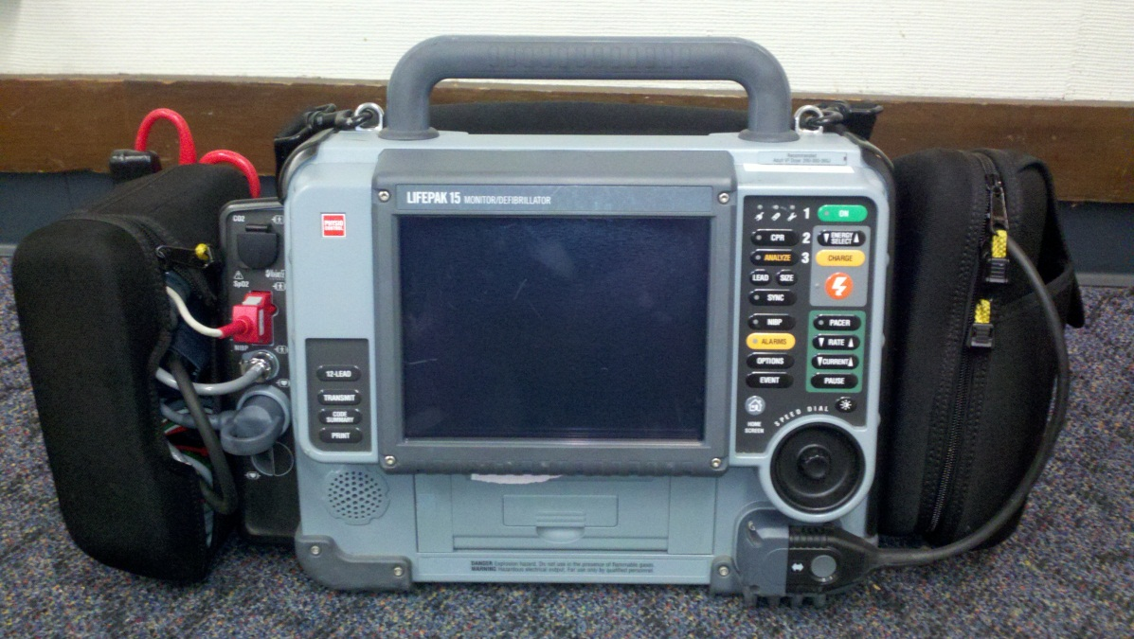
There are contacts at each location you should be aware of.
Also, all of the City Purchased AEDs are compatible with our Paramedic Monitors

Slide 22
Review Training Regularly
On a regular basis review the AED training video or check with the contact to practice.
Practice compression only CPR to maintain the skill
The Training Video will be placed on the City/Fire Website for reference

Slide 23
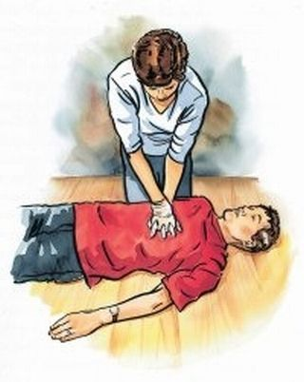
Summary
The City of Palo Alto is working towards a HeartSafe Community Initiative
Increase the number of trained CPR/AED lay providers within our community.
Help set up AED programs in public places.
Dispatch will have AED locations
To save lives!

Slide 24
Let’s Practice

