Slide 1
Collabio A Game for Annotating People within Social Networks
Michael Bernstein, Desney Tan, Greg Smith, Mary Czerwinski, Eric Horvitz
mit csail | microsoft research
mit human-computer interaction

Slide 2
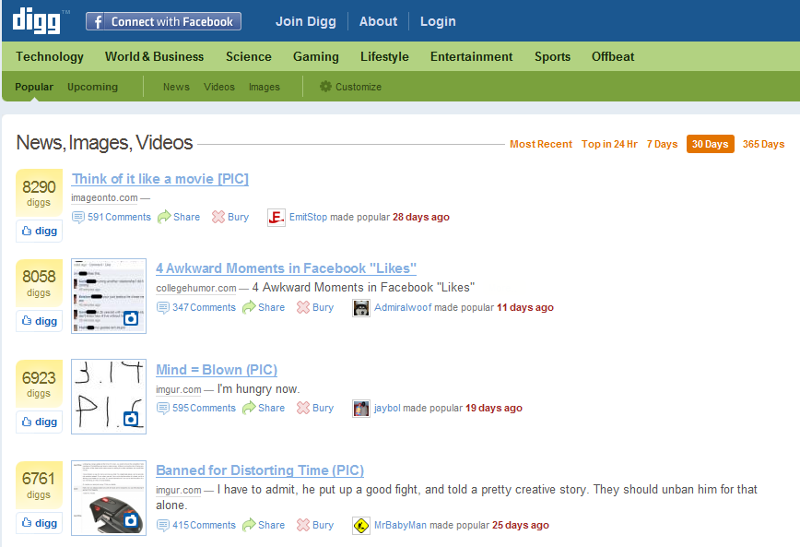
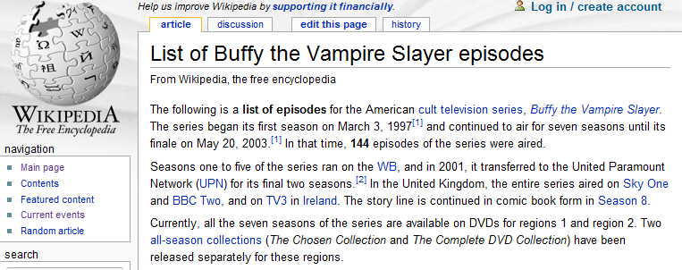
crowdsourcing
can solve problems at massive scale.

Slide 3
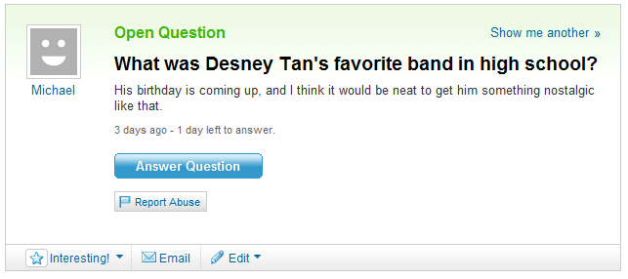
crowdsourcing
struggles when only a small network is qualified.

Slide 4
Your friends, family and colleagues know your interests, activities, and personality.

Slide 5
Your friends, family and colleagues know your interests, activities, and personality – and use it to help you.
friendsourcing

Slide 6
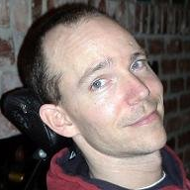
Our Goal
input
output
poker
MSR
VIBE
band
dogs
vegas
groupbar
c#
Greg Smith
Microsoft
Stanford Alum ‘92
Notes:
Note why tags are useful – we’re going to use these later to personalize some web services. I’ll get back to that at the end of the talk.

Slide 7
The Challenges
Motivation
Why would anyone want to do this?
Accuracy
Can we trust the information?
Novelty
Can we find the information elsewhere?

Slide 8
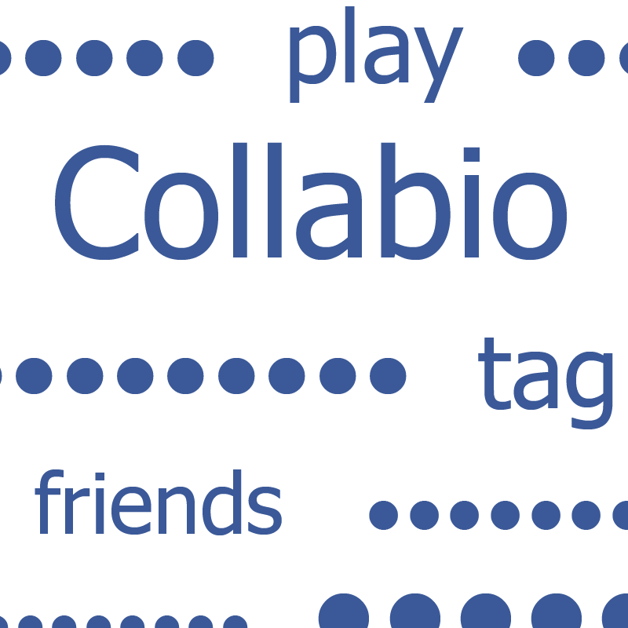
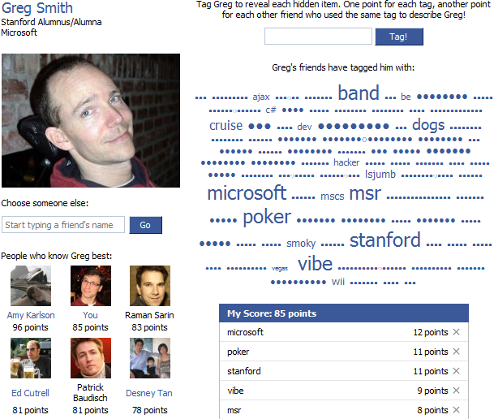
http://apps.facebook.com/collabio
Introduction
Demo
Related Work
Evaluation
Future Work
Collabio
Notes:
Demo Collabio – tagging, my tags, leaderboards.

Slide 9
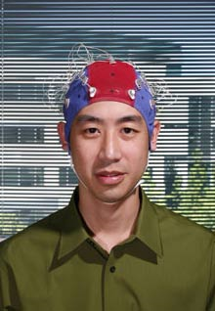
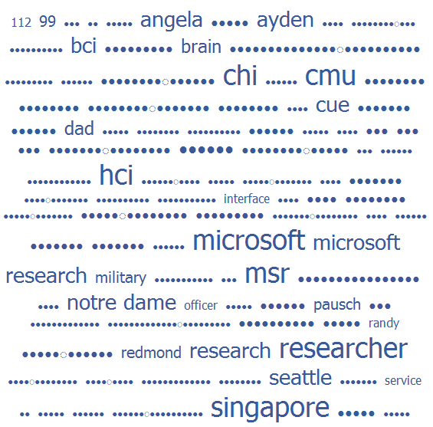
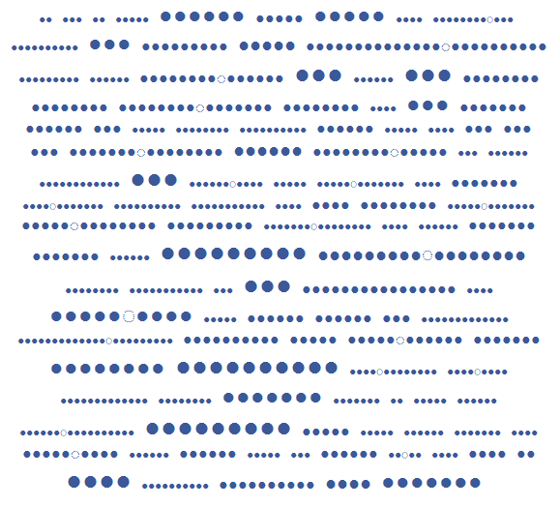
Desney Tan
Microsoft
Carnegie Mellon
Tag Desney to reveal each hidden item. One point for each tag, another point for each other friend who used the same tag to describe Desney!
BCI
Tag!
9 points
Desney’s friends have tagged him with:
bci

Slide 10
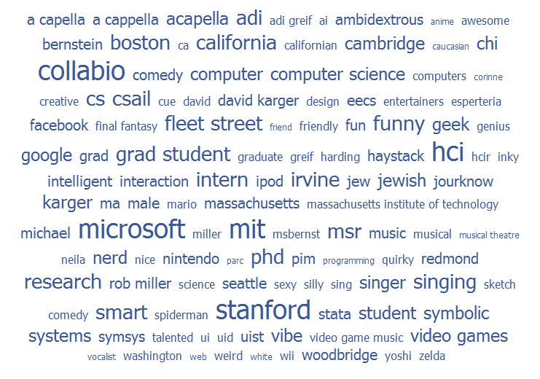

Slide 11
Collabio’s Influences
Social tagging
Fringe Contacts Farrell et al., UIST 2007
Spar.tag.us Hong and Chi, CHI 2009
Dogear Millen, Feinberg and Kerr, CHI 2006
Games with A Purpose von Ahn and Dabbish, CHI 2004
Introduction
Demo
Related Work
Evaluation
Future Work
Collabio
Notes:
Comparing to social tagging (e.g., Fringe): Attempting to solve motivation and accuracy problems outside of a firewall and completely within a social framework. How we’re different than run-of-the-mill Hcomp: we don’t explicitly control for cheating, we don’t attempt to find information common to all web-enabled humans, social motivators play as strong a role as points.

Slide 12
Collabio’s usage on Facebook
July 2008 – March 2009
●●● ●●●●●●●●● ●●● ●●●●●● ●●●●●●
29,307 tags on 3,831 individuals
825 total users
at peak, 60-100 users / day
●●●●●●
●●●●
●●● ●●● ●●●●
●●●●●●●● ●●●●
●●●●●●●●●
●●● ●●●●●
●●●●●●●●● ●●● ●●●●●●
Introduction
Demo
Related Work
Evaluation
Future Work
Collabio

Slide 13
Are Collabio tags accurate?

Slide 14
Accuracy survey
Participants were shown nine of their own tags:
Popular Tags: 3 most popular tags
Unique Tags: 3 random tags applied by only one friend
Middling Tags: 3 random tags applied more than once, but less than the popular tags
7-point Likert rating scale for each tag: “This is a good tag for me.”

Slide 15
Accuracy results N=49
The more popular the tag, the more accurate the fact.
all pairwise comparisons are significant p < .001
Notes:
Generally, the more popular the tag, the more accurate and the well-known the fact.

Slide 16
Popularity results N=49
The more popular the tag, the more well-known the fact.
all pairwise comparisons are significant p < .001
Notes:
Generally, the more popular the tag, the more accurate and the well-known the fact.

Slide 17
Are Collabio tags accurate?
Yes, even the uncommon ones.
Yes, even the uncommon ones.

Slide 18
Are Collabio tags novel?
●●● ●●●●●●●●● ●●●
Basic Information
Networks: MIT Grad Student Stanford Alum '06
Sex: Male
Birthday: June 16, 1984
Hometown: Irvine, CA
●●●●●●
MIT
●●●●
●●● ●●● ●●●●
●●●●●●●●●
●●● ●●●●●
Notes:
A tag cloud that tells us that I can be described by “MIT” doesn’t gain us much if I’ve put it in a publicly available location like Facebook anyway.

Slide 19
Four trained raters
Asked to find evidence on Facebook for 12 tags for each of twenty Collabio users.
9 tags + 3 fakes as a control
Likert scale: “I can find strong evidence that the tag applies to this individual.”

Slide 20
Novelty results
The more popular a tag, the more evidence available.
all pairwise comparisons significant p < .001

Slide 21
Ranking results
Raters were the most reliable at identifying the extreme buckets. Only ~40% of Middling and Uncommon tags were correctly recognized.
 |  | True Buckets
 |  | Popular | Middling | Uncommon | Fake
Rater Predictions | Popular | 151 | 61 | 24 | 7
 | Middling | 63 | 94 | 50 | 30
 | Uncommon | 15 | 51 | 103 | 73
 | Fake | 11 | 34 | 63 | 130

Slide 22
Are Collabio tags novel?
Yes, especially the less common ones.
Yes, especially the less common ones.

Slide 23
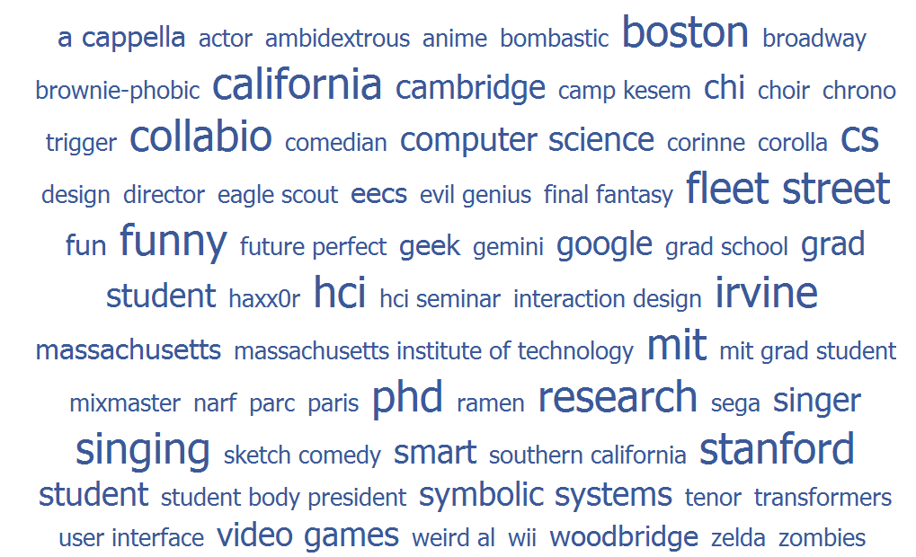
Thus, tags in Collabio’s long tail are accurate and novel.

Slide 24
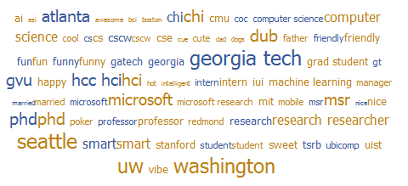
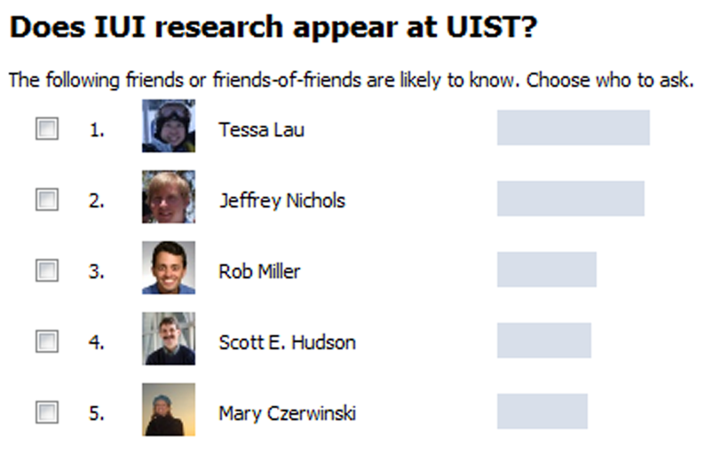
Collabio Clouds
Collabio QnA
Collabio RSS
Weekly Mashable Social Media & Web Event Guide
Job Offer: PhD Position in Information Visualization, Växjö University, Sweden, and TU Kaiserslautern, Germany
6 Y Combinator Startups I Would Have Invested In Back Then
Introduction
Demo
Related Work
Evaluation
Future Work
Collabio
Notes:
Show video

Slide 25
Notes:
Show video

Slide 26
Collabio A Game for Annotating People within Social Networks
http://apps.facebook.com/collabio
mit human-computer interaction
Notes:
Think of the kind of relationships you have with your family, friends and colleagues
You call and talk to each other. You help each other answer questions and solve problems. You do unasked favors on their behalf.
Now think about how this plays out online.
Most of it is actually communication or social grooming. Think of the most popular Facebook applications, or what plays out on Twitter
This is a shallow cut of the kinds of social interaction that could occur.
The goal of my research is to bring the kind of depth we see in everyday social interaction to online social computing. Ideally, we don’t just want to recreate these behaviors, but to also create fundamentally new behaviors at the scale of your social network. I’ll be showing a few of those to you today.

Slide 27
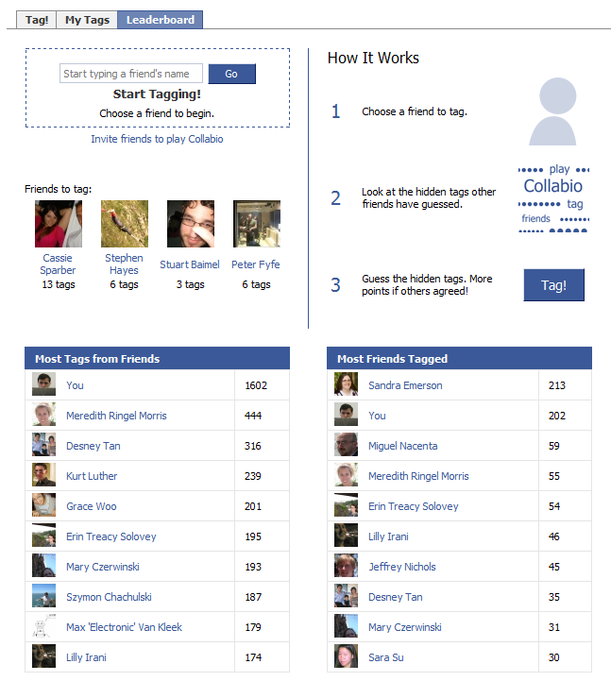

Slide 28
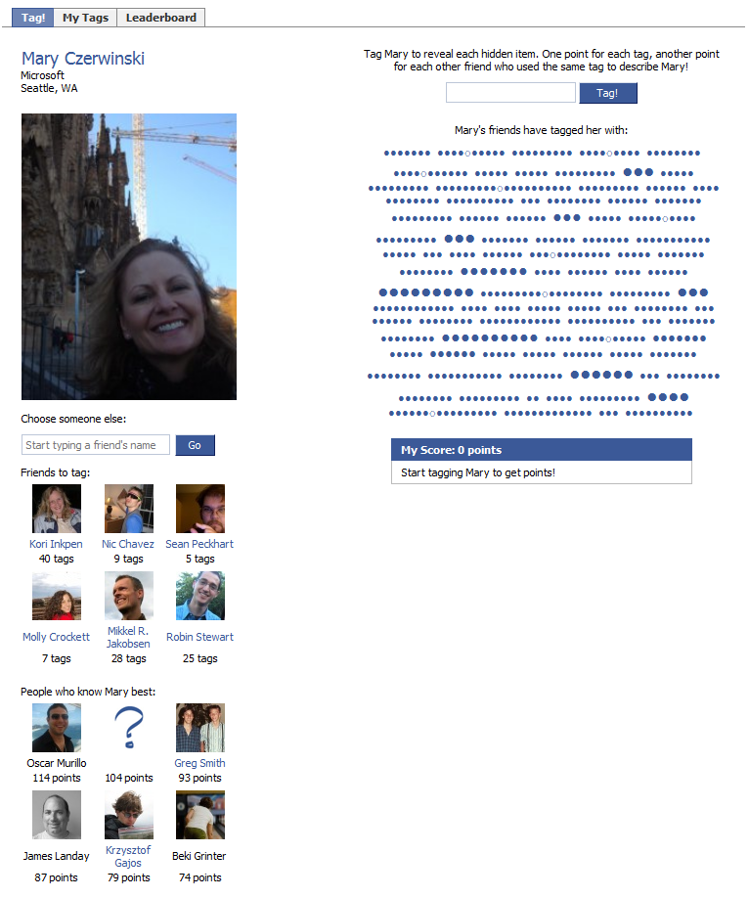

Slide 29
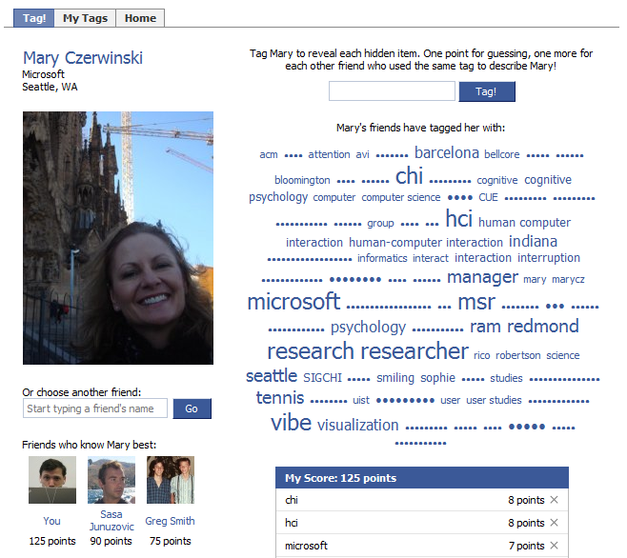

Slide 30
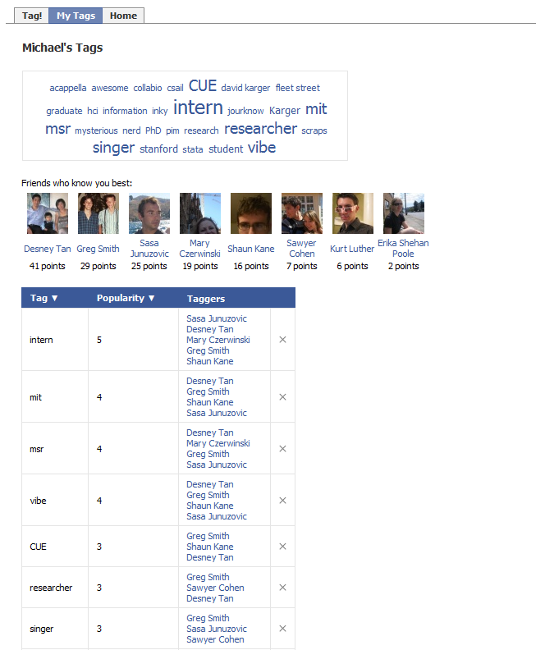

Slide 31
Incentive Design
Demo
Related Work
Evaluation
Future Work
Applications
Collabio
Notes:
Collabio is but a point in a large design space. We iterated via a prototype game played over IM, but there is a large design space we have yet to explore. Several points I’d like to call to your attention though. When we playtested a game design rewarding uncommon information with more points, there wasn’t enough agreement to give anyone any points – AND

Slide 32
Notes:
Show video

