Slide 1
Postdoctoral Administrators Quarterly Meeting
July 26, 2012
10:00 a.m. – 11:30 a.m.
LKSC 130

Slide 2
Agenda
GFS Topics: Tips/Reminders for Postdoc Entry &
Unapplied Aid
Leave of Absence Form
Submission of Early/Incomplete Recommendation Forms
Uploading Additional Documents to the
Recommendation Form
Confirmation of Reappointment Document
Reporting Social Security Numbers to OPA
Mentoring Expectations, Requirements and Form
Upcoming Workshops and Courses

Slide 3
GFS Topics: Tips/Reminders for Postdoc Entry & Unapplied Aid
Shannon Monahan

Slide 4
GFS Topics
What I found while running the Unapplied Aid Report
Salary paylines where TAL was not recalc’d
Salary paylines where TAL was re-calc’d but the TAL line was not completed on the Assist TAL tab
Both TAL and TUT were entered (likely that TUT was entered first, TAL entered later, but TUT never removed for applicable quarters)
Suspicion: rejecting a TUT line is not enough—it needs to be cancelled after the fact as well
There were salary pay lines in GFS that extended beyond the reported Termination date!
Postdocs incorrectly Aid-Year activated

Slide 5
GFS Topics
Salary Line Termination
When a salary line is terminated earlier than originally expected, TAL for successive quarters may need to be removed. If this is the case:
Terminate the salary pay line as necessary.
Click on the Calc TAL button for the salary line that was just terminated.
On the Assist TAL tab, the TAL Calc Total should change to reflect the new TAL owed. Click on the Detail button to make sure all aid is removed (example following).
Set the line to Completed (C) in the Status box, and click on Save at the bottom of the page.
The pay line will then be routed for approval as appropriate.

Slide 6
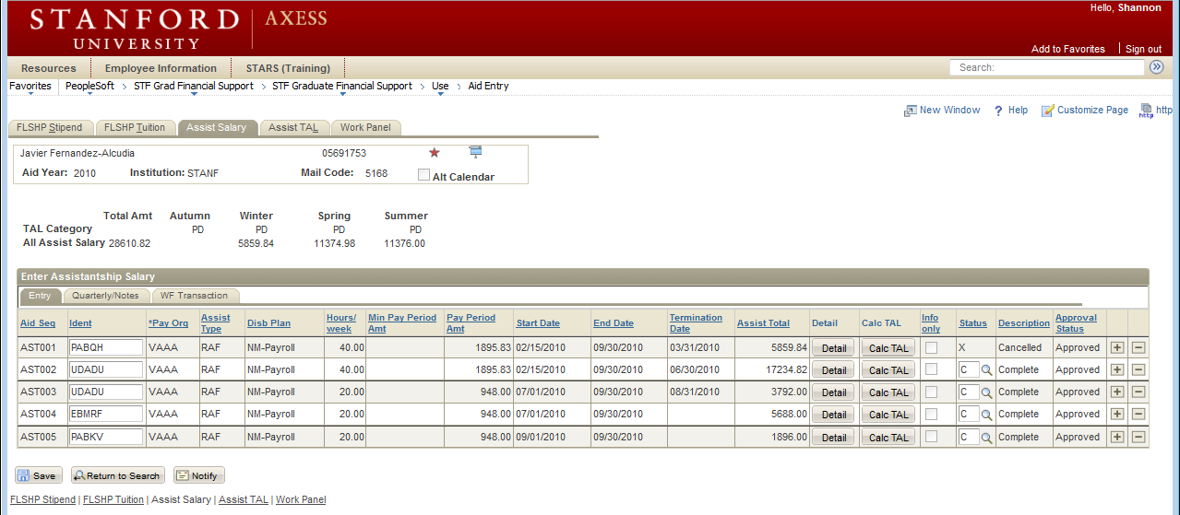
GFS Topics
Sometimes, unapplied aid wasn’t really removed…
Unapplied Aid for Winter and Spring

Slide 7
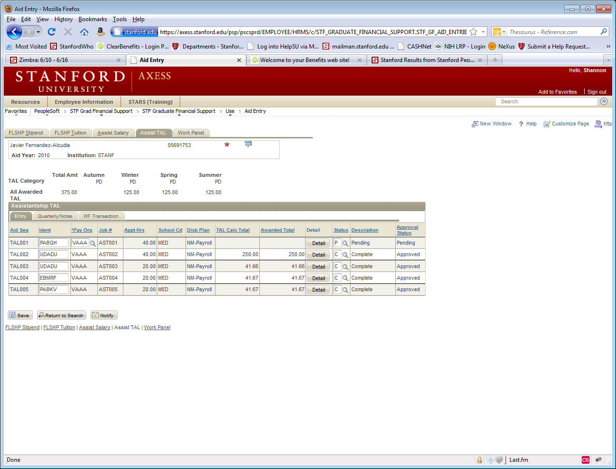
GFS Topics
TAL001 looks OK, right?
So what’s the problem?

Slide 8
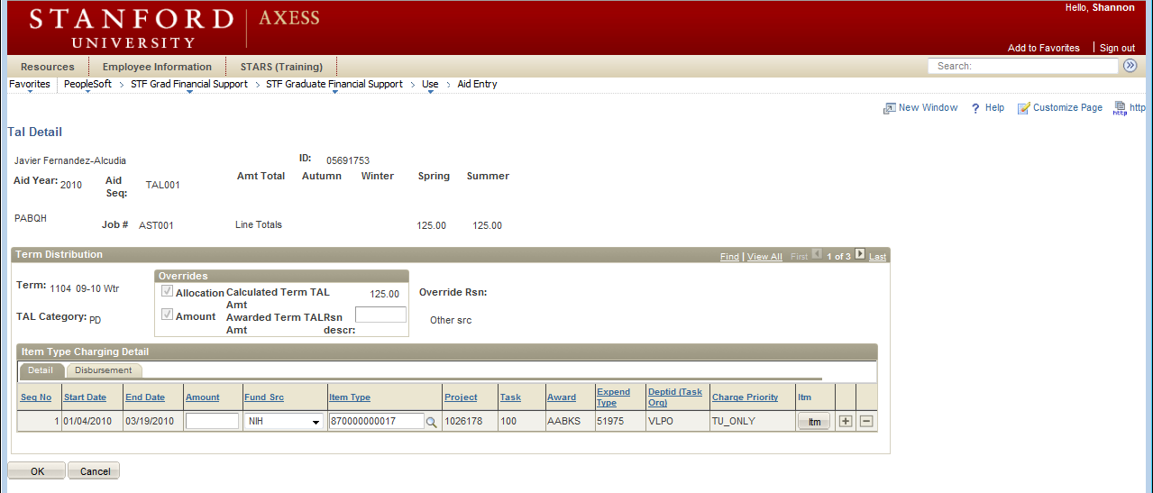
GFS Topics
Click on Detail.
Notice: line totals still have Spring and Summer with $125

Slide 9
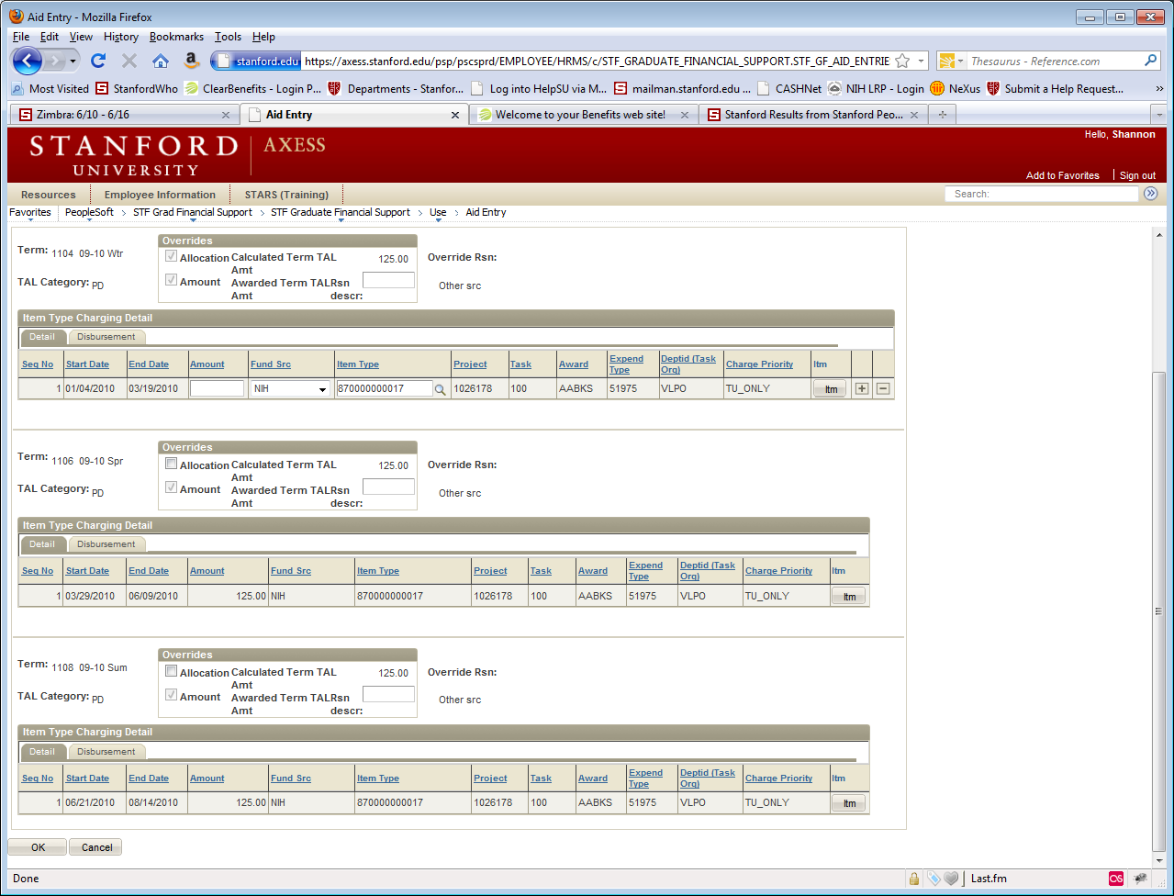
GFS Topics
Click on View All.
Notice that the $125 for the Spring and Summer are still entered in the Amount field

Slide 10
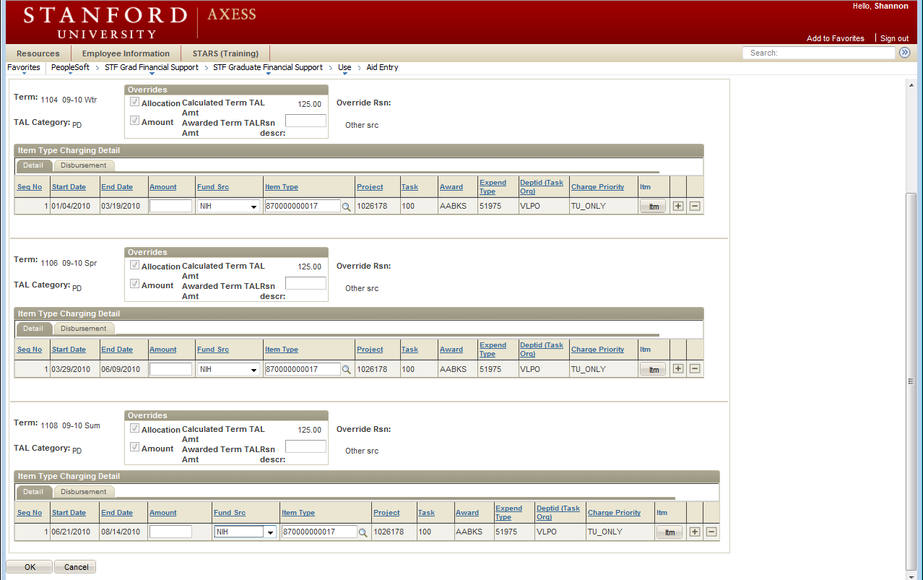
GFS Topics
Note: it is not enough to zero the amount—you still need to zero out the Allocation
Click on the Allocation check box for Spring, enter 0 (zero) into the
Amount field, and tab out! Repeat for summer.

Slide 11
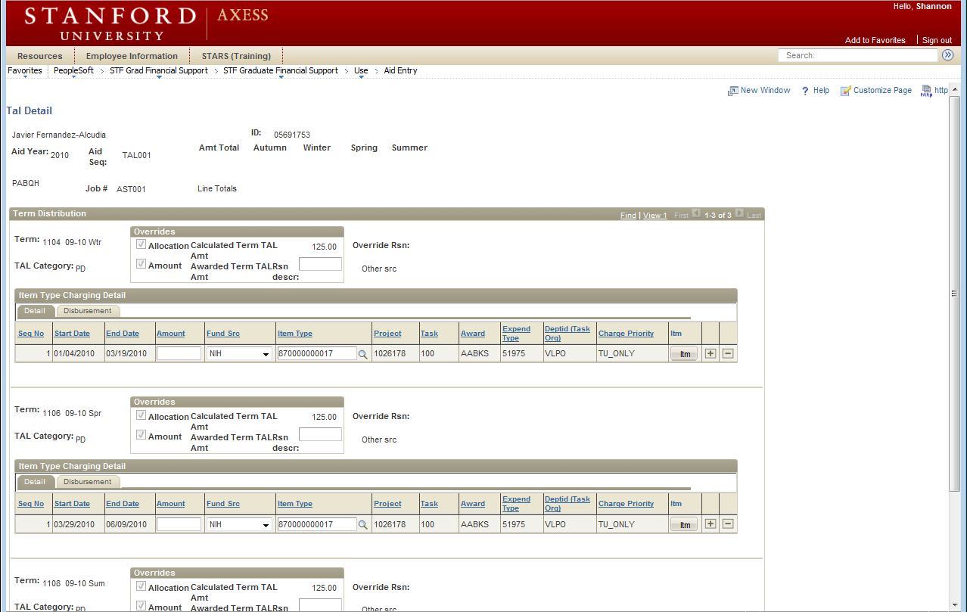
GFS Topics
Scroll to top to verify that there are no line totals left, and then click OK.

Slide 12
GFS Topics
Now complete the line, and press Save to route for Approval.

Slide 13
GFS Topics
Stipend Line Termination
When ending stipend lines due to postdoc termination, remember to remove any necessary TUT lines/quarters from the FLSHP Tuition tab.
Sometimes, postdocs will move from stipend to salary. In these cases: Remember to remove any TUT for any quarters that they will have a salary payment.
TAL over TUT in all cases

Slide 14
GFS Topics
Disbursement Plans
For salary, stipend, and Info-Only lines:
NM-Payroll (not Qtr, not Sem, …)
For TAL and TUT:
Qtr (AWSS, AWS, …)

Slide 15
GFS Topics
Aid Year Activation
Postdocs should be activated as… PD (not NM)
Postdocs should not be activated as GRPD for more than one quarter
Should only be used when the postdoc is transitioning from a PhD student to a PD in the middle of a quarter
GR Tuition is charged for quarters with GRPD (not PD tuition)
Need to (actively) activate as PD for terms following the first quarter
Note: this must be done at the same time that the GRPD activation takes place—otherwise, the GRPD will keep copying over until the end of the Aid Year; after stipend or salary lines are entered, it may be impossible to go back and fix (still waiting to hear from the GFS gurus on a HelpSU ticket)

Slide 16
GFS Topics
Best Practices
If a pay period is missed, enter the GFS line as it should have been entered, and send a HelpSU to payroll to have a check cut—do not add the amount to the current/next month.
If a postdoc is funded from an outside foreign source, periodically check the exchange rate to make sure that their pay is still meeting the minimums.

Slide 17
GFS Topics
Best Practices
When terminating pay lines, make sure to fully Complete (C) the pay lines, not just put them in Pending status. When I run my reports, it doesn’t look disbursed.
For maternity leaves and LOAs, terminate pay lines completely—lines should not be set to pending and then re-completed when the postdoc returns. New lines should then be entered upon their return.

Slide 18
GFS Topics
Going Forward, Expect…
To be asked to clear Unapplied Aid on a more regular basis
To keep up to date with TAL and TUT entry
Enter in any and all necessary Info-Only lines, including Maternity Disability lines
In return, I will work on…
Getting the ReportMart1 Unapplied Aid Report to work more effectively for postdoc administrators (export to Excel?)
Getting a report that shows outstanding tuition bills for postdocs

Slide 19
Leave of Absence Form
Annelies Ransome

Slide 20
Leave of Absence (LOA)
Form now on AXESS
Postdoc Requests Form online
Routing Goes through usual workflow
Is Received and Reviewed by OPA
J-1 Visa Regulations Apply
Submit prior to start of LOA
LOA form not used for maternity leave
Live Now!

Slide 22
LOA Form is under “Personal Information” Menu Bar

Slide 23
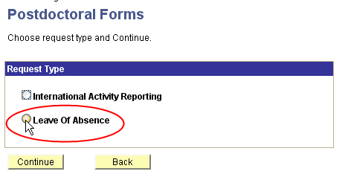
Postdoc Uses Drop Down Menu

Slide 24
Postdoc’s View of LOA Form

Slide 25
Information that must be completed in the LOA Form

Slide 26
LOA Form Successfully Submitted

Slide 27
Submission of Early or Incomplete Recommendation Forms
Tammy Wilson

Slide 28
Submission of Early or Incomplete Recommendation Forms
Early Submission is when you are asked to generate an offer letter several months ahead of the start date of the appointment.
This often means that not all documents, especially proof of degree, is available.
What to do?
Admin creates and submits Recommendation Form
DFA/Chair/Proxy approves Rec Form (generates offer letter)
Postdoc accepts offer letter online
Rec Form comes back to Admin workflow for verification/approval and submit to OPA.
Admin should HOLD REC FORM in admin (your) workflow until you receive all the documents.
Do not submit incomplete appointment paperwork too far in advance of the start date. This Rec Form may be returned to you. Process will restart.
Do not submit a Recommendation to appoint without an accompanying submission of a DS-2019.
If you are interested in submitting an early appointment, you must be ready to submit an early DS-2019 at the same time.
(The above instructions should not be confused with the conditional appointment process sometimes granted to accommodate the required 8 week advance visa processing time)

Slide 29
Uploading Additional Documents to Recommendation Form
Tammy Wilson

Slide 30
Uploading Additional Documents to Recommendation Form
After submission of the Recommendation Form, Admins may upload additional documents to the postdoc record – i.e., copy of diploma, notice of award letter, reappointment confirmation, etc.
Consider the Rec Form Documents are the “online file” of the postdoctoral scholar

Slide 31
How to add a document to an existing postdoc record in PS
Only possible for appointments that started in the system. Not possible for legacy records.
Search for existing Recommendation Form in AXESS
Click on “Postdoc Administrative Forms”
Click on “Recommendation Form”
Enter postdoc “First Name” and “Last Name”, click “SEARCH”
In Search Results, click on the “Transaction ID” (rec form appears)
Scroll down to “Supporting Documents”
“Browse” and “Upload” the additional documents
NOTIFY OPA staff if necessary when additional documents are uploaded; there is no system-generated upload notice to OPA

Slide 32
Reporting Social Security Numbers to OPA
Tammy Wilson

Slide 33
Reporting SSNs to OPA
SSNs are classified by the University as “Prohibited Data” and cannot be reported to OPA via email, voicemail, or HelpSU
Postdoc or Admin should complete the SSN Reporting Form available here: http://postdocs.stanford.edu/admin/pdfforms/SocialSecurityReportingForm.pdf
Payroll I-9 Notice includes link to OPA SSN form
Please type in SSN and Stanford ID; illegible chicken scratch = processing delay (fillable form; do not “save” a completed SSN form to your machine)
Fax SSN form to 5-6106 (fax is in a locked room) or hand-deliver to 1215 Welch Road, Modular A, Room 88

Slide 34
Mentoring Expectations, Requirements and Form
Rania Sanford

Slide 35
Beyond Paperwork: Administrator Roles
Local Orientations, directing/facilitating support resources, advocate for your postdocs
Mentoring Initiative
Required for any extensions beyond 4 years
Will be required in the near future for a broader
Resources online for faculty
Include Mentoring Form in the materials you give to your incoming postdocs.

Slide 36
Upcoming Trainings http://postdocs.stanford.edu/admin/profdev.html
ClearBenefits Training (Register in STARS):
Future dates will be added to STARS
PD Web Forms Training (Register in STARS):
Sept. 13th, 9:30 to 11:30 AM in 1215 Welch Rd. #62
Nov. 8th, 9:30 to 11:30 AM in 1215 Welch Rd. #62
Policies and Procedures (Register in STARS):
Oct. 11^{th,} 9:30 to 11:30 AM in 1215 Welch Rd. #62
Open Labs (Drop-in):
First Fridays of Every Month, 9-noon in 427 Arguello Way

Slide 37
Questions?
Happy Summer!

