Slide 1
Postdoctoral Administrators
Quarterly Meeting
October 25, 2011
10:00 a.m. – 11:30 a.m.
Clark 360

Slide 2
Agenda
Postdoc Benefits
Preparing for 2011 Winter Closure & Visas
Preventing Duplicate IDs
On-boarding Postdocs
HelpSU Tickets – Where Do They Go?
PeopleSoft Project (PD Web Forms) Update
Quarterly Meeting Dates
Programs Update

Slide 3
Postdoc Benefits
Sandra DeGaine

Slide 4
Postdoc Benefits
Open Enrollment for postdocs: 11/4 – 11/18
New medical carrier: Blue Shield of California
New medical plan: EPO replaces HMO
Rates are increasing
No plan changes to dental (2% increase) or vision
OE Benefit Fairs: November 3 and 10 from 12:00 – 2:00, Li Ka Shing 102
J1 Visa requirements for non-postdoc medical insurance
Pregnant postdocs? Medical leave of absence? Please contact us asap!

Slide 5
2012 Medical Rates
Plan | Rate Summary - Monthly Cost
 | Total Cost | Institutional Cost/Allowance ⁽¹⁾ (charged to PTAs) | Postdoc Cost (billed and paid through University Bill/Stanford ePay) | COBRA
Medical - Blue Shield EPO
Postdoc Only | $686.67 | $686.67 | $0.00 | $700.40
Postdoc + Spouse/Domestic partner | $1,510.68 | $1,057.48 | $453.20 | $1,540.89
Postdoc + Child(ren) | $1,236.02 | $865.21 | $370.81 | $1,260.74
Postdoc + Family | $2,060.03 | $1,442.02 | $618.01 | $2,101.23
Medical - Blue Shield PPO
Postdoc Only | $745.04 | $686.67 | $58.37 | $759.94
Postdoc + Spouse/Domestic Partner | $1,639.09 | $1,057.48 | $581.61 | $1,671.87
Postdoc + Child(ren) | $1,341.08 | $865.21 | $475.87 | $1,367.90
Postdoc + Family | $2,235.13 | $1,442.02 | $793.11 | $2,279.84

Slide 6
Family Healthcare Fund
Continues in 2012
Monthly Subsidy – Applies directly as a credit on University Bill towards PD+Children or PD+Family medical premium charge
Current recipients need not re-apply
Subsidy amounts in 2011: $50-$75/month
Subsidy amounts in 2012: $75-$120/month
Continuing postdocs will have their subsidies increase
Deadline to apply: Nov 9. Notifications: Nov 15
Check OPA website for details

Slide 7
Preparing for 2011 Winter Closure & Visas
Al Murray

Slide 8
2011 Winter Closure Dates
Monday, December 19, 2011 through Monday, January 2, 2012.
Regular operations will resume on Tuesday, January 3, 2012.

Slide 9
Winter Closure – Process Deadlines
DEADLINES FOR DS-2019 REQUESTS
  INITIAL DS-2019: Dec 4
  EXTENSIONS: Dec 11
  AMENDS: Dec 13
Remember that OPA requires complete Appointment or Change Form submission in order to review any DS-2019 requests
DEADLINES FOR US CITIZEN or F1 OPT HOLDERS
  New Appointment: Dec 12

Slide 10
Nov/Dec Start Dates and J1 Visas
Postdocs MUST report their arrival to Bechtel by Dec 14 or they will be out of status.
SEVIS record validation can only be done after the postdoc arrives AND submits the completed J Arrival and Insurance Confirmation webform
NO SEVIS RECORD VALIDATIONS will be done during the winter closure.

Slide 11
Nov/Dec Start Dates and J1 Visas
J regulations require that the postdoc arrives and confirms arrival within a limited timeframe after the program start date.
If the record isn't validated by the 30th day after the program start date, the postdoc will be out of status, if he/she has already entered the U.S.; or, if the postdoc has not yet entered, the DS-2019 will become invalid.

Slide 12
Upcoming DS-2019 Expiration Dates
Check your records if the DS-2019s of any of your postdocs will expire between now and January 30 (many expire at the end of December).
If so, submit your extension requests as soon as possible to ensure that the J visa status doesn't expire while the postdoc's appointment is continuing.

Slide 13
Travel Validation Signatures Required for Re-Entry after Travel Abroad
Please remind postdocs on J visas that if they're planning to travel out of the U.S. their DS-2019s (and those of their J2 dependents) must be signed by an I-Center scholar advisor in the travel validation section of the document in order to be permitted to re-enter the U.S.
The travel validation signature is valid for multiple entries for up to one year from the date of the signature. They can bring their DS-2019s to the upstairs front desk of Bechtel to request the signature. No appointment is needed for this.

Slide 14
End of program more than 30 days prior to end date on DS-2019
If a postdoc's appointment will end more than 30 days prior to the program end date (i.e., postdoc resigns or there is an early termination), you must submit a Shorten Program Request Form to revise the program end date on the DS-2019 to the new, earlier end date.
Unless:
The postdoc is transferring to another U.S. institution or Stanford department, or changing Stanford classification (i.e. from postdoc to Research Associate)
More questions on J1 scholar and employment-based visa processing? Go to http://icenter.stanford.edu/depts/scholars.html

Slide 15
Bechtel’s Nov. 2nd Visa Meeting
Bechtel’s upcoming meeting to focus on J-1 scholar and employment-based visa processing at Stanford.
Wednesday, November 2nd, 2-3 p.m.
Bechtel International Center Assembly Room (584 Capistrano Way)
Refreshments will be served

Slide 16
On-boarding Postdocs
Annelies Ransome

Slide 17
Administrator Responsibilities in Onboarding New Postdocs
Departmental/Lab Orientation- Prepare a packet. Create your own checklist and onboarding procedures.
  http://postdocs.stanford.edu/prospects/orientationtoolkit.html
Paperwork Checklist: http://postdocs.stanford.edu/admin/checklist.html
“Getting Started at Stanford” for Postdocs: http://postdocs.stanford.edu/incoming_scholars/
People and Offices to Support You: http://postdocs.stanford.edu/prospects/people_offices.html

Slide 18
Helpful Information from Fellow Postdoc Administrators
Next quarterly meeting: presentation by postdoc administators about onboarding postdocs and internal hiring requests
Ideas for other topics? Please send them to postdocaffairs@stanford.edu We would like to make this a regular part of our quarterly meetings.

Slide 19
HelpSU Tickets –
Where Do They Go?
Annelies Ransome

Slide 20
Who Answers Help Tickets?
To reach OPA, you must select the following in HelpSU:
  Category: Student Services
  Request Type: Postdoctoral Affairs
Tickets routed in this manner are triaged and answered by OPA Staff (not the Help Desk)
  OPA escalates tickets to other groups when the issue submitted cannot be resolved by OPA.

Slide 21
PeopleSoft Project (PD Web Forms) Update
Annelies Ransome

Slide 22
Update
Project website: http://postdocs.stanford.edu/admin/PeopleSoft_Project.html
Training slides are up-to-date with “Tips and Tricks” slids added
Open Labs & Trainings on the website
“Policies & Procedures” Training – need to attend an upcoming session if you are new to postdoc administration

Slide 23
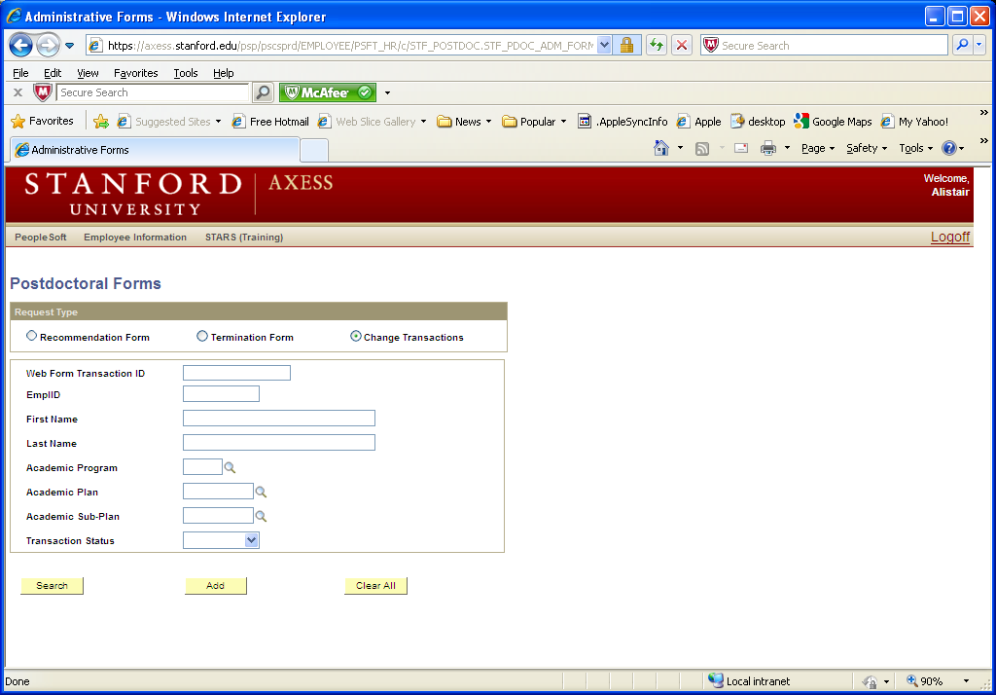
How to find Student ID # if you do not have PeopleSoft Search/Match

Slide 24
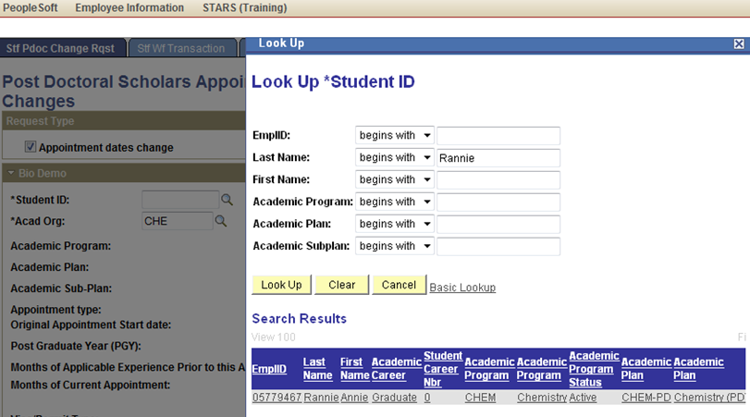
Use Change Transaction Form (remember to add) to search for student

Slide 25
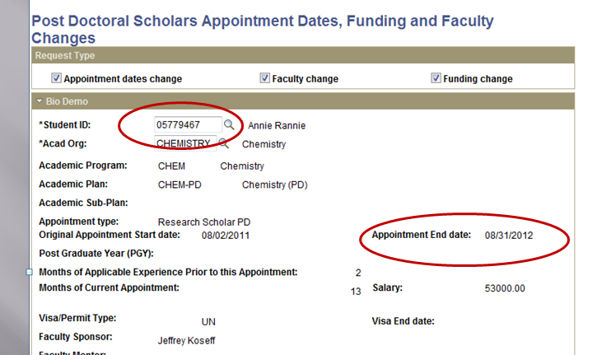
Can find ID # and current end date

Slide 26
Quarterly Meeting Dates for 2011-12

Slide 27
Please save the following dates:
Feb. 9, 2012, 10-11:30 AM
April 12, 2012, 10-11:30 AM
July 26, 2012, 10-11:30 AM
Oct. 25, 2012, 10-11:30 AM

Slide 28
Programs Update
Beth Leman

Slide 29
Current Events
Family Healthcare Fund
Brown Bag Lunches
SACNAS & ABRCMS Annual Meetings
Academic Chat Series
Session II of Oral Communication for Non-Native Speakers

Slide 30
Open Forum
Questions?
---------------------------------------
AskJane.stanford.edu
HelpSU.stanford.edu
(Category: Student Services; Request Type: Postdoctoral Affairs)

