Slide 1


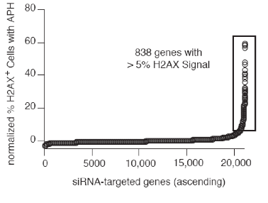
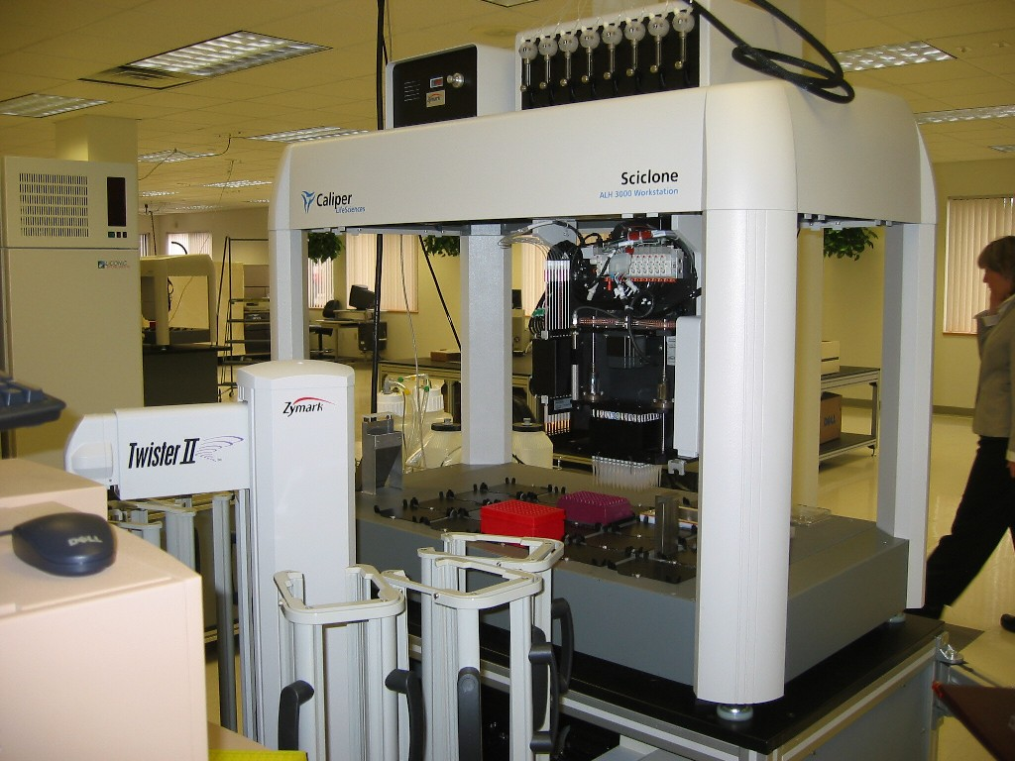
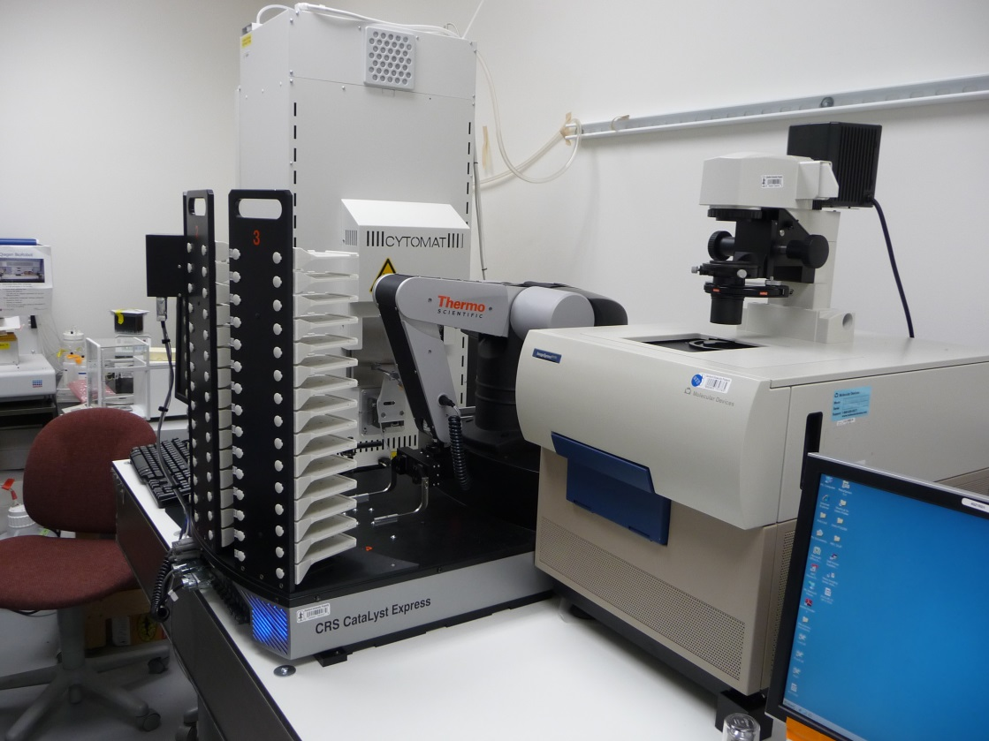
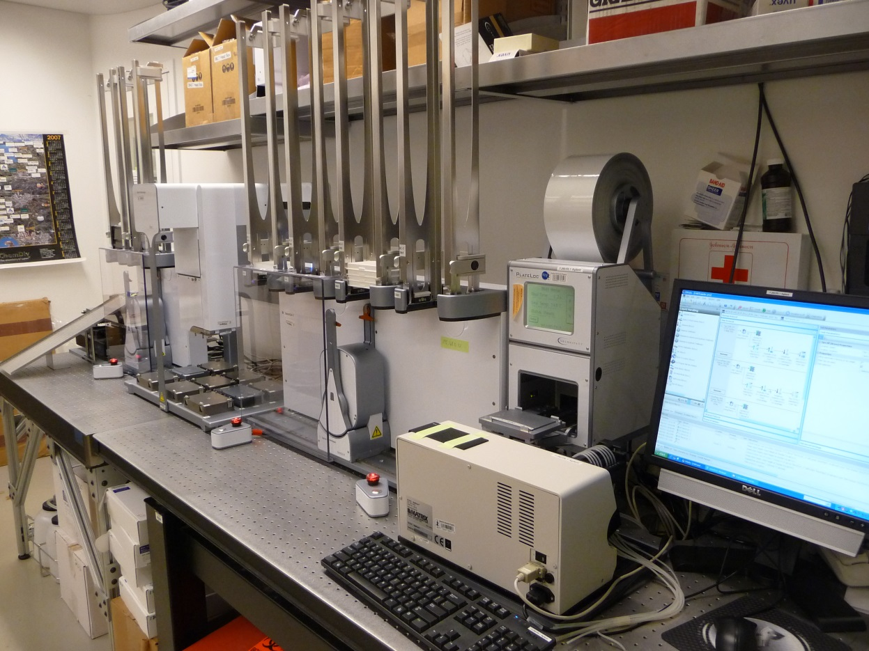
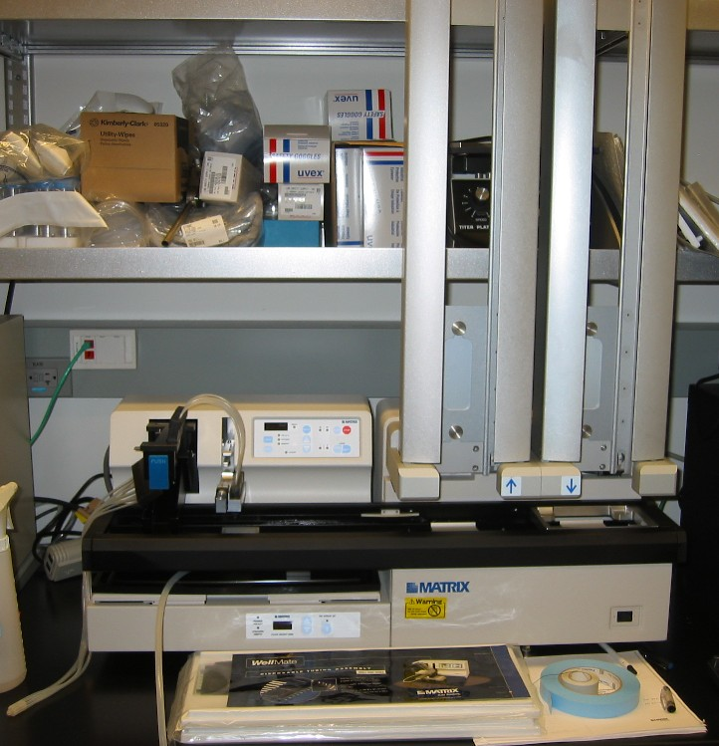
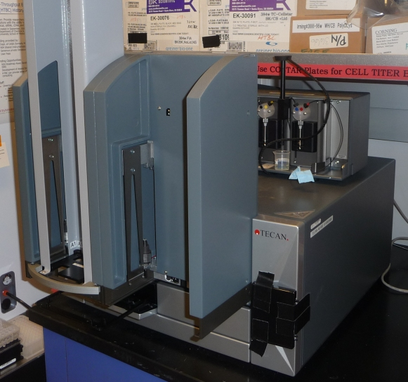
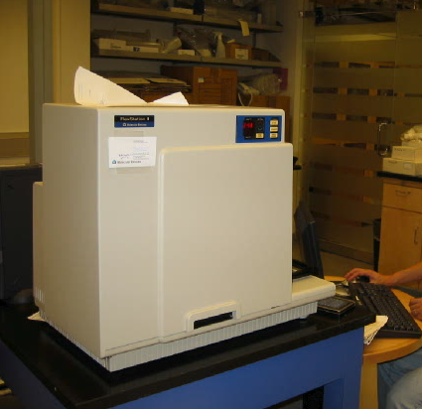
High-Throughput Bioscience Center (HTBC)
Facility Director: David E. Solow-Cordero, Ph.D.
Faculty Director: James K. Chen, Ph.D.
HTBC Mission & History
High-Throughput Screens
High-Content Imaging
Mission: Provide researchers at Stanford and nearby institutions with the ability to run high-throughput chemical, siRNA, cDNA, and high-content screens for the purpose of drug and/or target discovery.
  Created: September, 2003 by Prof. James K. Chen, Department of Chemical & Systems Biology, Stanford University School of Medicine.
  Summary: Research approaches that were previously done exclusively in industry are now being used in academia to advance basic research. This high-throughput screening (HTS) laboratory allows Stanford researchers and others to discover novel modulators of targets that otherwise would not be practical in industry. The center incorporates instrumentation, databases, compound libraries, and personnel whose previous sole domains were in industry.
Funding provided by:
  Dept. of CASB (formerly Mol. Pharm.), Sept 2003
  NIH Shared Instrumentation Grants, April 2004 & April 2010
  Generous private Donations, Aug 2005 and Dec 2005
  Stanford Cancer Institute (SCI)
  Spectrum/SPARK, Med School Dean’s Office
  User Fees-for running screens and using instrumentation
Funding Opportunities:
  SCI: see http://cancer.stanford.edu
  SPARK: see http://sparkmed.stanford.edu
  NIH NCATS: see http://www.ncats.nih.gov
  HTBC can provide letter of support/resources and grant consulting
Staff:
  Director-David E. Solow-Cordero, PhD
  Manage Day-to-Day operations, databases, servers, assay development, robot programing, screen project management, major purchases
  Research Assistant-Jason Wu
  Tissue culture, molecular biology, run screens, equipment maintenance, high-content imaging, lab manager
The HTBC provides researchers with the ability to rapidly test thousands of molecules in various bioassays.
Small Molecule Compound library--130,000 diverse compounds (ChemDiv, Chembridge, Specs, ChemDiv Kinase, NCI DTP) including Drug/known bioactive libraries (LOPAC, NIH CC, Biomol FDA & ICCB, Microsource Spectrum)
  Small interfering RNAs (siRNAs)--21,000 genes, siARRAY whole Human genome siRNA library from ThermoFisher Scientific (formerly Dharmacon) and the whole Mouse genome from Qiagen
  cDNAs—15,000 genes, E. coli stocks Human ORFeome in Gateway vectors from Open Biosystems
High-Throughput Assays are performed in 384-well plates.
  In vitro targets-- Enzymes, Protein-protein interactions, Ligand-receptor binding, Protein-DNA binding
  In vivo targets (cell based-spectrophotometric)-- Signal transduction events-Ca++, cAMP, reporter gene, proliferation, toxicity
  High-Content Imaging-- Mitosis, protein translocation, cellular morphology, apoptosis
  Fully automated and integrated CaliperLS Staccato System:
Featuring:
  CaliperLS SciClone ALH 3000 pipetting workstation
    With 96-tip High Volume Pipettor, 384-tip fixed tip Pipettor, 384-Pin Tool
  Zymark Twister II robotic arm with stackers
  Robotic 198 plate CO₂ Automated Incubator
  Bio-tek EL406 plate washer/reagent dispenser
  Titertek Multidrop reagent dispenser
  Bar Code reader
  Molecular Devices AnalystGT multimode microplate reader
  Capable of fully automated cell-based and protein/enzyme based HTS
siRNA Screening at the HTBC
The HTBC has the siARRAY whole Human Genome siRNA library from ThermoFisher (formerly Dharmacon)
  80 gene targets per plate
    4 siRNA oligos per gene--pooled in each well
    267 X 96 well plates targeting 21,122 genes
  Library subdivided in:
    10 Kinase (779 genes, can be tested separately)
    7 GPCR (517 genes)
    76 Druggable genome (6022 genes)
    174 Rest of genome including XMs (13,804 genes)
  All individual siRNA oligos available for retests of hits (deconvolution of individual siRNAs)
    4 individual oligos per gene
High-Throughput siRNA assays performed in 96- or 384-well (preferred) plates
Results from 1st siRNA screen on DNA Repair .
Agilent siRNA Robotic System
Bravo liquid handler with 96 and 384-tip disposable tip pipettor (0.5-200 μL)
PlateLoc—automated thermal plate-sealer
BenchCel Stackers-automated tip changing, rapid plate replications, rapid siRNA transfections
Bio-Tek ELx405 plate washer and Matrix Wellmate reagent dispenser
ImageXpress Micro (Molecular Devices)
  ● Fully automated Inverted Epi-Fluorescent Digital Microscope capable of imaging 6-, 12-, 24-, 48-, 96-, and 384-well plates
  ● Nikon 4x, 10x, 20x, and 40x Objectives, Xenon Lamp/filter based and bright field/phase contrast module
  ● Live Cell Imaging via environmental chamber with CO₂, humidity and temperature-control.
  ● 24/7 Access to Facility. Full backups of images and data.
  ● Easy to get started - training only takes 15-30min.
  ● Complete spectral range with 16 Top-of-the-Line SEMROCK filter set combinations allowing use of nearly every available fluorophore and up to 4 colors per sample.
  ● Integrated external automated incubator and a Thermo Catalyst Express robot with stackers to permit long-term or large-scale studies of cellular events.
  ● MetaXpress software (based on industry-standard MetaMorph) provides pre-programmed digital analysis modules for Angiogenesis tube formation, Cell health, Cell scoring, Count nuclei, Granularity, Live/Dead scoring, Mitotic Index, Neurite outgrowth, Transfluor® , Translocation, and assembly into movies.
  ● Dedicated High-speed Laser Auto-Focus allows the acquisition of an entire 96-well plate in under 5 minutes (1 color/1 site/well) and up to 5000 images in under 2 hours (384-well plate/4 colors/3 sites) with 100 nm accuracy.
unclassified
703 genes (3.3%)
nucleic
acid-
binding
% Positive Cells
deconvolute
264 genes (1.3%)
transcription
factors
Screens and Data Analysis
Other Liquid Handling
HTS Throughput:
Compound screening:
    Enzyme/protein/in vitro assays: up to 100,000 wells a week.
Compound or siRNA screening:
    Cell based assays: 75,000 assays a week.
    High Content Assays: 40,000 assays a week
Assays:
Developed to be robust, inexpensive and simple perform.
Reproducible, low CVs, good signal to noise, Z’ > 0.5
Good secondary assays for hit specificity and selectivity
Selected Completed Screens:
  Renal Cancer Cells synthetic lethal compound screens
  Irestatin compound modulator screen
  Hedgehog pathway compound modulator screen
  BMPRII activator screen
  ALDH activation compound screens
  HSP90 inhibitor screens
  DNA repair siRNA screen
  See http://htbc.stanford.edu/papers.html for more information
Data Analysis:
Hardware:
  2 Dell Poweredge R810 servers with external RAID6 SAS and automated autoloader tape backup (LTO-4)
Databases:
  ImageXpress Micro images (2.5 MB each, average 20,000 images a day)
  ORACLE11.2 Database 10 TB RAID6 drive storage (1 year of images)
  HTS Data: ORACLE9i (273 GB RAID5 drive)
High-Content data analysis:
  Molecular Devices MetaXpress
  Molecular Devices Metamorph
  MatLab
HTS Data Analysis (for both compound and siRNA screens):
  MDL ISIS (ChembioAE): Structure viewing
  MDL Plate Manager: Compound and siRNA plate database
  MDL Assay Explorer: HT data analysis and storage
  MDL Report Manager/ISIS for Excel: HT data reporting tool
Matrix WellMate Reagent Dispenser with Stackers
For 96- or 384-well plates, 1-1000 uL dispensing of reagents or cells
Integrated 50 plate Stacker, Programmable dispensing (by columns)
Velocity11 VPrep
Liquid handler with 96-tip pipetting head for 96 to 96-well plate replications or 96 to 384-well plate remapping.
Bio-tek EL405x Plate Washer with Stackers:
For 96 or 384-well plate media exchanges or fixing and staining washes.
More Info: htbc.stanford.edu,
CCSR-0133, David E. Solow-Cordero, Ph.D Director, HTBC, desolow@stanford.edu
Plate Readers
Molecular Devices Flexstation II 384
Fluorescence Plate Reader
  Dual-Monochromometer based
  Can read 6, 24, 96, 384-well plates
  Top or bottom reading capability
  Internal 8- or 16-tip pipettor for agonist addition during kinetic timecourse
Assays:
  Migration Fluoroblock assays
  Standard fluorescent assays
  Enzyme assays-rapid kinetics
  GPCRs
  Ca++ Flux (FLIPR assays)
  Ion channels
  Membrane potential
Tecan Infinite M1000 Pro
Multimode Plate Reader
    Fluorescence Intensity, Fluorescence Polarization, Flash/Glow/Color Luminescence-with dual injectors, Absorbance-UV/Vis, Time-resolved fluorescence resonance energy transfer (TR-FRET), including HTRF, AlphaScreen
  40 plate stackers
  Extremely fast
  6, 12, 24, 48, 96,364, or 1536 well plates
  Top or bottom reads
  Quad4 monochromators
Molecular Devices AnalystGT
Multimode Plate Reader
      Integrated into the CaliperLS Staccato System

