Slide 1
Pediatric Head Trauma
Deb Updegraff RN, MSN, PNP, CNS, CCRN Clinical Nurse Specialist
LPCH PICU

Slide 2
Stats
Trauma: leading cause of death in children and adolescents > 1 year of age
Head Injury:
accounts for 80% of all trauma
75- 97% trauma deaths
5% of these are dead at the site

Slide 3
Stats
Traumatic Brain Injury (TBI) insult to the brain from an external mechanical force possibly leading to permanent or temporary impairment of neurologic function.
10-20 % with moderate to severe short term memory problems and delayed response times
> 50% will have permanent neurologic deficits
5- 10 % will end up in long term care facilities

Slide 4
Common Causes
Motor vehicle accidents: (27-37% of cases)
Ages: less than 15 years usually a pedestrian or bicyclist
Ages: 15-19 years are passengers, alcohol common
Falls: (24% of cases) common ages < 4 years
Assaults and firearms: (10% of cases)
Recreational Activities: ages 10-14 (21% of cases)
Child abuse: ages < 2 years (24% of brain injury)

Slide 5
Stats
Males 2X more likely than females
African American males account for majority
of firearms related head trauma

Slide 6
Minor Head Trauma
> 95,000 children seen in ERs each year
One of the most frequent reasons to visit MD

Slide 7
Minor Closed Head Injury
No Loss of Consciousness
1/5000 adults require medical intervention
Good History and Physical
Evaluate at home ok with reliable caregiver

Slide 8
Minor Head Injury
Loss of Consciousness and /or
seizures, prolonged N & V and HA
2-5% will have injury requiring medical intervention
Most MDs will have child in the CT scan

Slide 9
Pros and Cons of CT
If child needs sedation or anesthesia to obtain an accurate CT scan, MD will weigh the benefits and might decide to monitor child in the hospital or at home with a reliable care giver.

Slide 10
What Happens
Pediatric brain more susceptible to certain types of injury
Larger in proportion to BSA
Depends on ligaments vs. bones for support
Higher water content 88% vs. 77% - more prone to acceleration deceleration injury
Un-myelinated brain : more susceptible to shear injuries

Slide 11
Primary Injuries
Scalp injuries
Skull fractures
Concussions
Contusions
Intracranial hemorrhages
Penetrating injuries
Diffuse axonal injuries

Slide 12
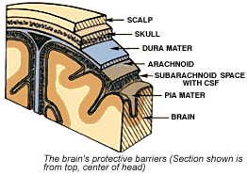

Slide 13
Concussion
Transient Loss of Consciousness
Infants and young children is common to have post traumatic seizures, somnolence, vomiting
Older children have post traumatic amnesia

Slide 14
Direct injury to the brain parenchyma as it is impacted on
the bony protuberances of the skull

Slide 15
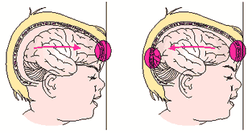
In children the skull is compliant and easily deformed. Impacts
result in a “coup Injury” intracranial hemorrhage may result from
shearing of the vascular structures.

Slide 16
Contusion
Bruising or tearing of the brain tissue
Temporal and frontal lobes are most vulnerable due to anatomic relationship to bony protuberances in the skull
.

Slide 17
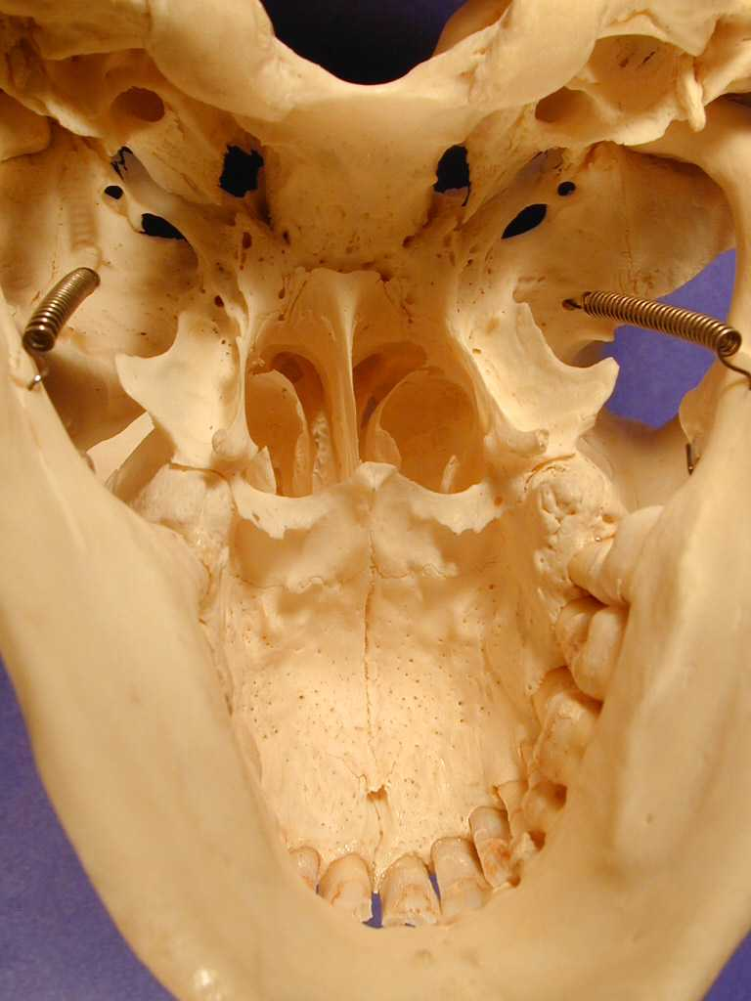

Slide 19
Subarachnoid hemorrhage is the most common and
results from the disruption of the small vessels on the
cerebral cortex

Slide 20
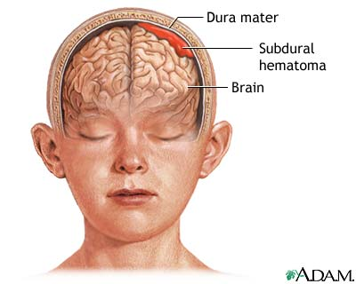
Subdural hematoma result from tearing or laceration of veins across the dura
during acceleration-deceleration forces. Usually associated with severe brain injury
with progressive neurologic deterioration.

Slide 21
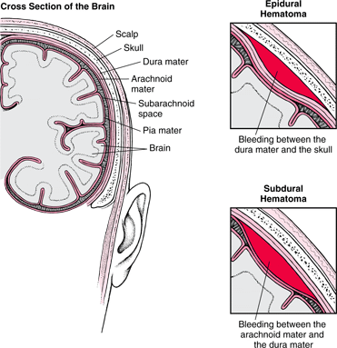
Epidural hematoma occurs secondary to a laceration of a vein or an artery.
Hemorrhages of arterial origin peak size by 6 hours, venous origin may grow
over 24 hours or more.

Slide 22
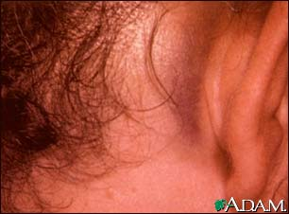
Basilar skull fracture

Slide 23
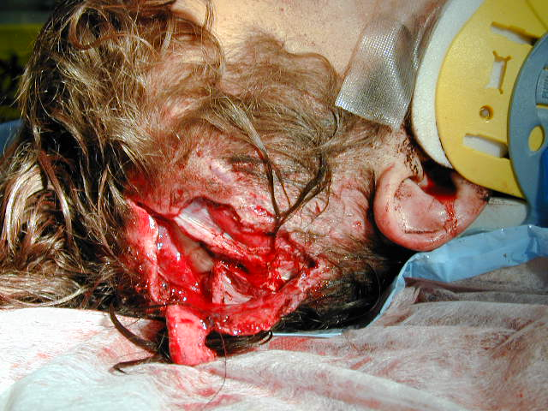
Penetrating wound to skull
Neurosurgical emergency
Fatal hemorrhaging can ensue

Slide 24
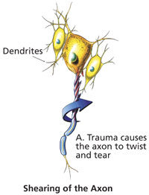
Diffuse axonal injury
Severe rapid acceleration-deceleration forces
Prognosis for recovery poor

Slide 25
CT scanning
Rapid diagnosis of intracranial pathology that requires prompt surgical intervention

Slide 26
Brain needs 02
Cerebral blood flow (CBF)
Minimal amt. to prevent ischemia ??????
Influenced by MAP

Slide 27
Autoregulation
Normal brain maintain CBF over a wide range
of blood pressure MAP 60-150 mmhg
TBI can lead to loss of autoregulation
Foundation for nursing /medical care of TBI

Slide 28
Pediatric Neuro Assessment
Glascow coma scoring
Eye Opening | E
spontaneous | 4
to speech | 3
to pain | 2
no response | 1
Best Motor Response | M
To Verbal Command:
obeys | 6
To Painful Stimulus:
localizes pain | 5
flexion-withdrawal | 4
flexion-abnormal | 3
extension | 2
no response | 1
Best Verbal Response | V
oriented and converses | 5
disoriented and converses | 4
inappropriate words | 3
incomprehensible sounds | 2
no response | 1
E + M + V = 3 to 15
> to 12 = minor injury
> to 9 not in coma
< to 8 are in coma
< to 8 at 6 hours - 50% die
Coma is defined as: (1) not opening eyes, (2) not obeying commands, and (3) not uttering understandable words.

Slide 29
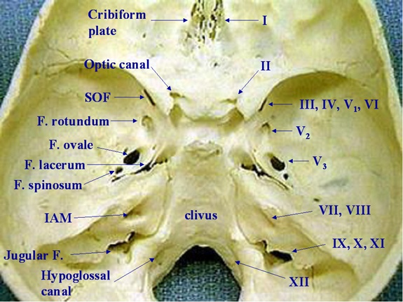
Cranial Nerves

Slide 30
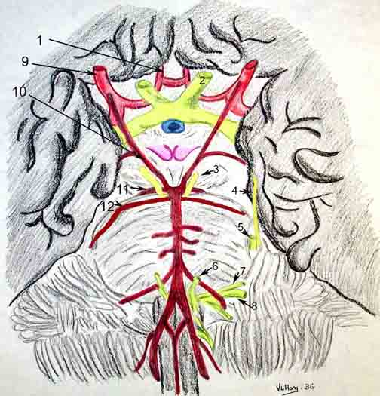

Slide 31
Cranial Nerves
CN 3 /4 / 6 Eyes: PERRL
CN 7 Face : symmetry
CN 9/10/12 : Swallow, cough, Gag

Slide 32
Nursing Care
Head midline with HOB elevated 30º
↓ environmental stimuli
↓ painful stimuli
Maintain normal Pao2 and Pc02
Carefully planned airway suctioning (preoxygenate)
Maintain normal temperature

Slide 33
Goals of Care
Prevent or reduce Secondary Injuries
Cerebral edema
Respiratory Failure
Herniation

Slide 34
Cerebral Edema
Cytotoxic Edema:
Intracellular swelling from hypoxia and ischemia
Cell wall Ionic pump is disrupted
Reflects cell death
Not easy to treat

Slide 35
Cerebral Edema
Vasogenic Edema
Alteration in cell wall permeability
Protein rich plasma comes into brain cells
May develop from a hematoma
Easier to treat

Slide 36
Nursing Care
Avoid hypotension
CVP must be adequate to avoid hypotension with sedatives
Optimum blood pressure is patient specific
Know optimum for your patient
Fluid, diuretics and or vasoactive agents may be indicated

Slide 37
Nursing Care
Lab
Maintain normal glucose
Serum Na should be 140 -150
Serum Osmo should be 275-295
Hematocrit monitor for loss of blood

Slide 38
Airway Mangagement
Immobilization of cervical spine
Intubation (avoid Nasal intubation/NG placement with suspected basilar skull fracture)
Premedicate: Lidocaine 1- 2mg/kg
Thiopental 4-7mk/kg
Ketamine contraindicated
Adequate sedation and paralyzation post intubation

Slide 39
Cardiovascular Managment
Normotension is goal
Cerebral perfusion pressure (CPP) = MAP – ICP defines the pressure gradient of cerebral blood flow (CBF)
Most studies suggest CPP at 70-80 mmhg
Use of hypertonic solutions is best vs. isotonic
Hypertension can be reflexive and tx could compromise CPP be careful (beta-blockers)

Slide 40
Cerebral Perfusion
↑ HOB, midline head and neck
Sedate and paralyze
Diuretics
Mild hyperventilation Pa02 30-35
Drain CSF
Barbituates ????? Reserved for intractable ↑ ICP
Treat seizures
Monitor for DIC (1/3 of head trauma pts.)

Slide 41
Extraventricular Drains
CSF drainage by EVD improves ICP
Able to continuously monitor ICP

Slide 42
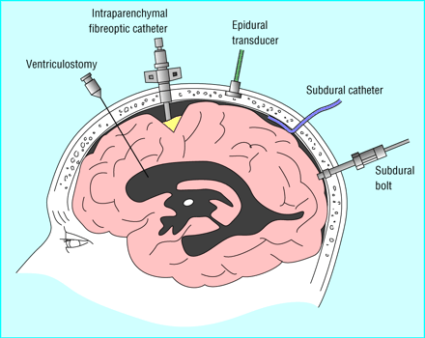
Monitoring

